Slide 1
The Importance of Art in Society

Slide 2
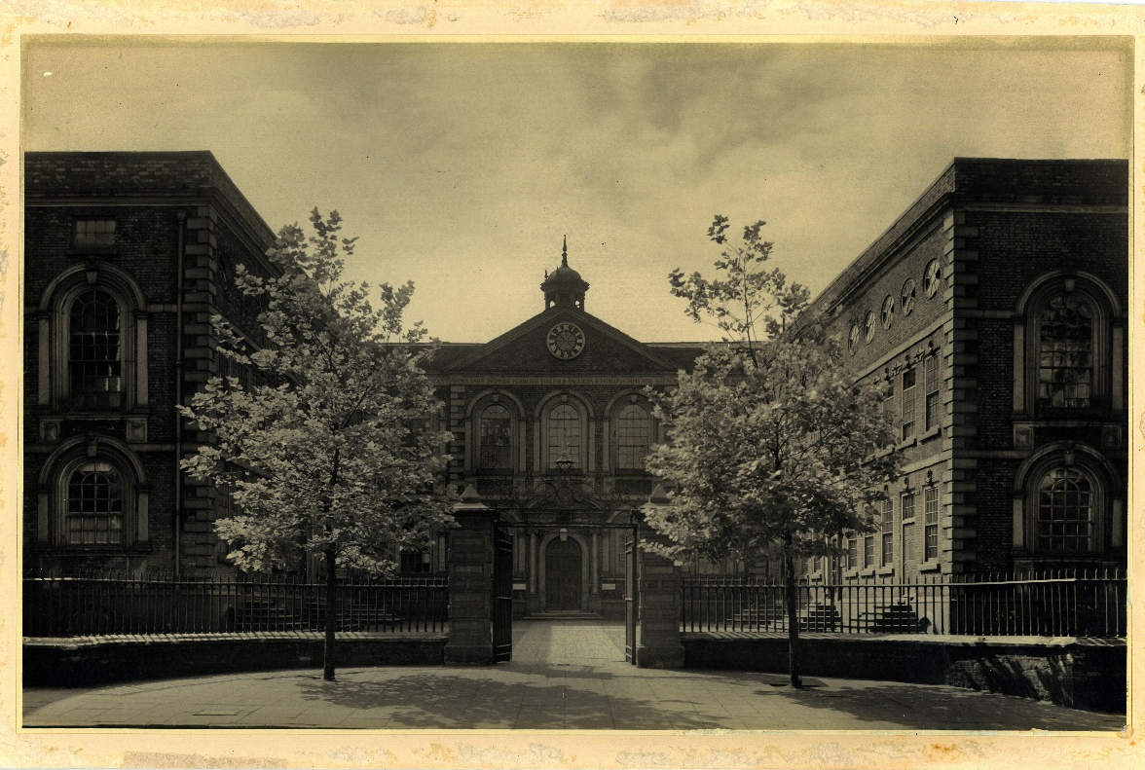
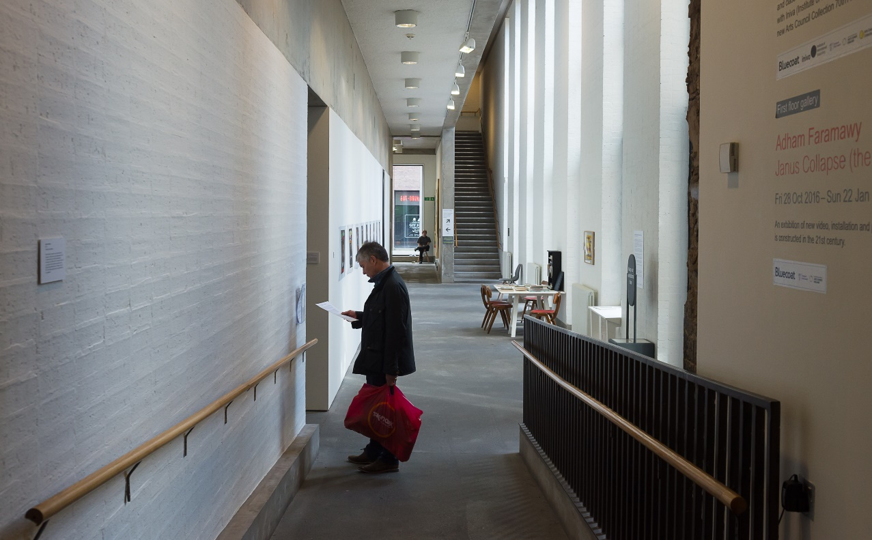
Starter Question
Have you ever visited Bluecoat and do you know anything about it?

Slide 3
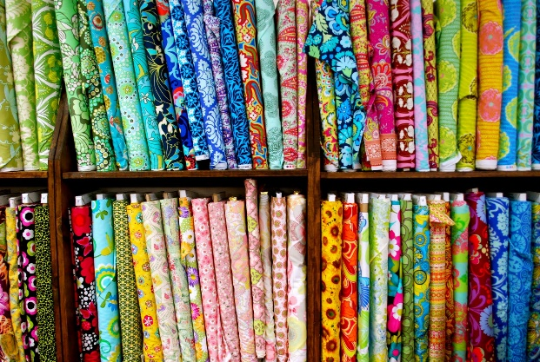
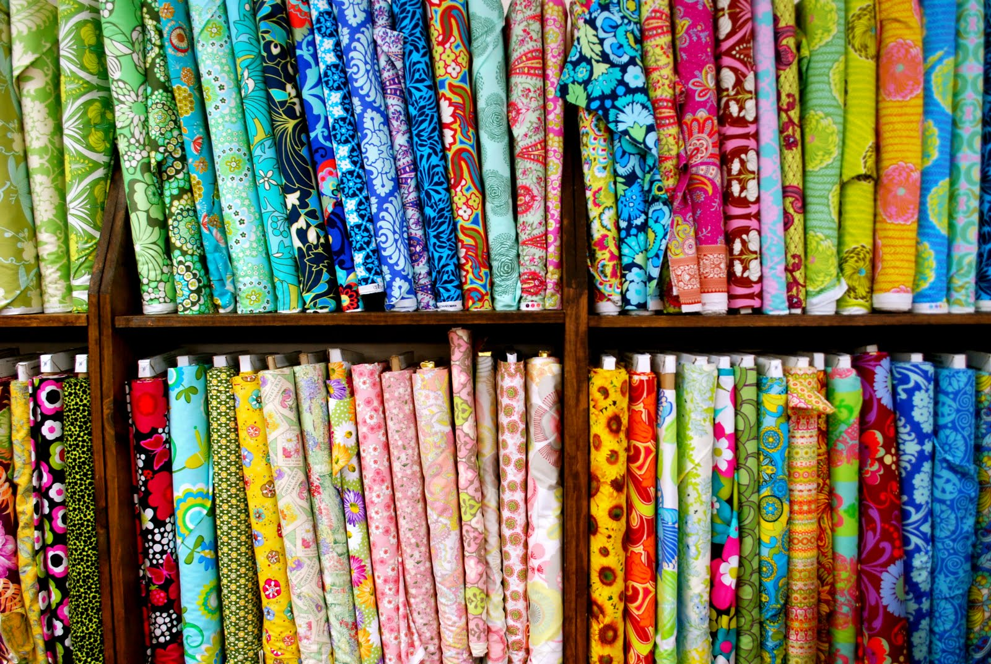
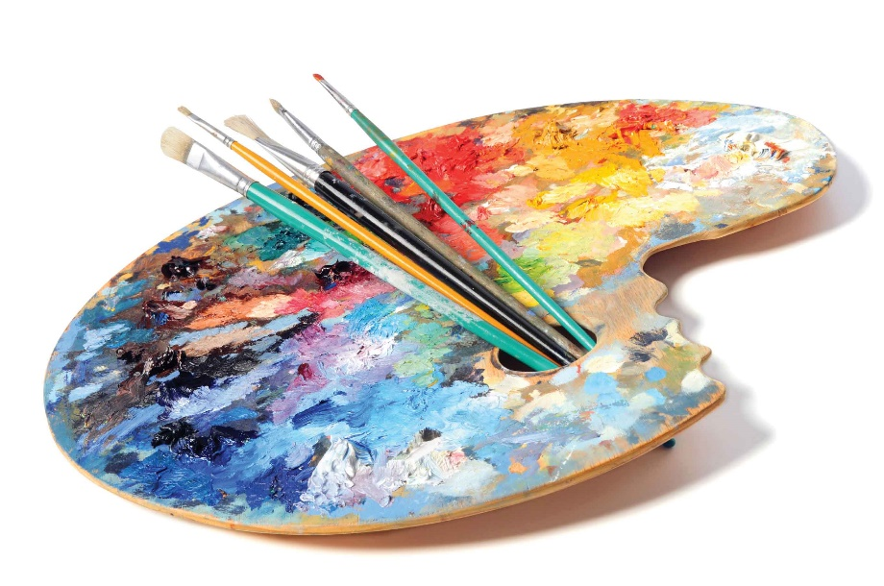
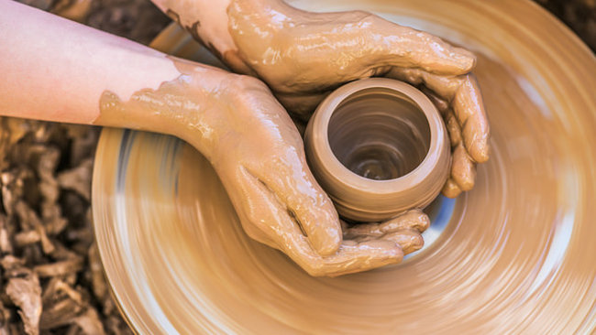
Starter Question
What is art?

Slide 4
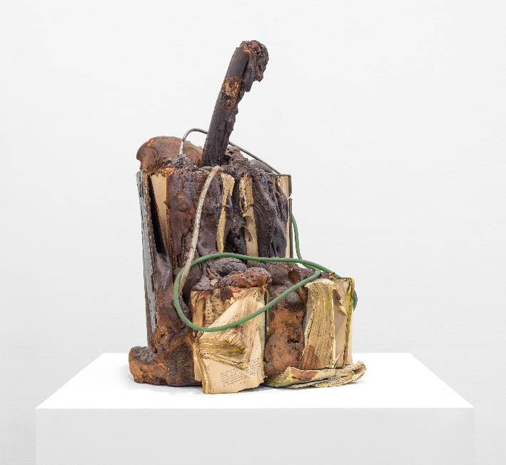
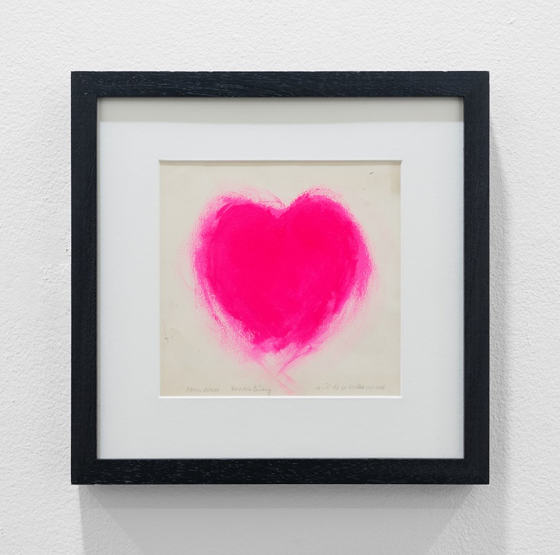
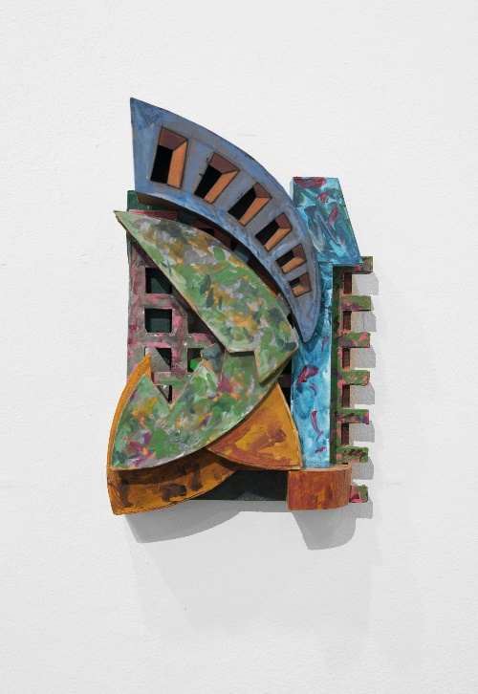
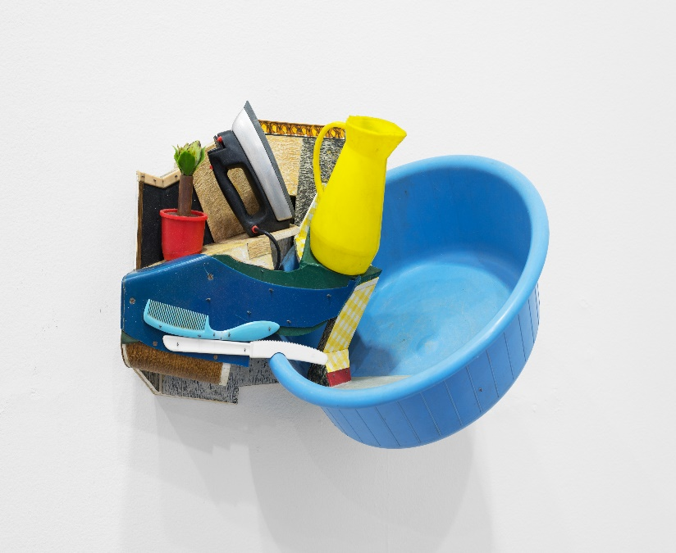
Starter Question
What art, if any, do you like?

Slide 5
Using Art to Record a Moment in History
Edward Carter Preston
View from Bluecoat
1909
This painting was created by Edward Carter Preston, an artist who is very important to Bluecoat’s history as an art centre. He was one of the first artists to have a studio here.
The photograph was taken in exactly the same position from which Carter Preston painted his picture over 100 years ago. Looking at both of the images, you can see what has changed since Carter Preston had a studio at Bluecoat. For example, the building in the photograph is now Primark.
Bluecoat was very important to Carter Preston. This painting records a moment in history, just after artists moved into Bluecoat. The building he painted was destroyed in the Second World War, when Liverpool was bombed, then after the War it was rebuilt. We can use the painting today to learn about how the city has changed.

Slide 6
Activity
In this activity you will be looking at old photographs of areas around the city, an image you have found of your school in the past or an important building in your local community. After looking carefully at the image, you can create your own version of how the landscape looks today.
You can do this by using paint, pencils, pens or collage. Make sure you look carefully at the details so the two images can be compared to see how the landscape has changed.

Slide 7
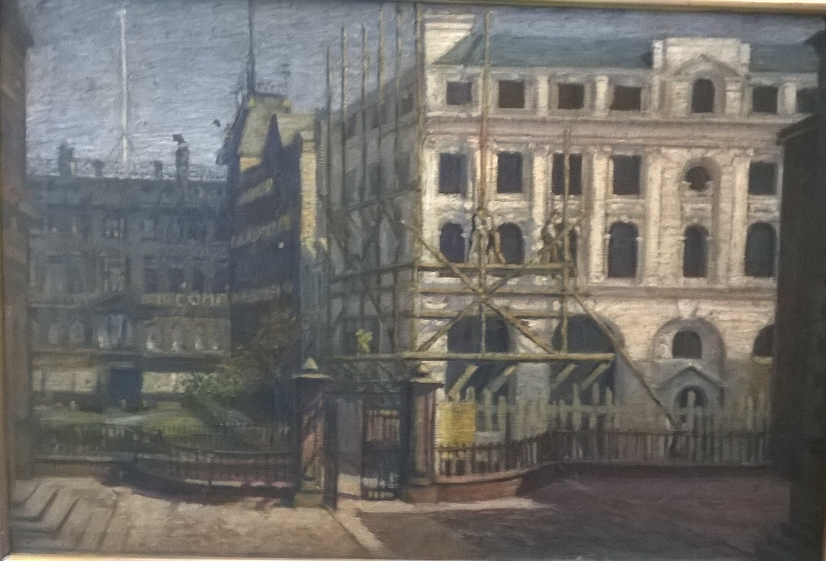
Edward Carter Preston
View from Bluecoat
1909

Slide 8
View from Bluecoat
May 2017

Slide 9
Using Art to Explore Ideas
Larissa Sansour
In the future they ate from the finest porcelain
Bluecoat, 2017
Larissa Sansour’s exhibition comprised a film, objects made from porcelain, and a sculpture made from miniature spaceships. It explored science fiction, archaeology and politics.
The film looked at myth in history and feelings of national identity. In it, resistance fighters bury objects to make it look like an imaginary group of people, which the artist has invented, lived in a particular place. Their aim is to make people in the future believe this civilisation existed.

Slide 10
Activity
For this activity, you will create a time capsule, similar to how porcelain is buried in the video. Creating a time informs people in the future about what life was like for people in the past.
The objects you choose to include may be all that people in the future will ever find out about the world we live in today, so you have to think carefully about what objects you would want to include.

Slide 11
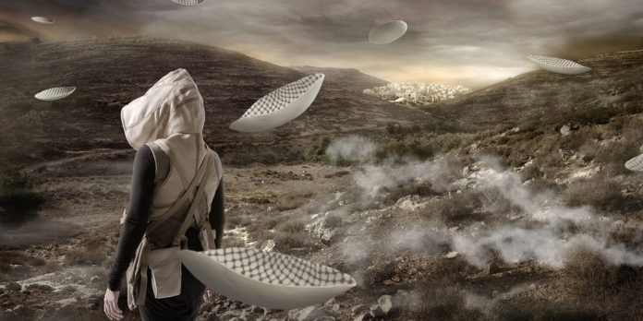
Larissa Sansour In the Future they ate from the finest porcelain, Bluecoat, 2017

Slide 12
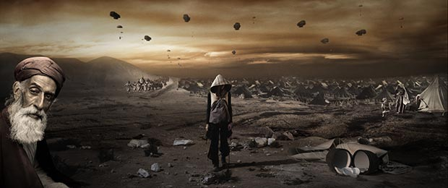
Larissa Sansour In the Future they ate from the finest porcelain, Bluecoat, 2017

Slide 13
Using Art to Shock People
Jacob Epstein, Genesis, Bluecoat, 1929 and 2017
This sculpture by Epstein was exhibited at Bluecoat in 1931 and again in 2017 in the final exhibition of our 300th anniversary year, In the Peaceful Dome. It is carved from marble and shows a pregnant woman. As well as reflecting Epstein’s sculptural skills and invention, the sculpture is one that caused controversy when first exhibited.
The sculpture was brought to Bluecoat to help raise money for the building, and nearly 50,000 visitors came to see the sculpture over four weeks, paying sixpence each. Many visitors were shocked by the sculpture, others regarded it as an important artwork by one of the country’s most progressive artists. It received both negative and enthusiastic press.

Slide 14
Activity
In this activity you will write your own review of the sculpture, with the help of the worksheets available.
You can either write that you like the artwork, or that you dislike it - but you must be able to justify your opinions. It is not enough to just say that you love or hate it!

Slide 15
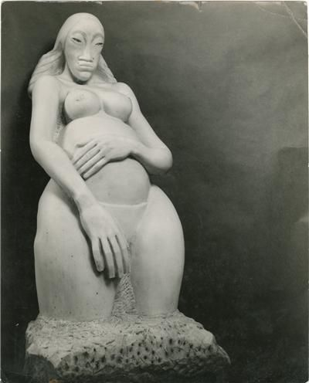
Jacob Epstein
Genesis
1929-31
marble

Slide 16
Using Art to Express Emotions
Louisa Martin, Proxy, 2017
Louisa Martin is an artist who works with different materials, including light and video. She is interested in how the spaces in which we spend time can influence the way we feel. For example, in her installation at Bluecoat, Proxy, she used different colours of light to influence the way the audience felt.
Many people have a favourite colour, and like some colours more than others. Being in a room painted your favourite colour might make you feel especially happy. Throughout history, artists have used colour to express different feelings, for example Picasso’s paintings during his Blue Period. Advertising and marketing also use colours to try and make people think and act a certain way, for example using light and fresh colours on cleaning products.

Slide 17
Activity
In this activity you will be looking at how colour can make you feel different thoughts and emotions, and how these feelings can be different for different people, as well as how some colours make you think of certain objects, times of the year, or situations.

Slide 18
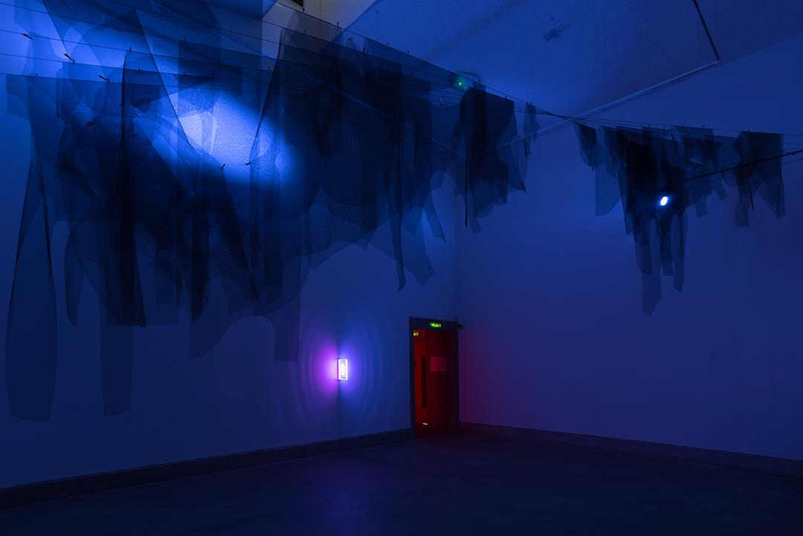
Louisa Martin
Proxy
2017

Slide 19
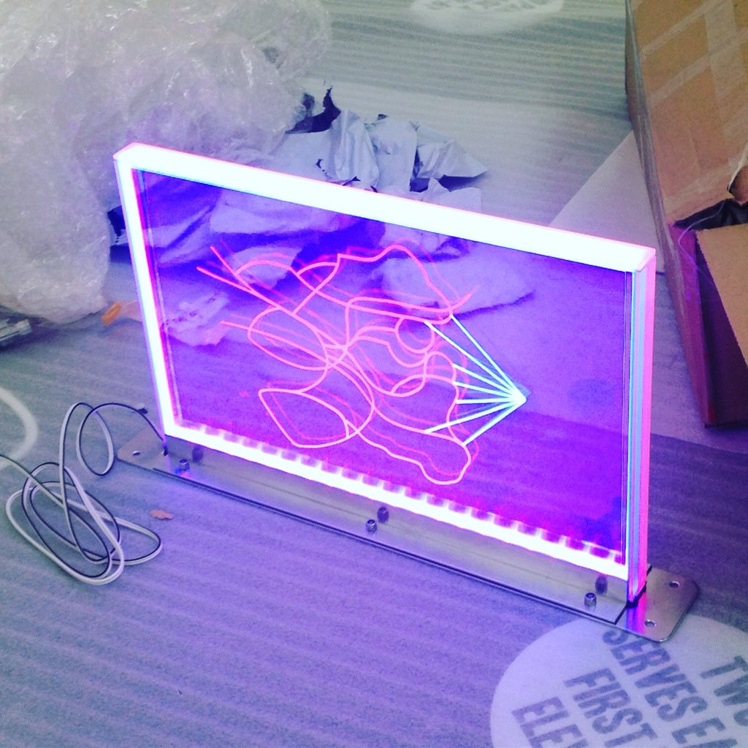
Louisa Martin
Proxy
2017

Slide 20
Using art to do a job
Julia Carter Preston
Ceramics
Julia Carter Preston was the daughter of artist Edward Carter Preston and had a studio overlooking the Bluecoat garden for many years (where the violin shop now is). She was a ceramicist, creating hundreds of pots, bowls and plates, in a distinctive s’graffito style, using nature as her inspiration. Her pieces are intricately designed and beautifully produced, and demonstrate great skill.
As well as being works of art, they are also functional objects – they are both aesthetically pleasing and can have a purpose. Artists like Carter Preston show us that beauty can be found in objects we use every day.

Slide 21
Activity
In this activity you will be thinking about how everyday objects can be art and can be created with lots of thought and design by looking around your classroom and your home.

Slide 22
Applied arts
Applied art uses design and decoration on everyday objects to make them pleasing to look at, as well as useful.
There are two different types of applied art:
1. Machine made products that have a design which make them nicer to look at and easy to use
2. Unique objects that are useful and decorative, which are made by artists.
Examples of people who work in applied art include: fashion designers, interior designers, graphic artists, jewellery makers, furniture makers, potters and illustrators.
Applied art includes a range of things: ceramics, furniture, wallpapers, a fountain pen or a computer mouse.

Slide 23
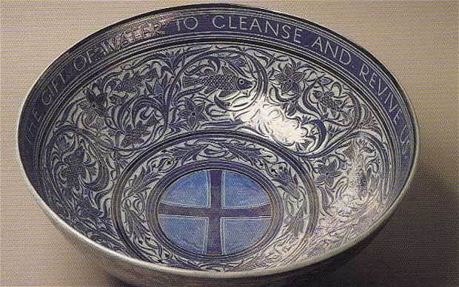
Julia Carter Preston
Ceramic bowl

Slide 24
Other types of art Working in small groups can you think of any other types of art than the ones we have explored? We have looked at: - art that shows a moment in history - art that explores ideas - art that shocks - art that uses colour - art that has a purpose Are there any other types of art you can think of? If you can, find some examples of these different types of art. It’s important to remember that art can be lots of different things and mean lots of things to different people.

Slide 25
The role of the artist
Bluecoat is Liverpool’s centre for the contemporary arts. It is the most historic building in Liverpool’s city centre, and was the first arts centre in the UK. It has galleries, a creative community of artists and businesses, and runs participation programmes for local communities. Since 1907 there have been artists working in studios here.
Have you ever been in an artist’s studio?
What do you think an artist would need in his or her studio?
Discuss the role of the artist and come up with a version of the different roles of the artist.

Slide 26
Activity
Using the template, design what you think an artist’s studio would look like if they were going to be able to play a role in the community of Bluecoat.
Before you begin the activity, you could collect some pictures of objects that you think you might need to make a collage of an artist’s studio.

Slide 27
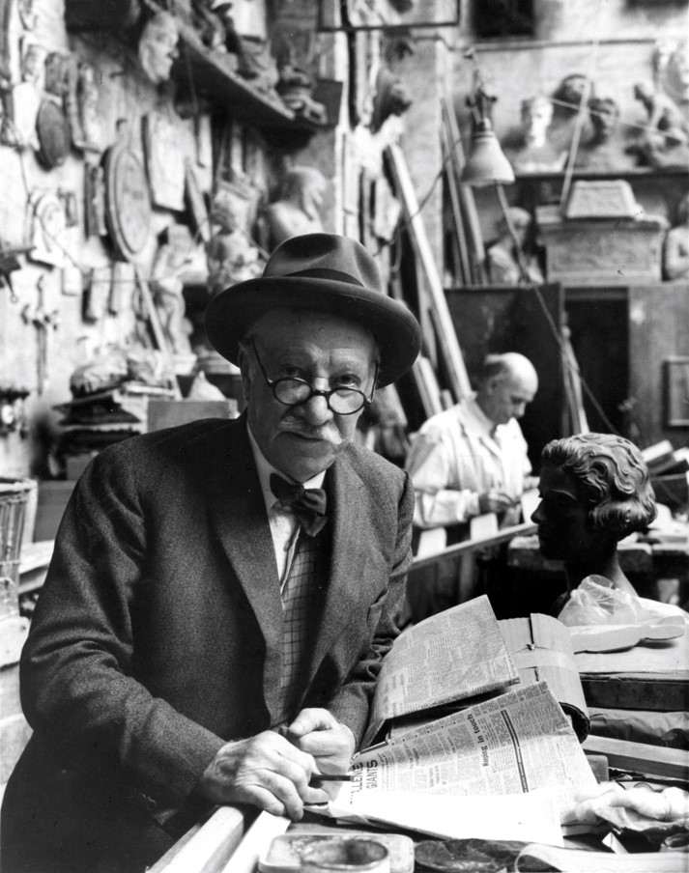
Sculptor Herbert Tyson Smith in his studio at Bluecoat in the 1960s

Slide 28
Julia Carter Preston, ceramicist, in her studio at Bluecoat, 1950s

Slide 29
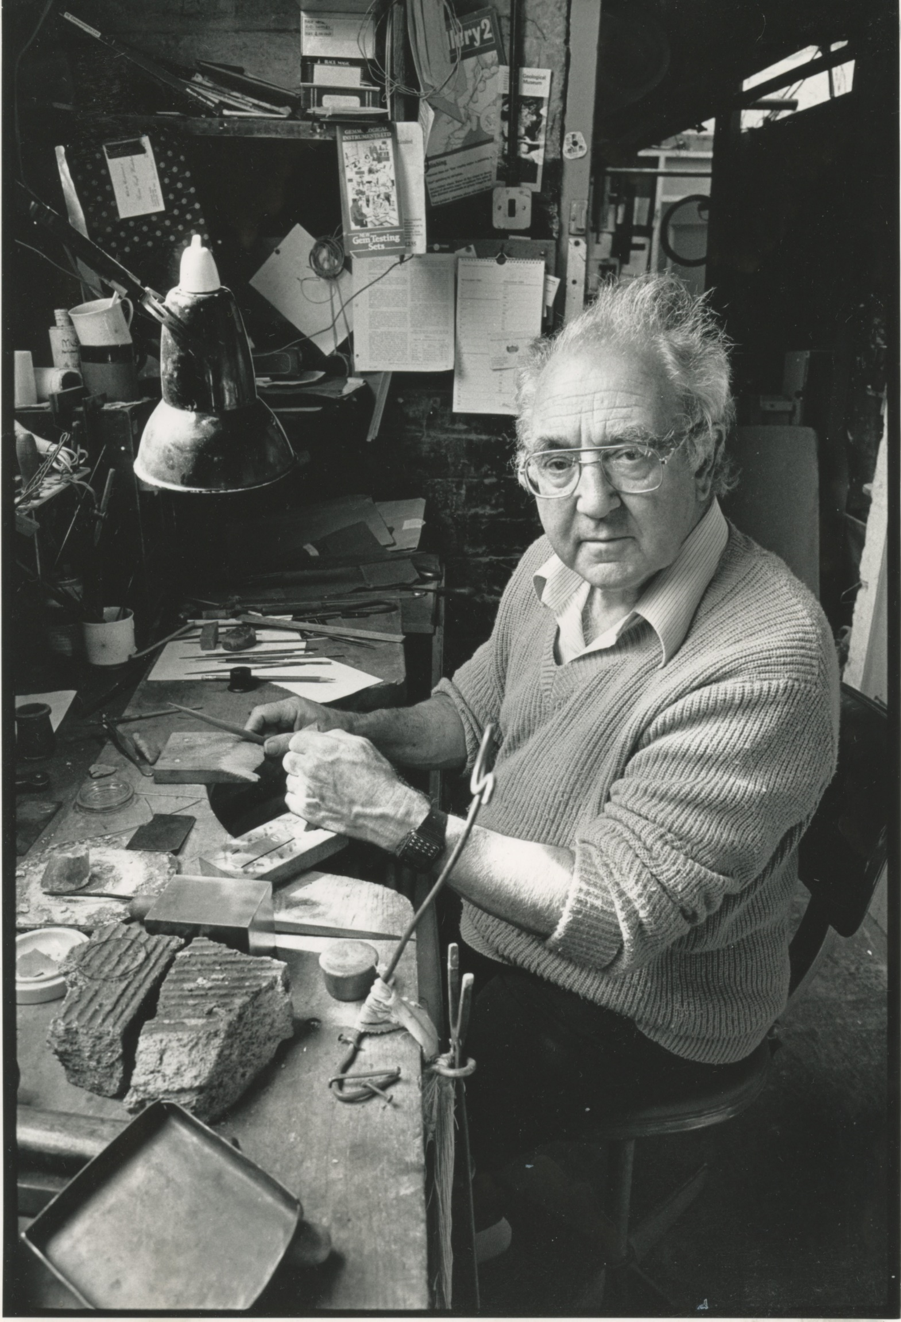
Stan Hill, silversmith,
in his studio at Bluecoat

Slide 30
End Question
What is art?

Slide 31
End Question
Is art important? If so, why?

