Slide 1
Blue Coat School on Strike

Slide 2
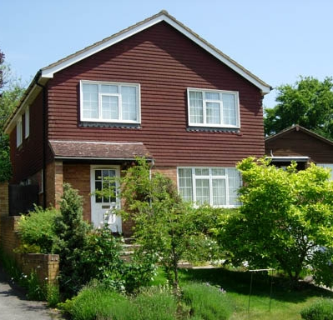
Starter question
What rights do you have?

Slide 3
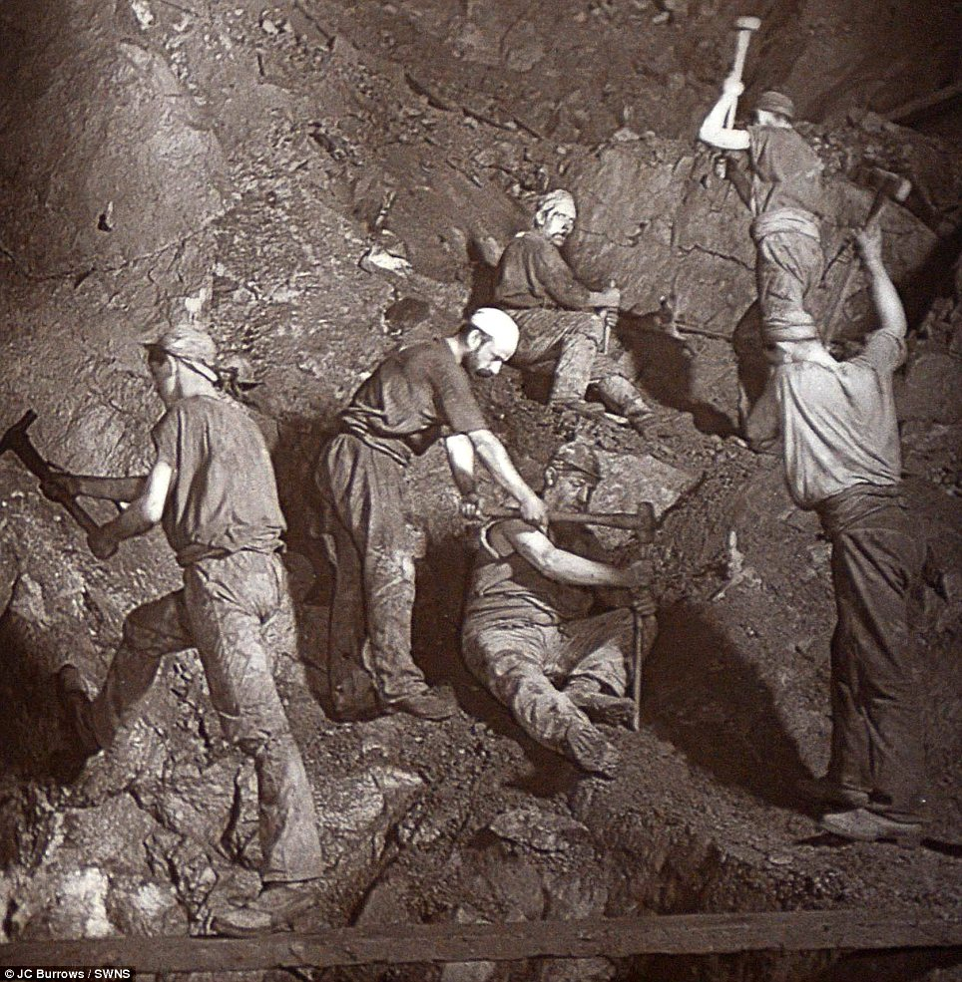
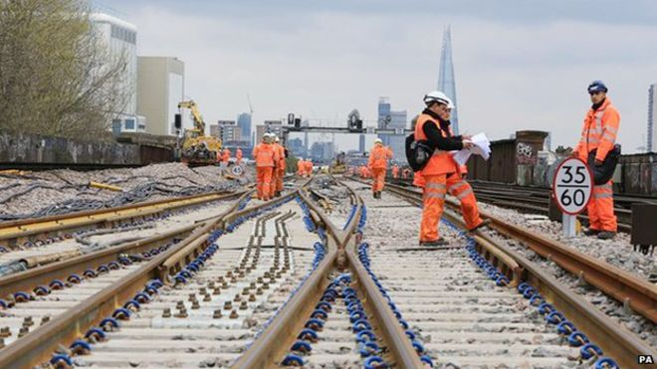
Starter question
Do you know who goes on strike?

Slide 4
Did you get these answers?
Miners
Miners went on strike because they were worried about the places they
worked being closed down and loosing their jobs.
Doctors and Nurses
Doctors and nurses have been on strike because they work very long
hours and don’t paid a lot of money
Railway workers
Railway workers have been on strike about people loosing their jobs and
not getting paid a lot of money
Teachers
Teachers have been on strike because of their long working hours and
loosing money
Can you think of any more?

Slide 5
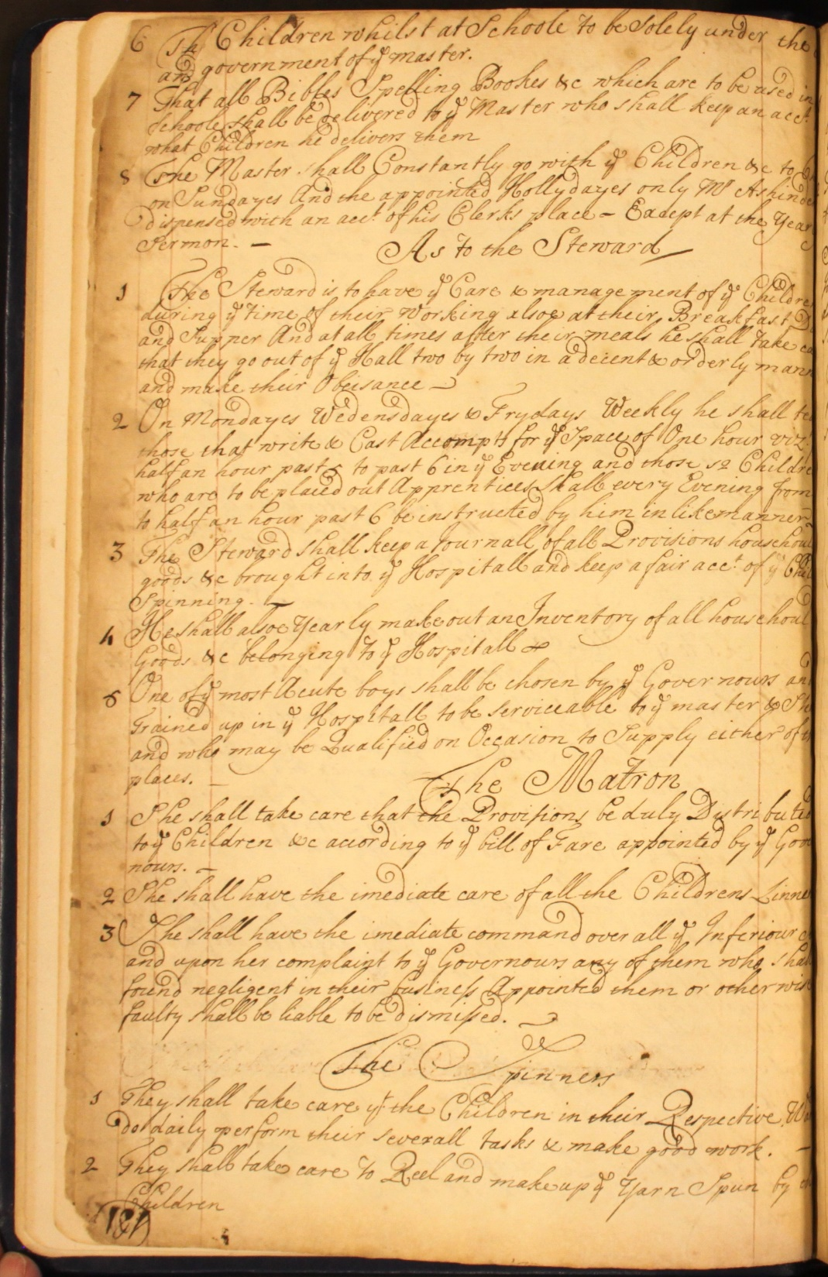
Class Charter
During 2017, Bluecoat’s 300th anniversary we have found lots of book that tell us more about the history of the building. One of the books we found have a list of rules for all people who were at the school from the Governors to the children.
Using these rules as a starting point and using the worksheets provided you will learn about the United Nations Rights of the Child and write your own class charter.
Then you can compare your rights to the ones that children had 300 years ago and see how the lives of children have changed.
Class Charter

Slide 6
THINK AND TALK ABOUT
We know that when the children at Blue Coat School went on strike in 1803 the school governors decided that they should be given longer break times and to spend some of the donation money on new toys. Perhaps they realised that the children needed some more leisure time.
You know that as children you have rights but that you also are responsible for your own behaviour.
How do you feel when you have something taken away from you when you have been naughty?
Does having something taken away from you make you behave better next time?
What responsibilities do you think you have?

Slide 7
Extension Activity 1
People can use persuasive writing to convince other people that what they think is right or that what someone else thinks is wrong.
When you are doing a piece of persuasive writing you need to think about:
Purpose
What are you trying to do? Make sure you think about what words you use very carefully to try and persuade people to your way of thinking.
Audience
Who are you writing for?
Key points
What are the key points you are trying to make?

Slide 8
Look at the pictures of artworks that have been exhibited at Bluecoat over the last hundred years and choose the artwork that you like best. Write a short persuasive speech to try and explain to other members of your group or class why the artwork you have chosen is the best one. Once you have all finished read your argument out and see if you can persuade anyone to change their mind!
Things you could write about:
What is the art work trying to tell us?
Is the artwork fun?
What materials does the artwork use?
What colours does the artwork use?
How does the artwork make you feel?
Would you like to see this art work in a gallery?

Slide 9
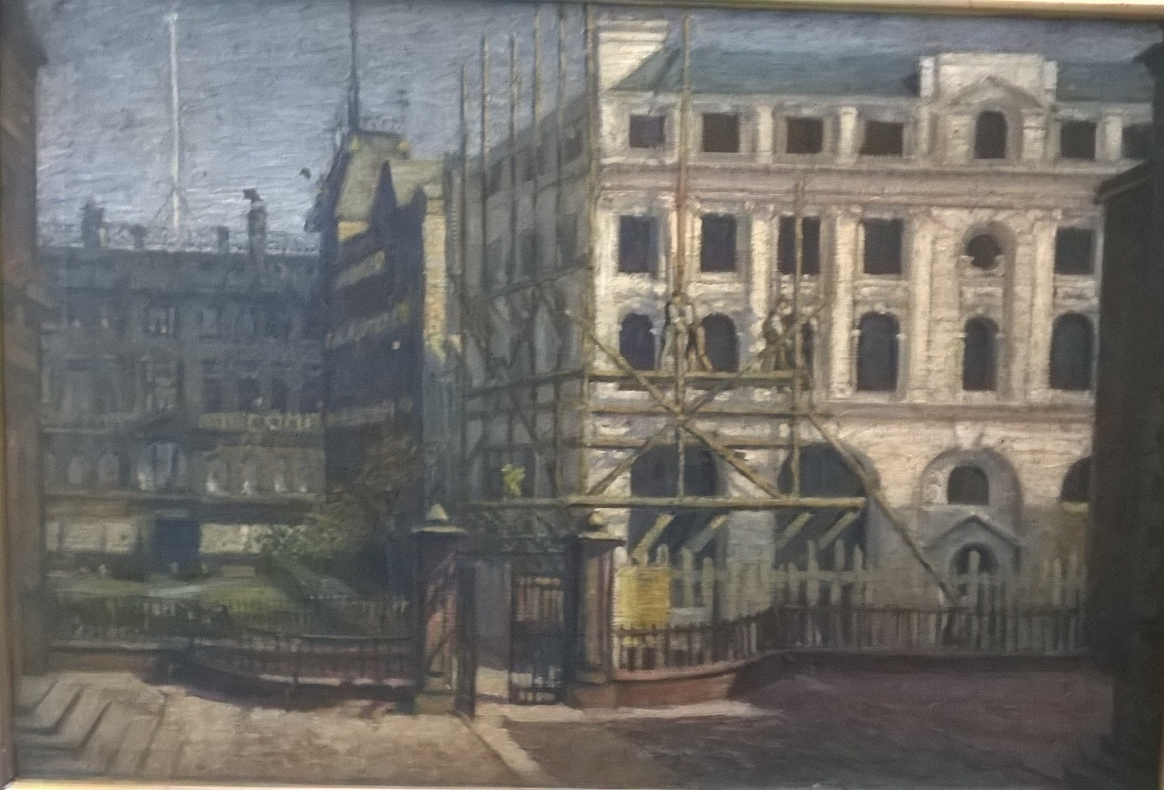
Edward Carter Preston
View from Bluecoat
1909

Slide 10
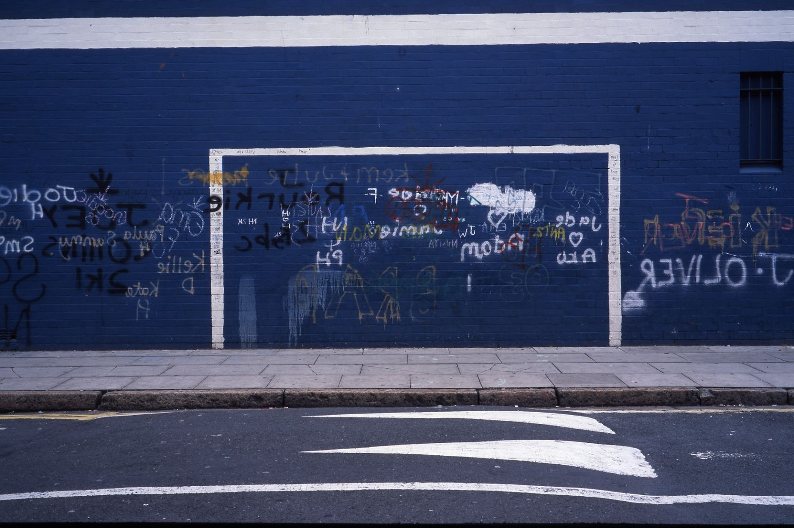
Neville Gabie
Playing Away on-going photographic series

Slide 11
Sonia Boyce
So Amazing
2002

Slide 12
Tony Hayward
Kitchen Sink Drama

Slide 13
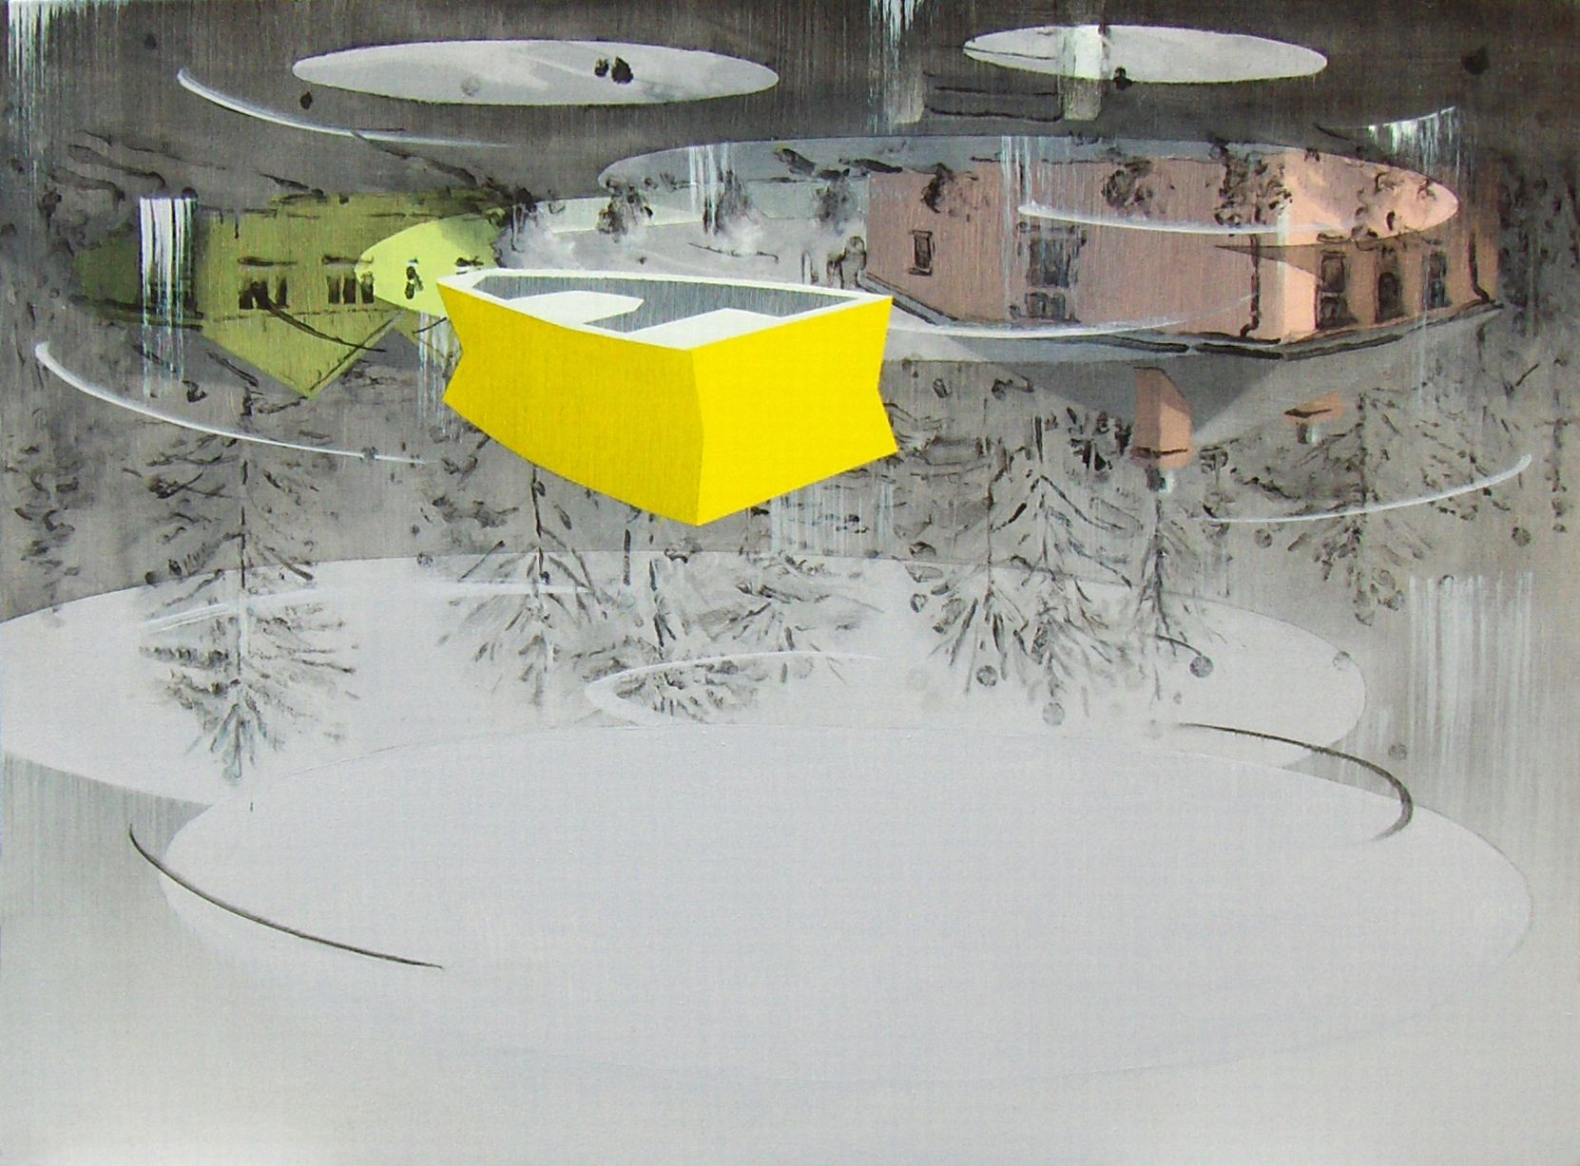
Graham Crowley
Grey Mooring I

Slide 14
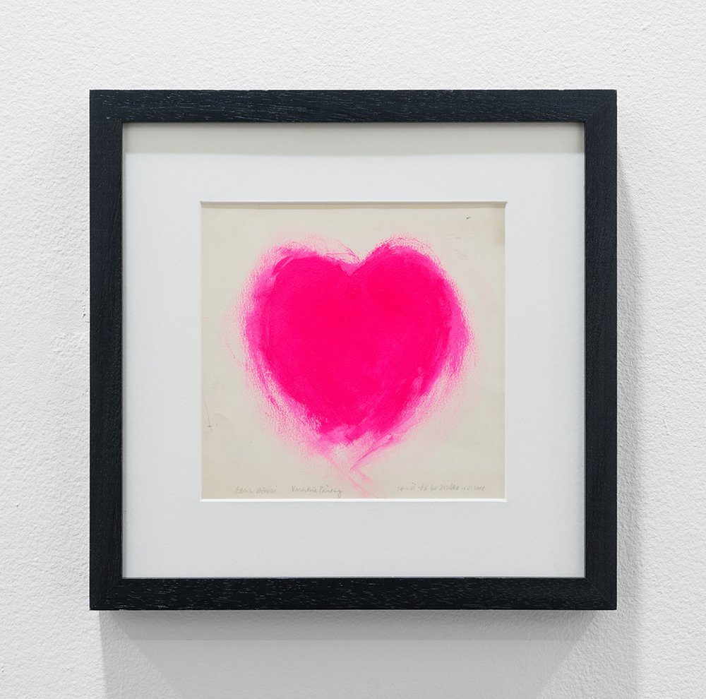
Adrian Henri Heart 1966

Slide 15
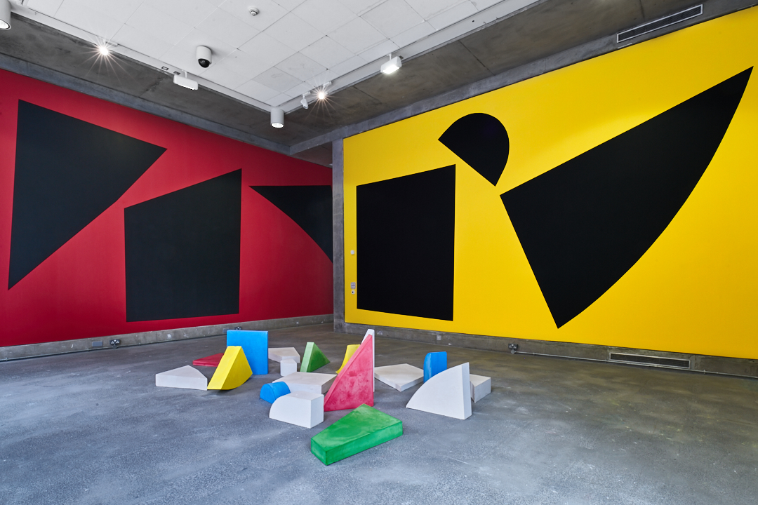
Simon and Tom Bloor New Possibilities in Familiar Situations 2017

Slide 16
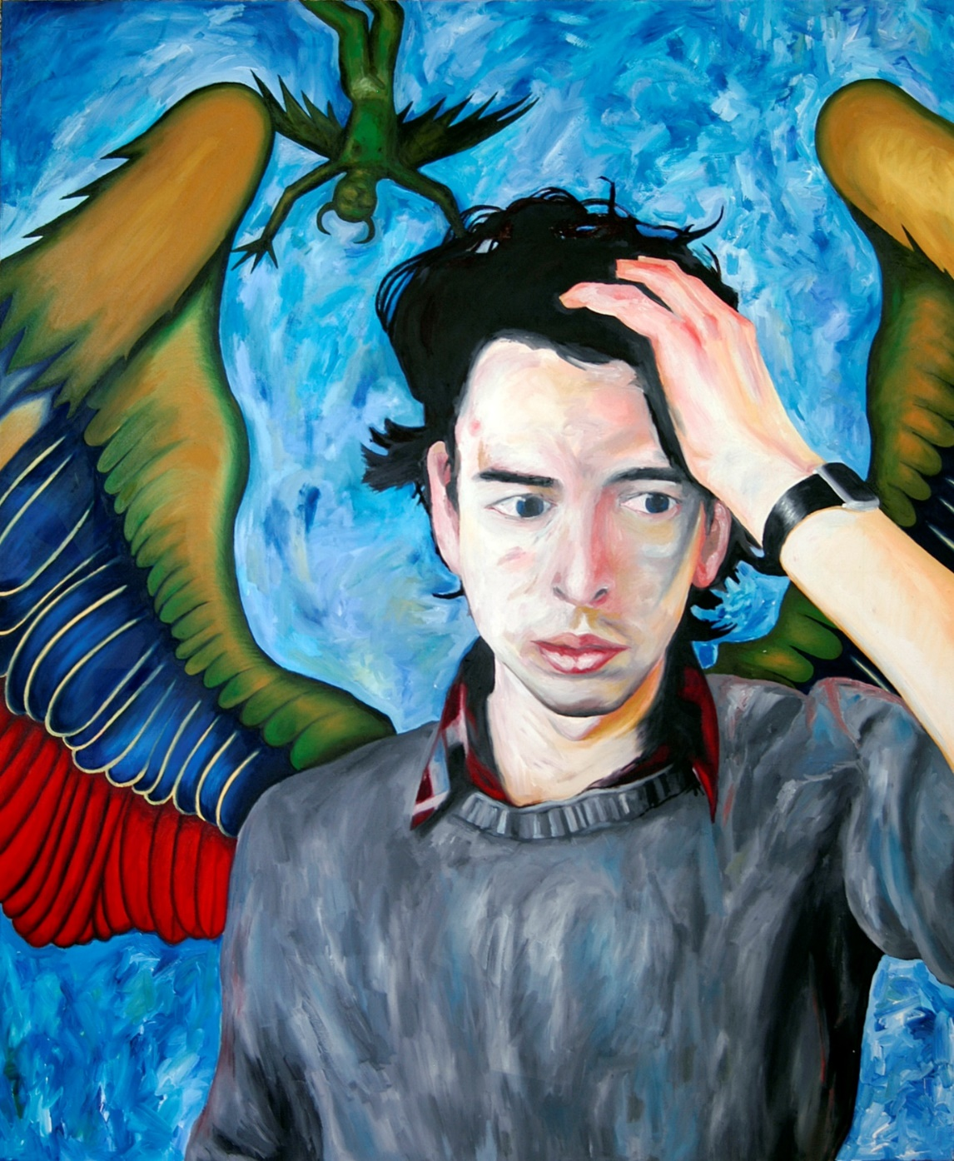
David Mabb Self Portrait as Angel of History

Slide 17
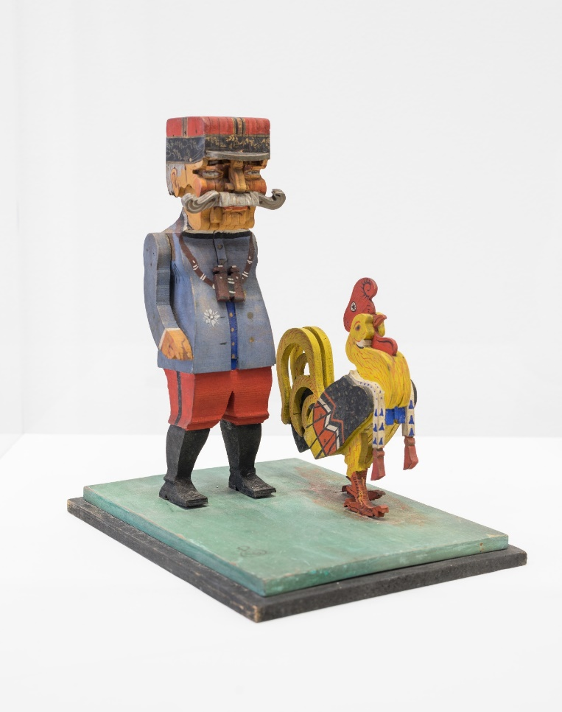
Edward Carter Preston Plychrome Figure c.1918

Slide 18
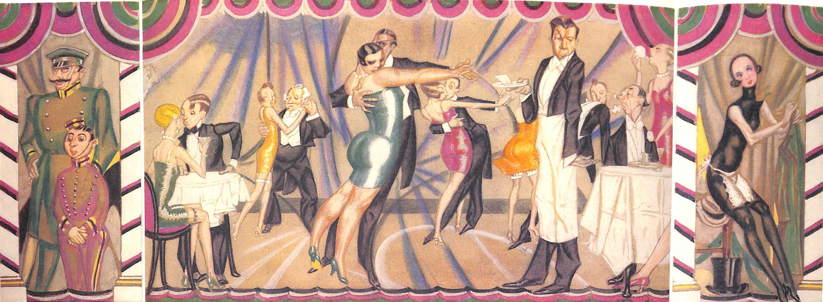
George Harris Sandon Cabaret

Slide 19
The Grantchester Potteries Wallpaper 2017

Slide 20
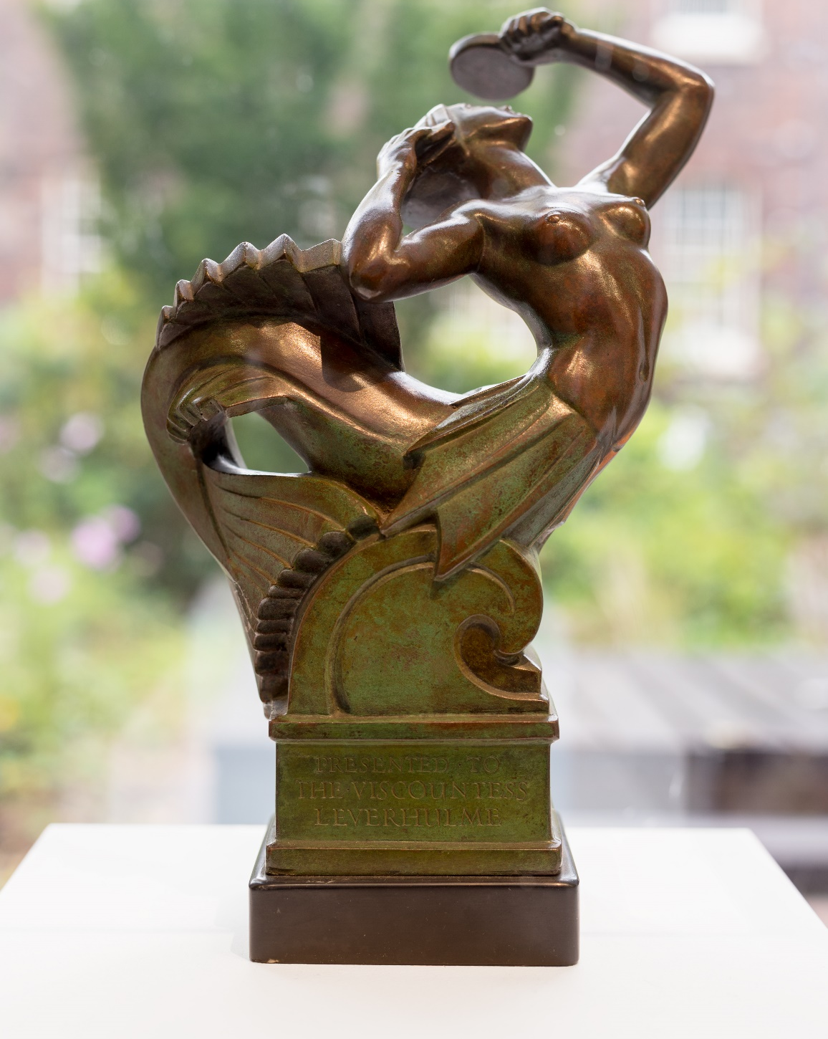
Herbert Tyson Smith Mermaid c.1920s

Slide 21
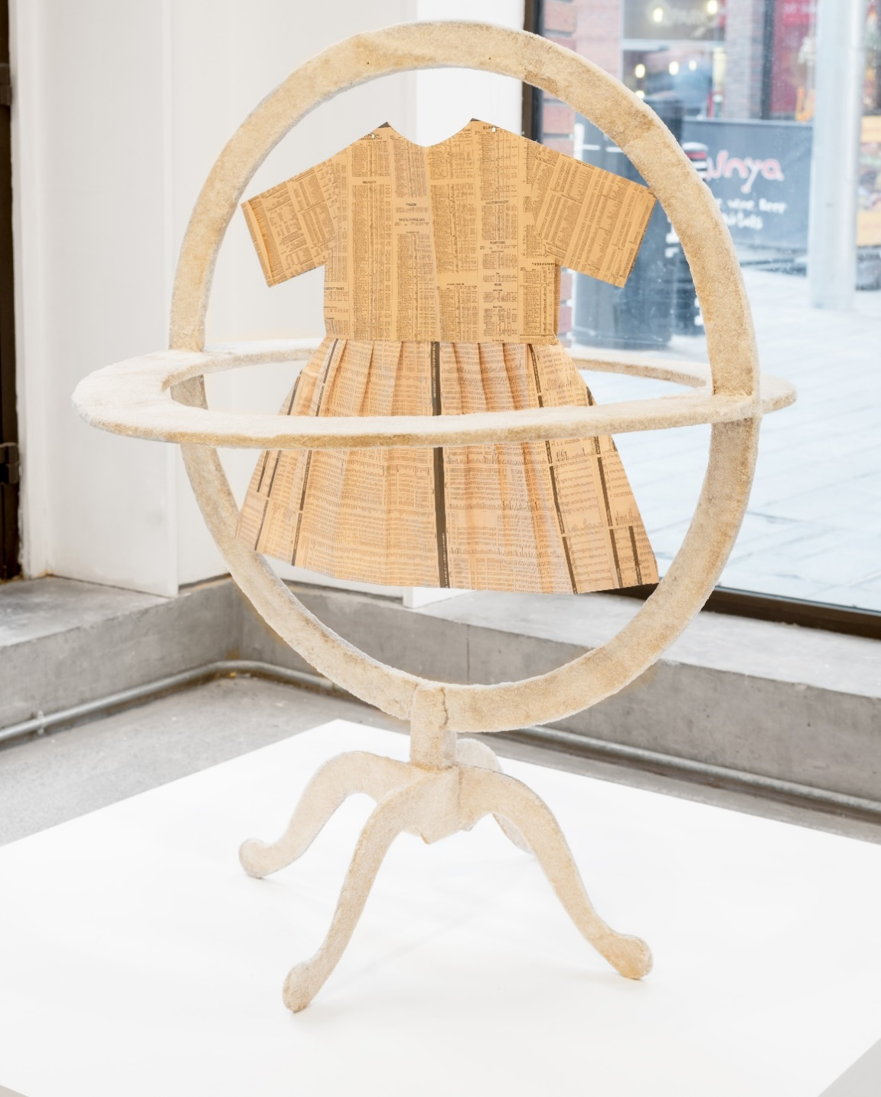
Jo Stockham Sugar c.1989 - 2017

Slide 22
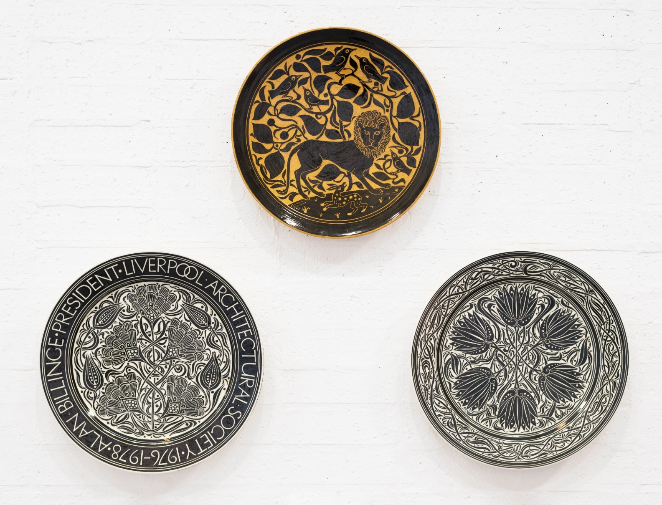
Julia Carter Preston Ceramics Various dates

Slide 23
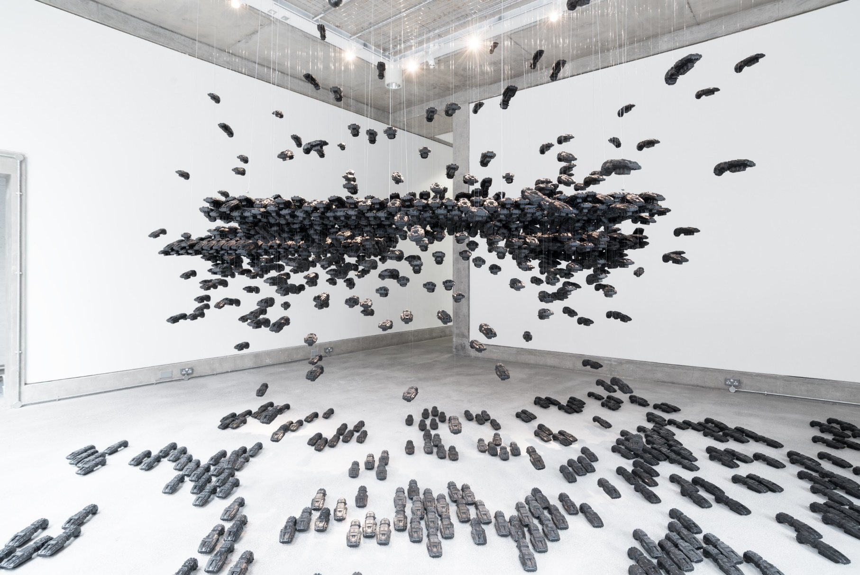
Larissa Sansour And they covered the sky until it was black 2017

Slide 24
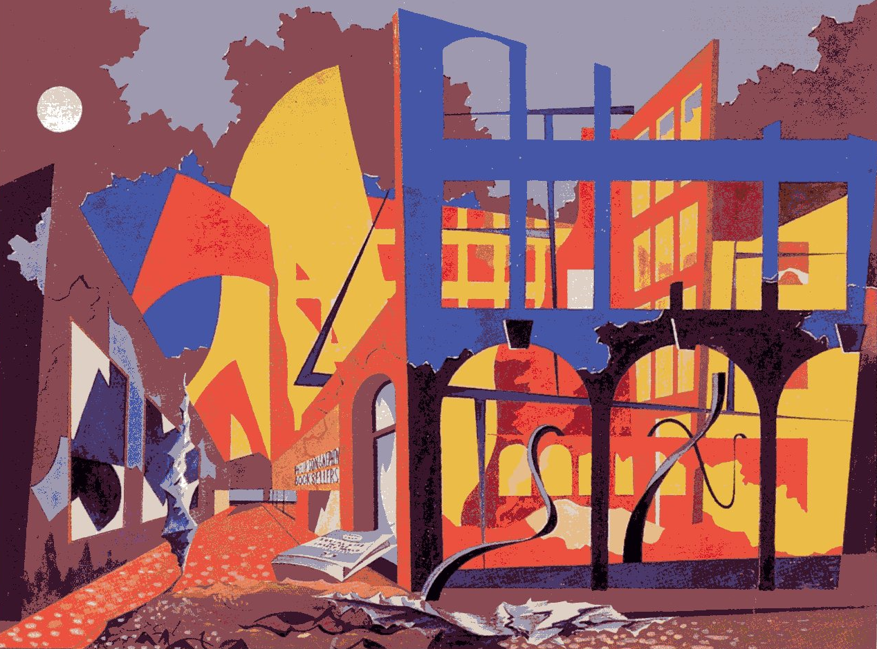
Roderick Bisson Building Ablaze in Church Alley 1941

Slide 25
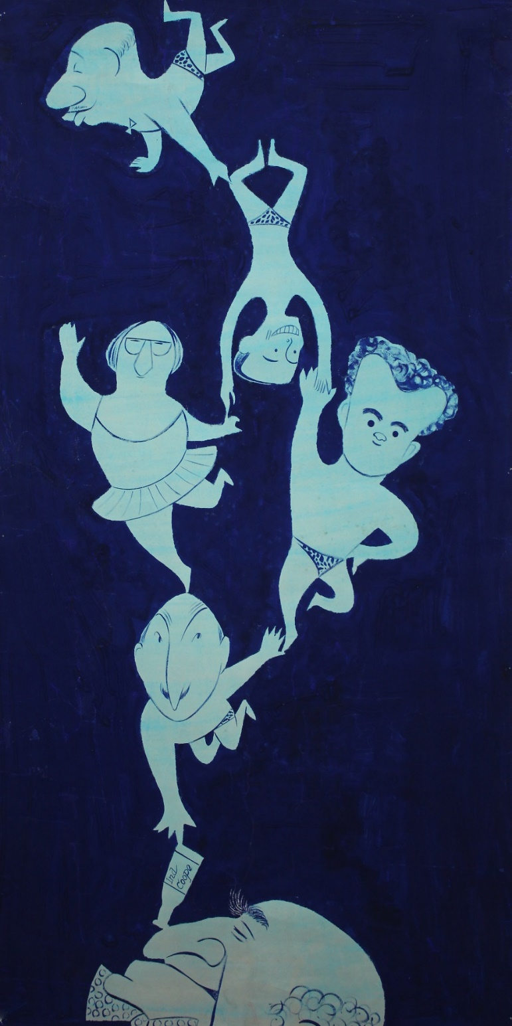
Unknown Artist Sandon Pool Party 20th century

Slide 26
Extension Activity 2
As a class discuss if there is anything that happens at your school that you think is wrong and that you would like to change. You could talk about things like:
Is there litter in the playground?
Are people sometimes not kind to each other?
Like the children at Blue Coat School, do you not think you get enough free time?
Do you think that any of these problems can be changed? If so, what do you think the solution is to the problem? Have a discussion about how you would solve the problem if you were in charge of the school.

Slide 27
Once you have decided on your topic you should discuss how you could get your point of view across by making a placard or banner. Like in the photographs, your sign should only contain a few words and some simple images so you need to think carefully about how you express your opinions. You could think about what words David Jacques chose to use in his artwork and what message he was trying to get across
Think of a slogan to go on your work. It should be short, catchy and make it clear to anyone who looks at is what it is you are concerned about and how you think it should be changed.
Think of an image or symbol that will also make it clear to anyone who sees it what the point is your trying to get across.

Slide 28
David Jacques – Robert Tressell Banner
Robert Tressell was the author of The Ragged Trouser Philanthropist.
It was a very political book and explored the idea that lots of people work hard for not much money whilst a small group of people have lots of money but don’t have to work.
The book talks about how this idea is unfair and David Jacques artwork uses the title of one of the books chapters ‘The Great Money Trick.’
This huge banner by Jacques celebrated this book. By choosing to make a banner the artist is making us think of people protesting.

Slide 29
David Jacques – Robert Tressell Banner
2011

Slide 30
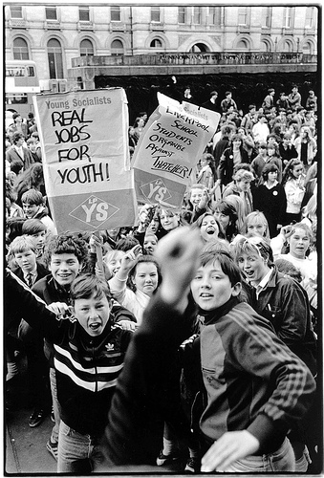
When the children protested in 1985 many of them carried placards, signs or banners that showed people what they were protesting about.
At Blue Coat School the children would have carried a large banner on St Georges Day to show that they were proud to attend the school.
These visual tools can be very powerful as they show people what your opinions are about things, what is important to you and that you are prepared to work hard to make changes.

Slide 31
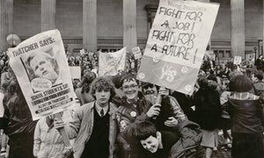

Slide 32
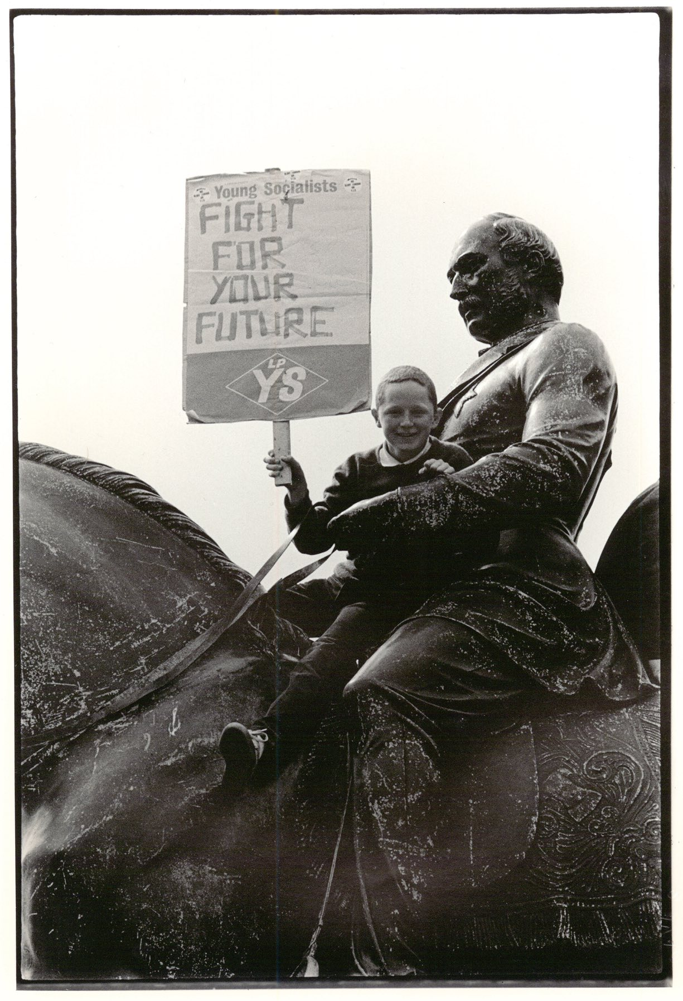

Slide 33
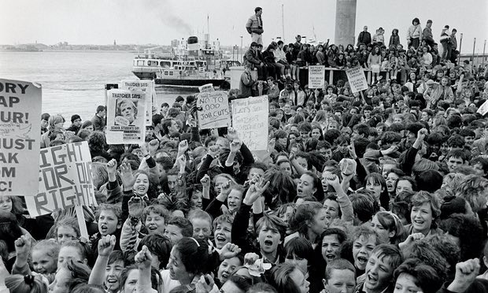

Slide 34
After looking at the photographs talk about and answer the following questions.
Why did the children feel like they needed to go on strike?
2. Do you think adults listen to the views of children enough?
3. Why do you think this might be?

Slide 35
End question
What is a protest?

Slide 36
End question
What does it mean when people talk about ‘their rights?’
What does it mean when people talk about ‘their responsibilities?’

