Slide 1
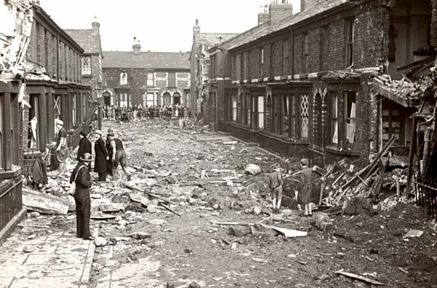
Starter question
How do you think living through a war could affect a community?
Liverpool street damaged in the War

Slide 2
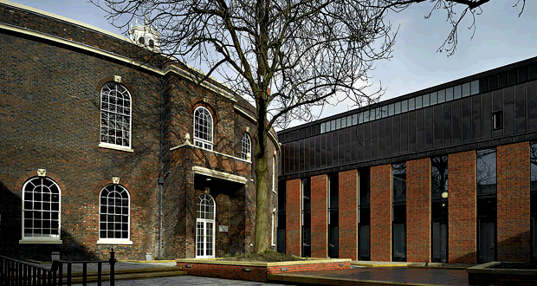
Bluecoat’s new arts wing, 2008, built on the site of an area destroyed in the War

Slide 3
The impact of World War Two on your community
These photographs show the damage Bluecoat suffered during the May Blitz in 1941. As well as losing many of its most historical buildings, Liverpool also lost many lives as a result of the bombing, and communities were changed forever.
Since 1907, Bluecoat has had a community of artists working in the building. Several of them fought during the two world wars, some losing their lives. All those working at Bluecoat were affected by the wars, but this is nothing compared to what many communities lost in the conflicts.
Do you know what happened to your community during the Second World War? Were any buildings bombed? Was there any assistance to help people cope with the stress and loss of war? Are there any photographs of what your local community looked like before and after the war?

Slide 4
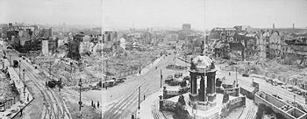
Liverpool city centre devastated by wartime bombing

Slide 5
Bluecoat bomb damage, 1941

Slide 6
Bluecoat bomb damage, 1941

Slide 7
Bluecoat bomb damage, 1941

Slide 8
Postwar reconstruction of Bluecoat

Slide 9
Postwar reconstruction of Bluecoat

Slide 10
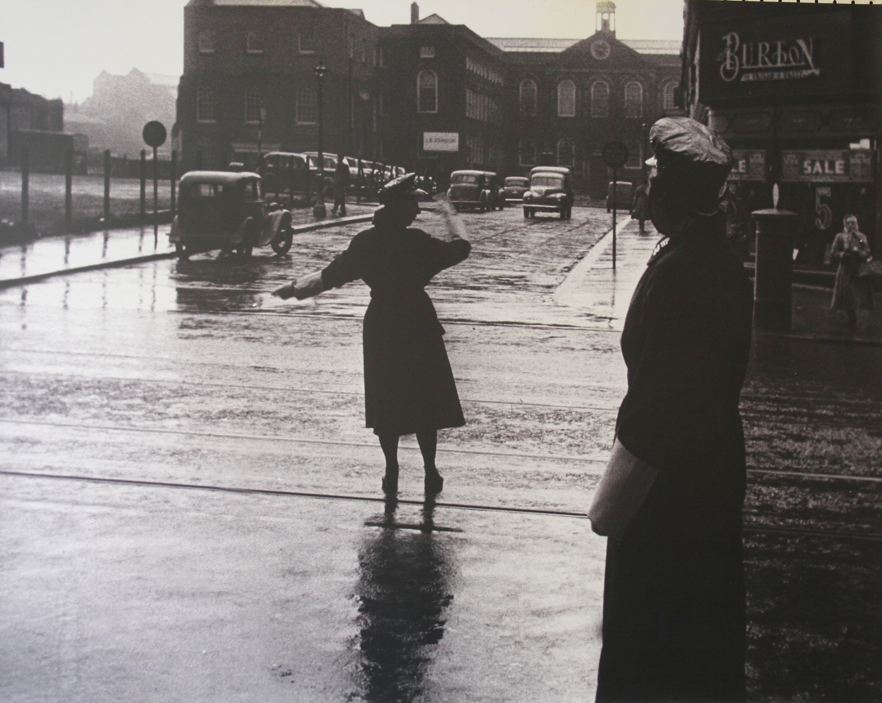
Bluecoat after the War, seen in the distance from Church Street. The bomb site on the left is now occupied by Primark

Slide 11
Core Activity
We know what happened to Bluecoat during and after the War from photographs and other documentation. In this activity you will start your own research project looking at your own communities during The Second World War, writing a report on what happened to the area during the War, and how this impacted on what it is like today.

Slide 12
Extension Activity
As part of Bluecoat’s 300th anniversary celebrations in 2017, we invited students from Liverpool University School of Architecture to re-design the wing of the building that had been built during our 2005 – 08 redevelopment. There was a wide range of imaginative ideas produced, using different shapes, materials and colours. One of the students, Edmund Tan, produced a short film imagining Bluecoat in the future, in ruins. This was shown in the exhibition, In the Peaceful Dome, and is featured on this website.
For this activity, you will be working as an architect to create your own design for a new wing of Bluecoat, using photographs of the building, examples of the students’ work, historical pictures of the building, and your own imagination, to create your design. You will follow the brief that has been set for you. The building has been used for many different things in the past, so when designing your building, think about what you want it to be used for.

Slide 13
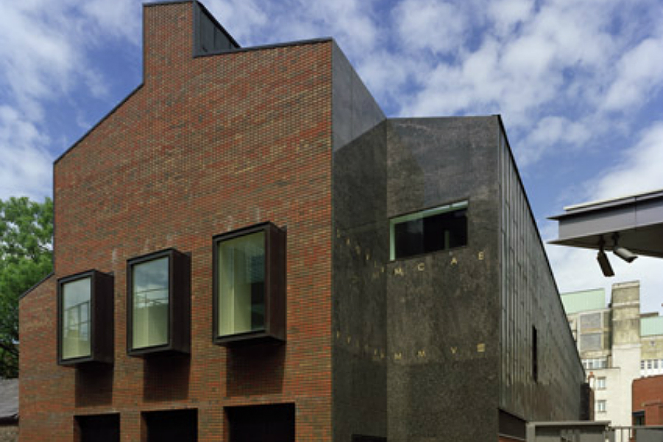
New arts wing at Bluecoat, 2008, designed by Biq Architecten, Rotterdam. Photo: Stefan Müller

Slide 14
Initial concept sketch for Bluecoat’s arts wing, by Hans van der Heijden, lead architect from Biq Architecten, Rotterdam

Slide 15
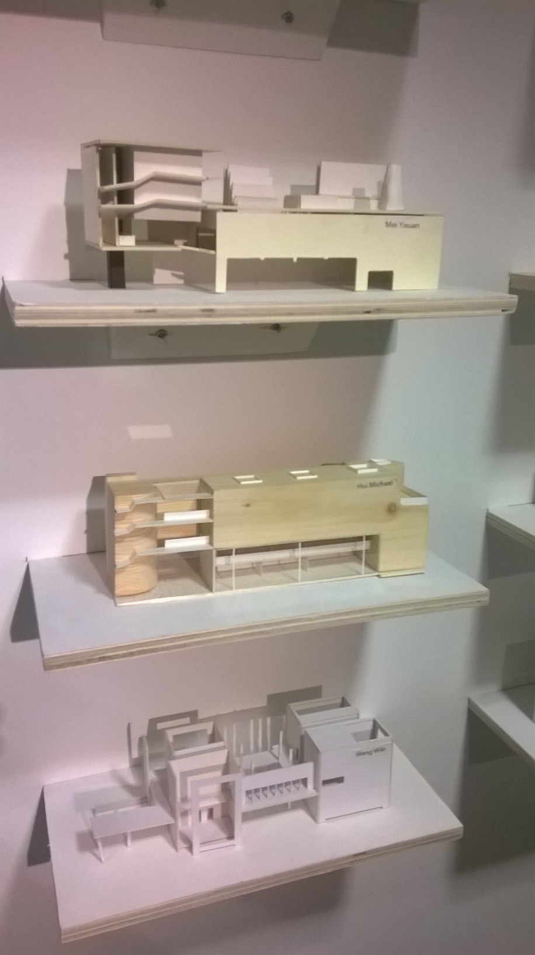
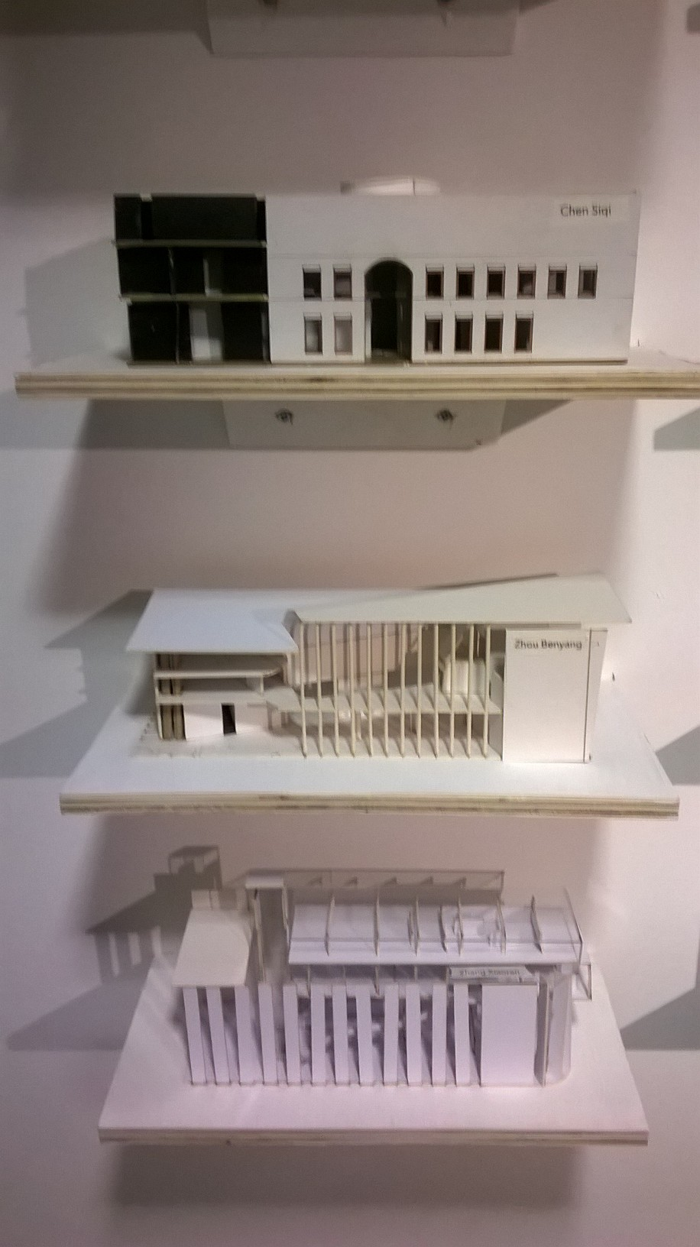
University of Liverpool architecture students’ designs for the Bluecoat’s arts wing, 2017

Slide 16
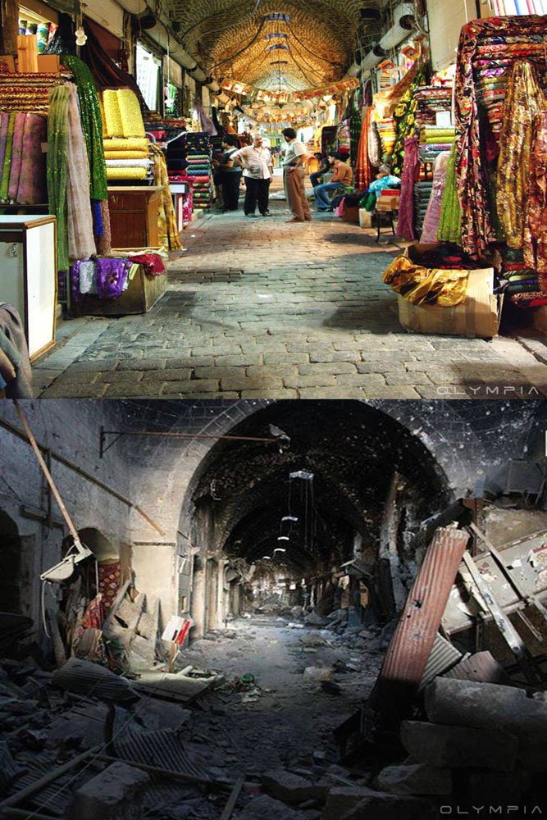
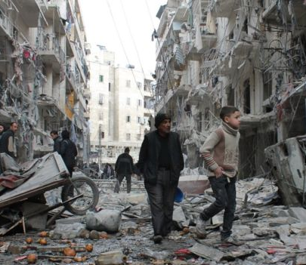
End question
Where in the world today are people living in areas ravaged by war, their buildings destroyed?
How might this be affecting their lives?

Slide 17
One in 10 children live in a conflict zone (an estimated 230 million children).
In these conflict zones, an average of four schools a day are targeted in violent attacks.
More than 25 million children have been driven from their homes by conflict.
In some countries, children have to be taught how to recognise unexploded bombs so that they don’t mistake them for toys.
There are many charities that work to help children affected by conflict such as Unicef and Red Cross.

