Slide 1
Child Labour Debate

Slide 2
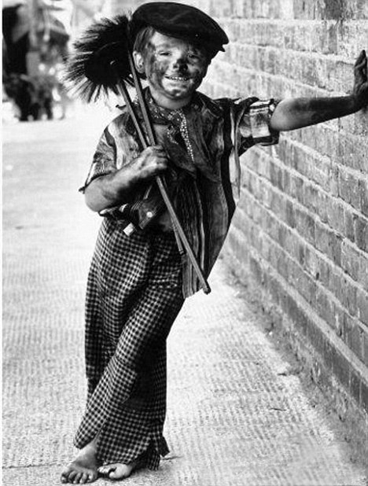
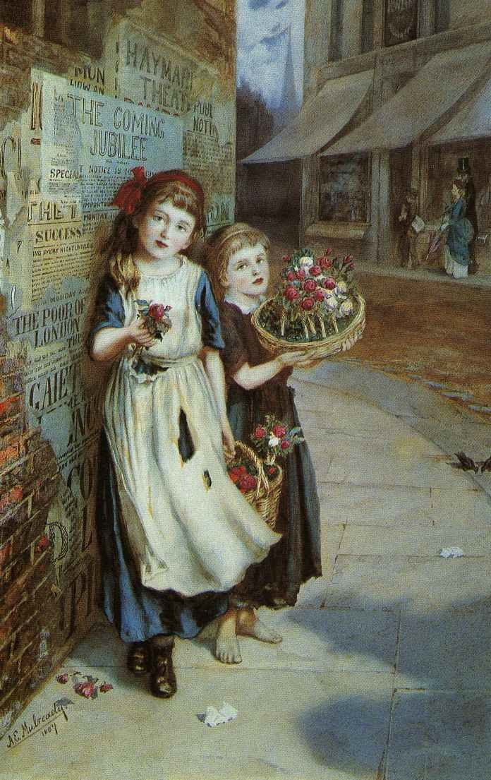
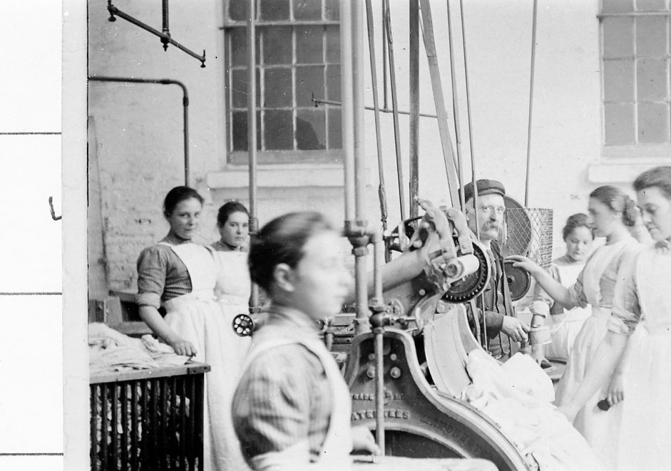
Starter question
What jobs did children do in the past?

Slide 3
When children attended Blue Coat School in the 18th century, childhood was very different than it is today. Children were not entitled to an education and many lived in terrible poverty, beginning work at a very young age, often in dangerous jobs. Although Blue Coat was set up as a charity to help orphan children, pupils spent only a third of their day in lessons, and two thirds working: weaving stockings, spinning cotton, making pins, picking oakum - even their urine was sold. In 1783, the school agreed that pin making was detrimental to the children’s health and against the principles that the school was founded on, and after that no child was made to work. Instead of manual labour, the children could finally focus on their lessons.

Slide 4
Activity
You will take part in a debate about the use of child labour in the early years of Blue Coat School. You will be able to structure arguments both for or against the following motion:
A charity school is very expensive to run. As we have helped the children so much and given them a better life, they should contribute to the running of the school. Besides, many children are working at this time.

Slide 5
Researching your argument
Use the material provided to research your argument and also discuss ideas as a group. If the children want to research their argument further using books or the internet here are some questions they might want to consider:
For
What life was like for children in workhouses during this time
The importance of being given an education during this time
Attitudes towards child labour at this time
The idea of ‘childhood’ and how this has developed over time

Slide 6
Researching your argument
Use the material provided to research the argument and also discuss ideas as a group. If the children want to research their argument further using books or the internet, here are some questions they might want to consider:
Against
The dangers of child labour
What life was like for children at this time, rich and poor
The importance of being given an education during this time
How ideas around child labour have changed since this time

Slide 7
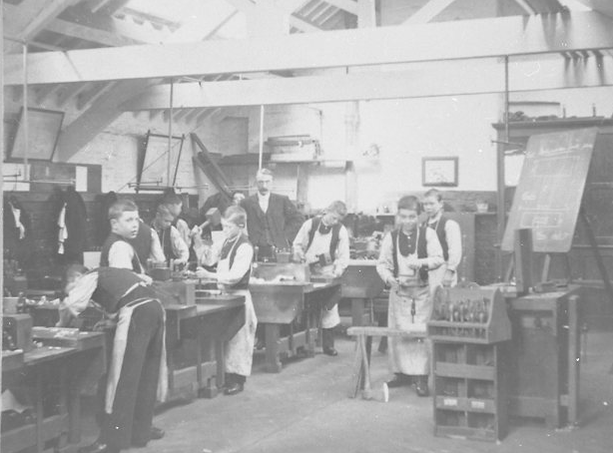
Bluecoat pupils in woodwork class, probably late 19th century.
This is not an image of children engaged in manufacturing things that the school then sold, as in the 18th century.

Slide 8
Extension Activity
Blue Coat School moved to Wavertree in 1906 and the building then became a centre for the arts.
Over the years, many artists have explored Bluecoat’s history and used it as inspiration to create different art works.
You will use some of these artworks to explore what life might have been like for pupils at Bluecoat in the past, and how children are affected by the issue of child labour today.

Slide 9
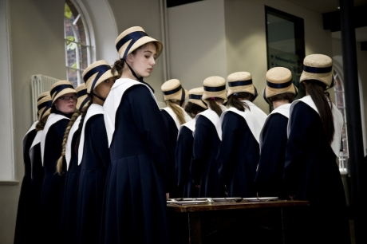
Geraldine Pilgrim Traces 2008 Photo: Sharon Mutch

Slide 10
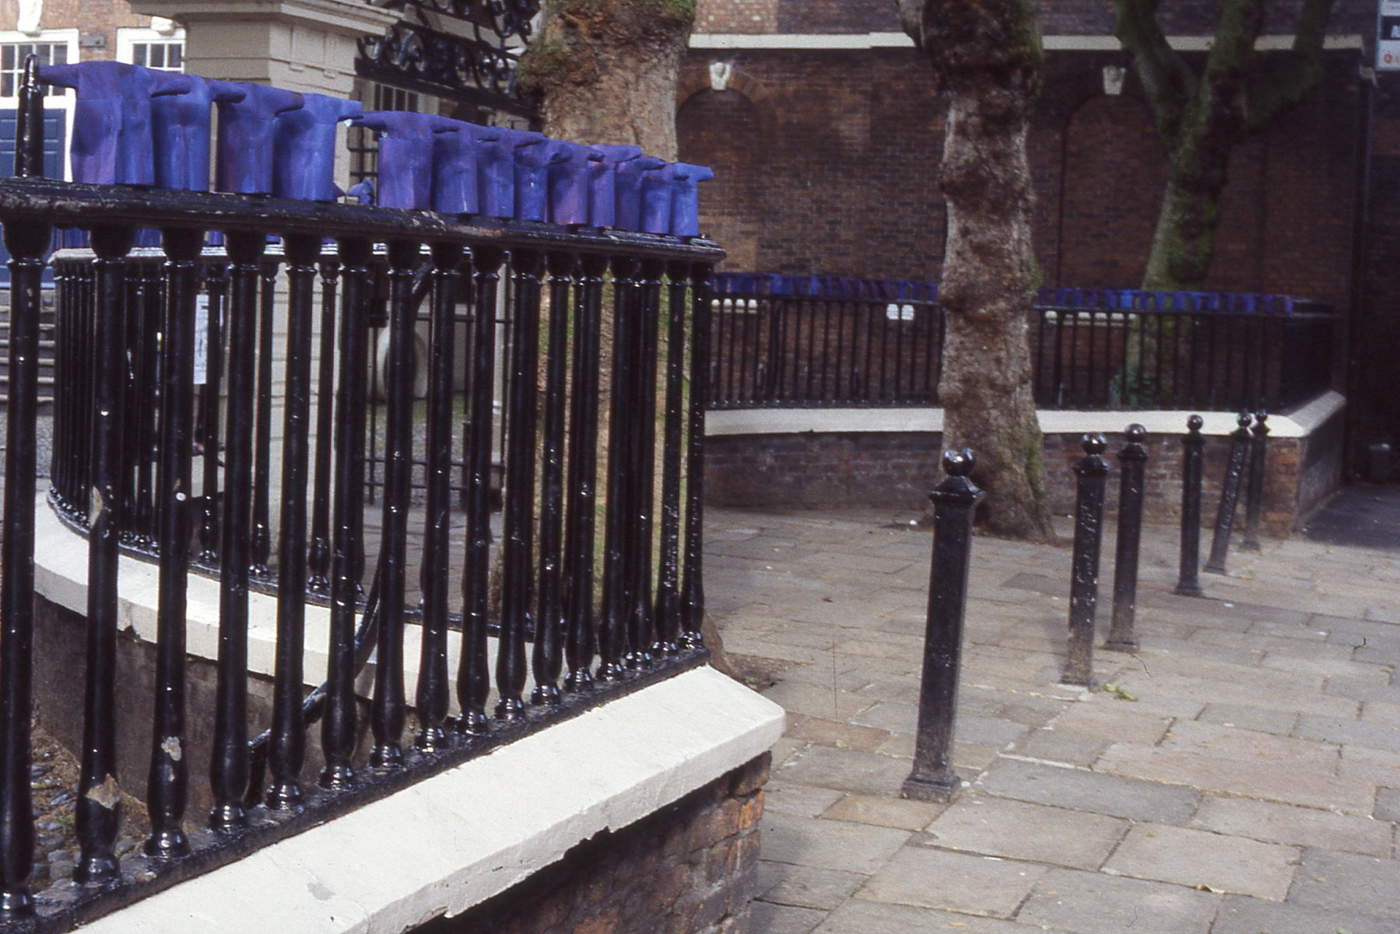
Susan Fitch Escape 1994

Slide 11
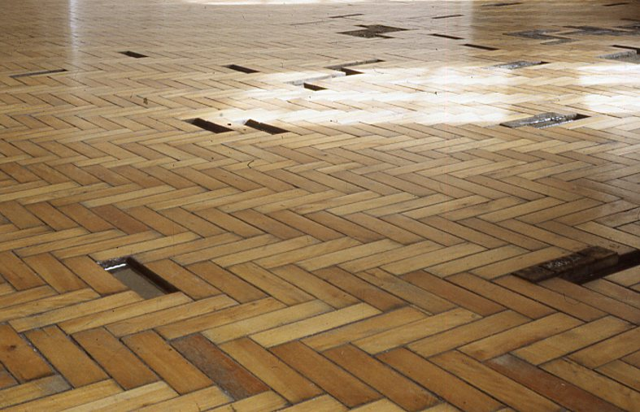
Susan Fitch from the exhibition, Somewhere in Particular 1994

Slide 12
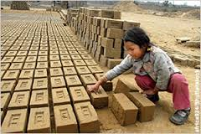
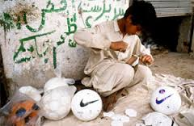
End question
What jobs do children do around the world today?

Slide 13
End question
Is it right that some children are made to work?

Slide 14
End question
What rights are being taken away from these children when they are made to work?

