Slide 1
Silhouettes

Slide 2
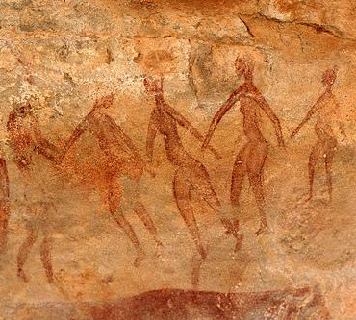
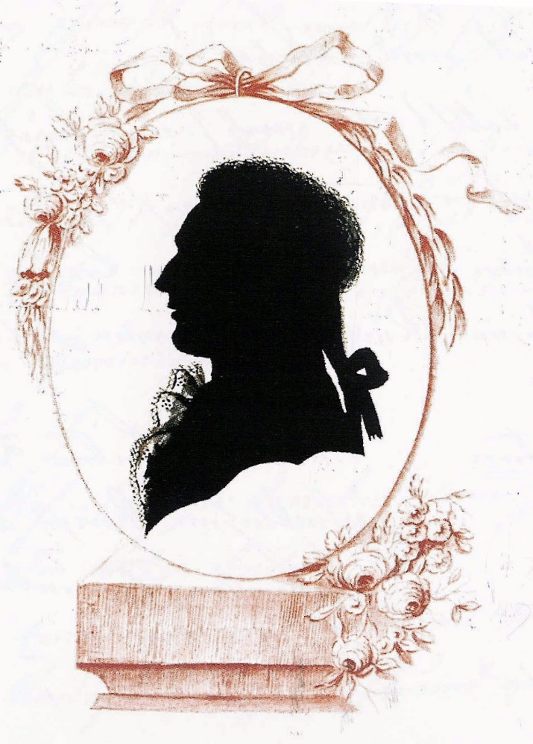
Starter question
Why do we create images of people and special moments?

Slide 3
Starter question
How have people done this over the years?

Slide 4
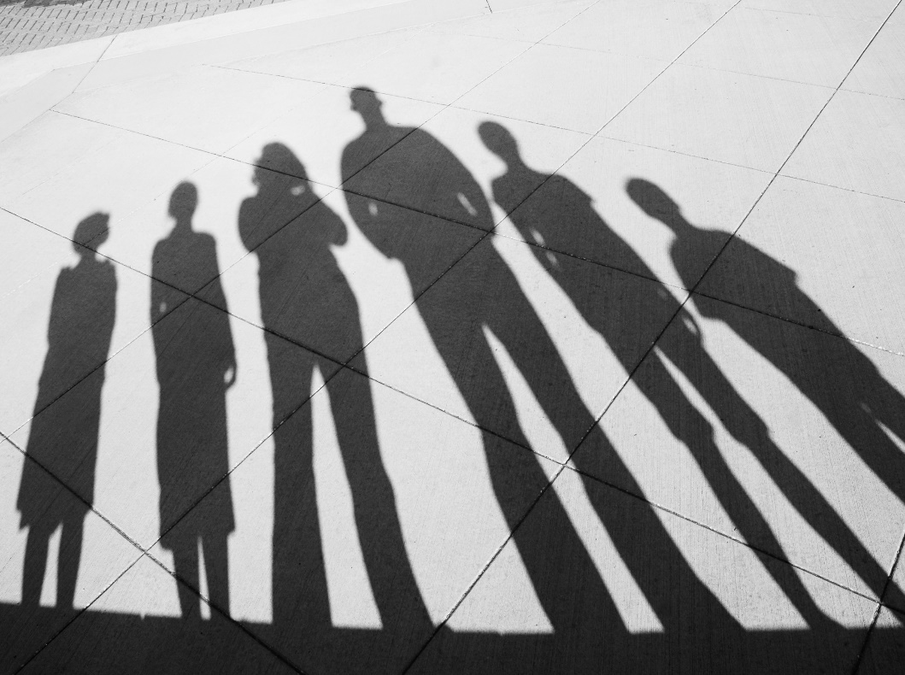
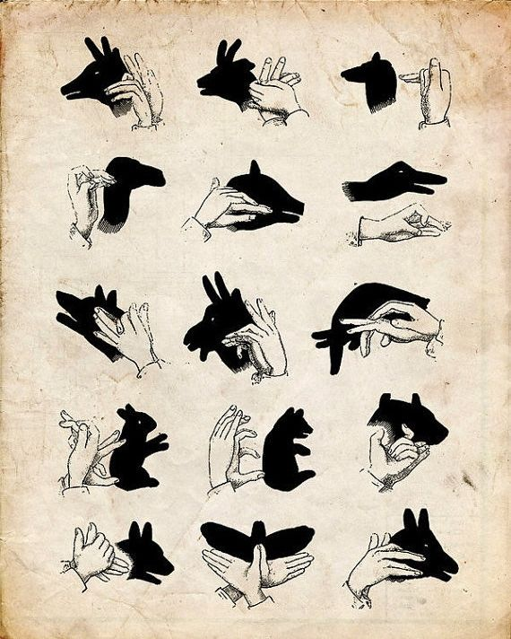
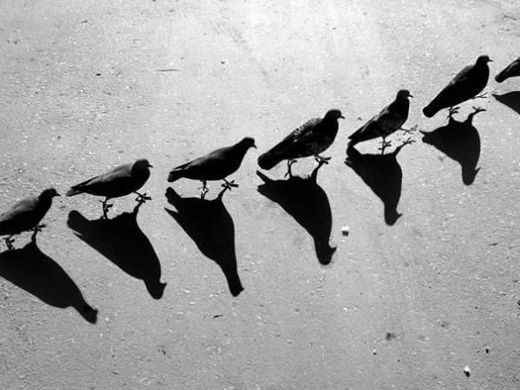
Starter question
How are shadows formed?

Slide 5
Silhouette Book, 1822
The Blue Coat School silhouette book is a collection by a local artist E. Gerard, of 31 miniature silhouette portraits of boys who attended the school in 1822. It also contains reports of their behaviour and ability, written by teachers.
Together, these give a real sense of the children at Bluecoat almost 200 years ago and provide an opportunity to consider the differences between the lives of children then and now.
The reports tell us about school lessons and what was expected of the children. Interestingly, they also give information about what the children might expect when they left school, with some details of the jobs they might have.

Slide 6
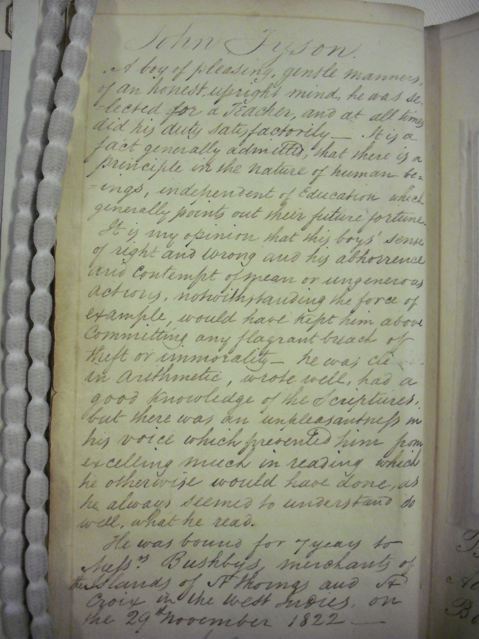
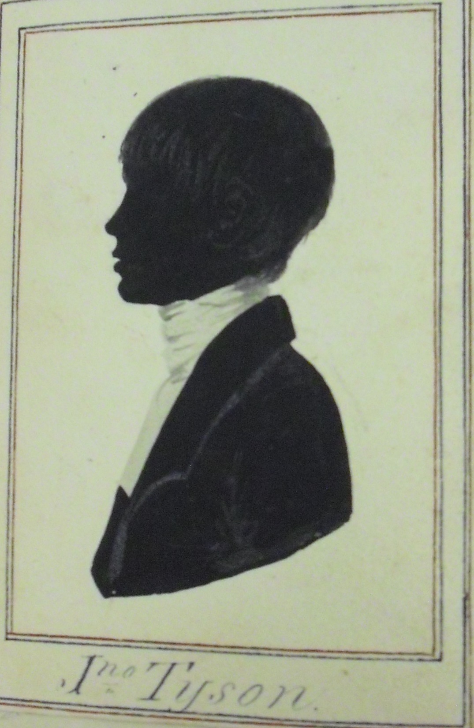

Slide 7
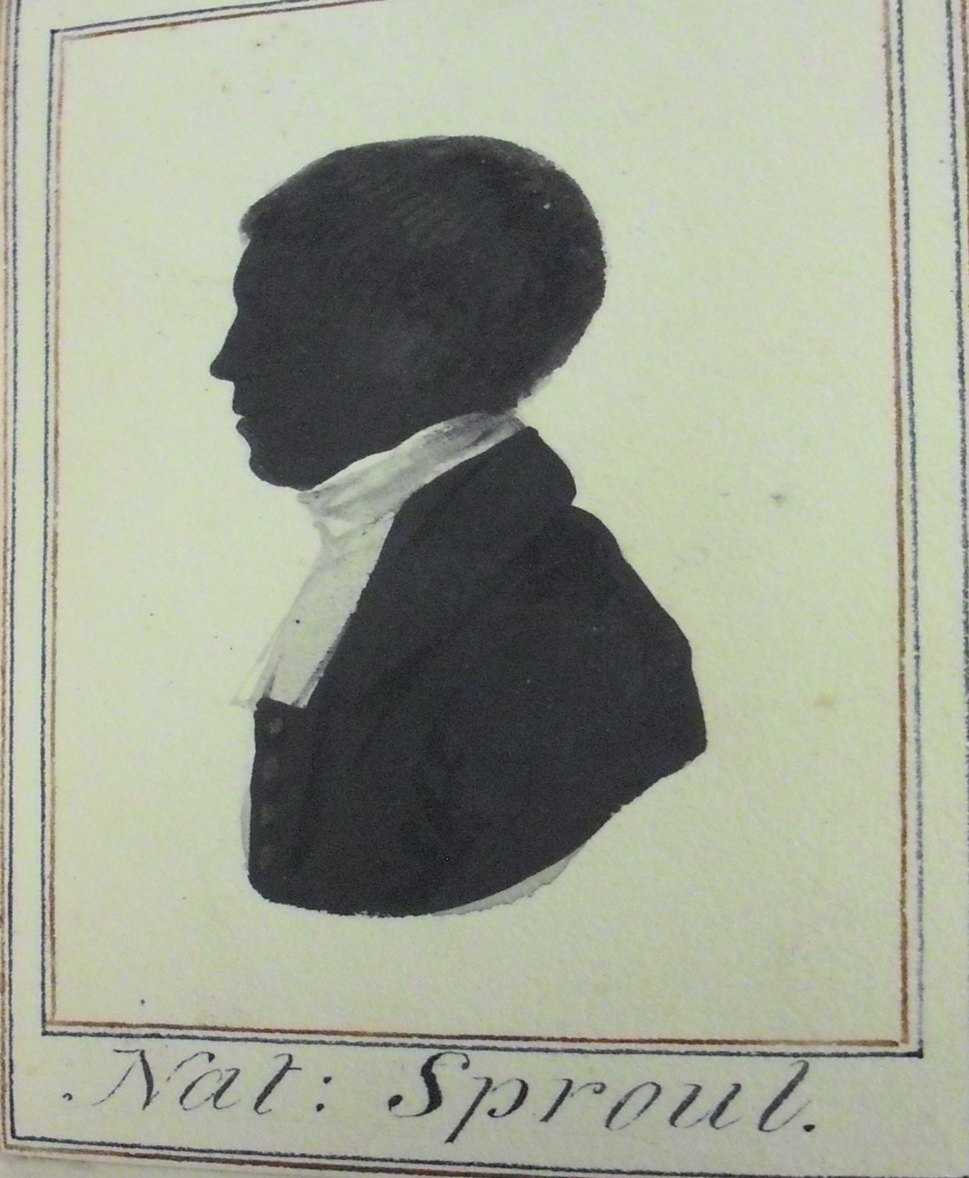

Slide 8
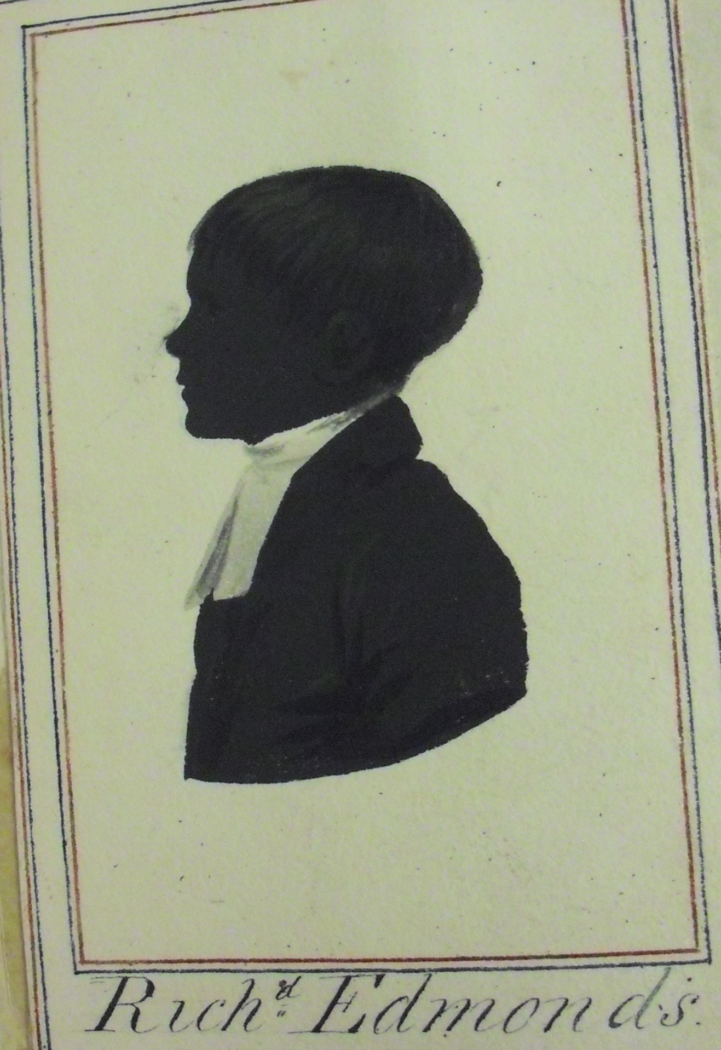

Slide 9
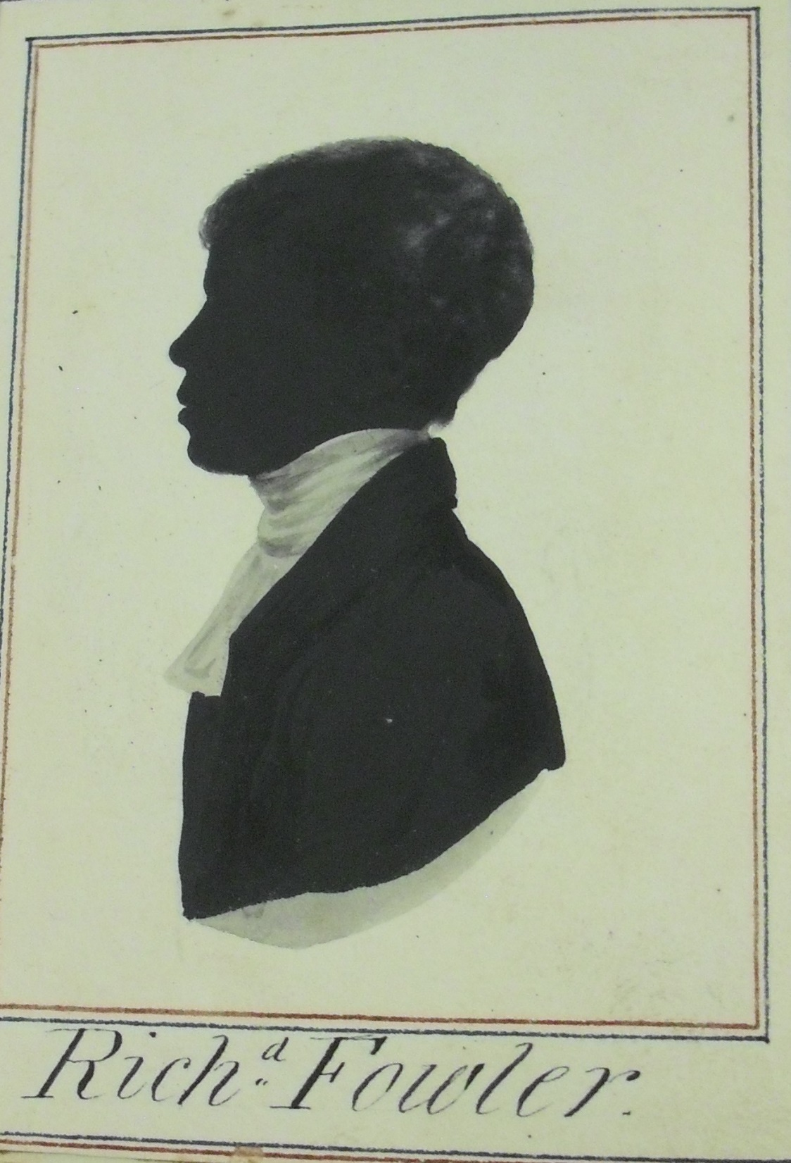

Slide 10
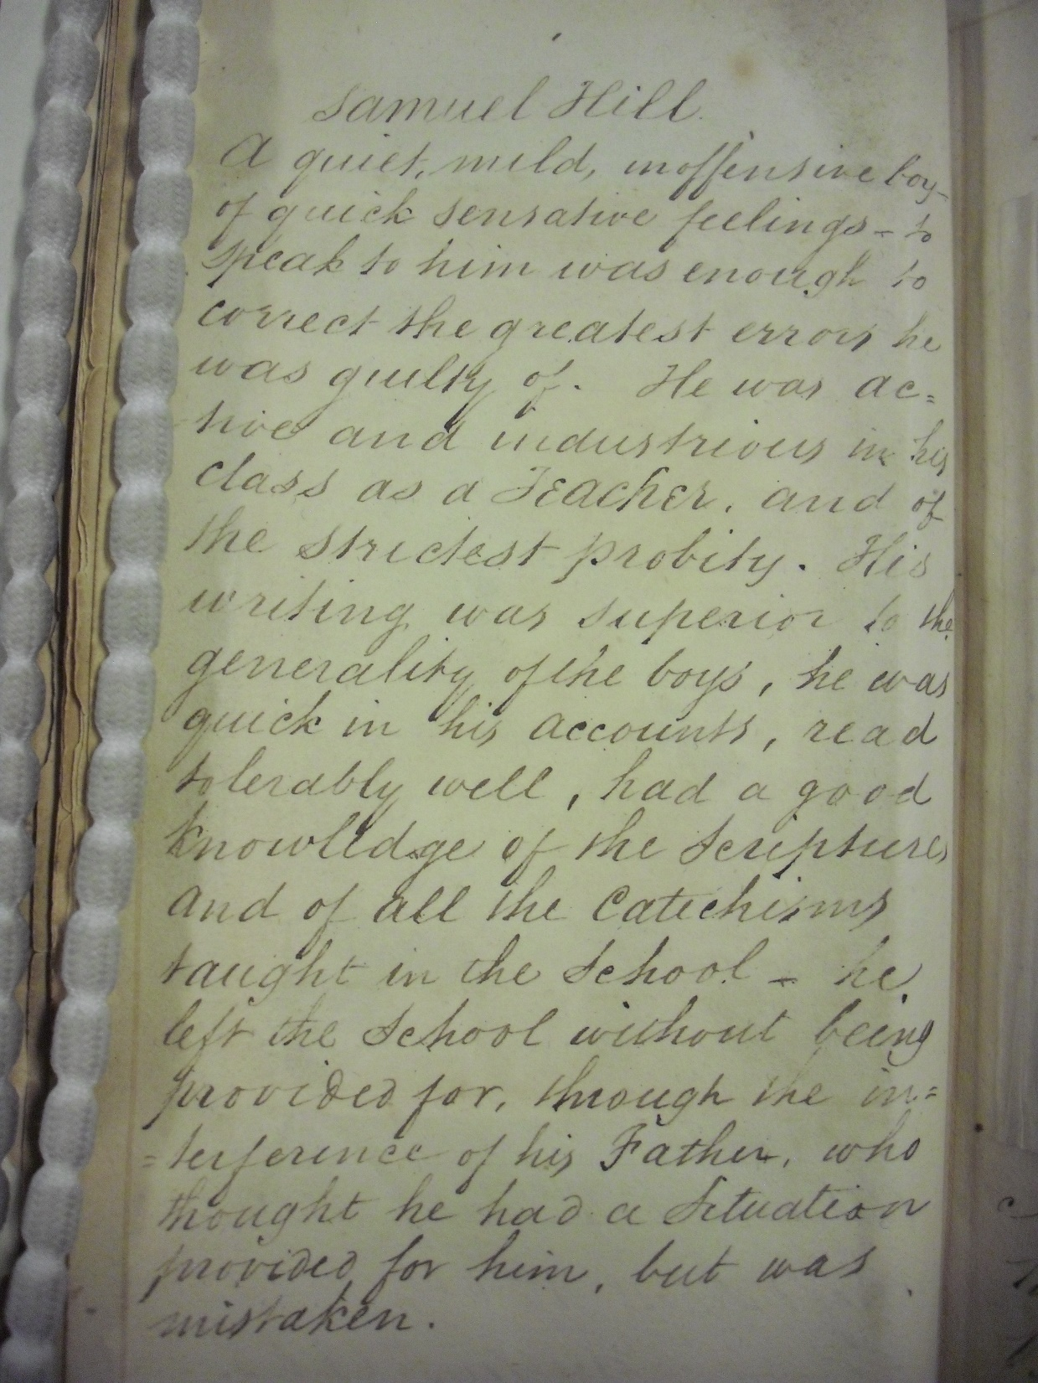
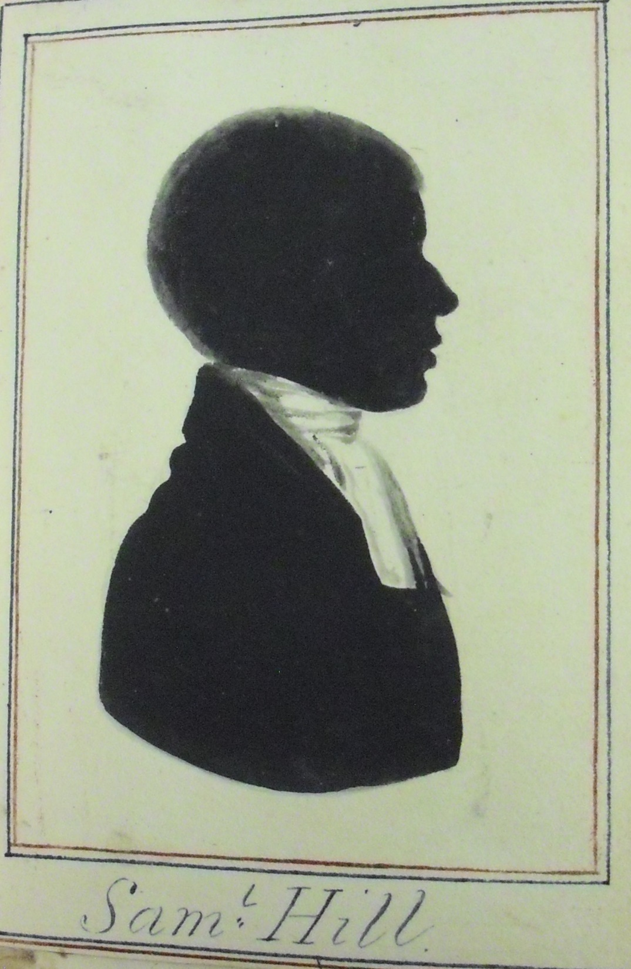

Slide 11
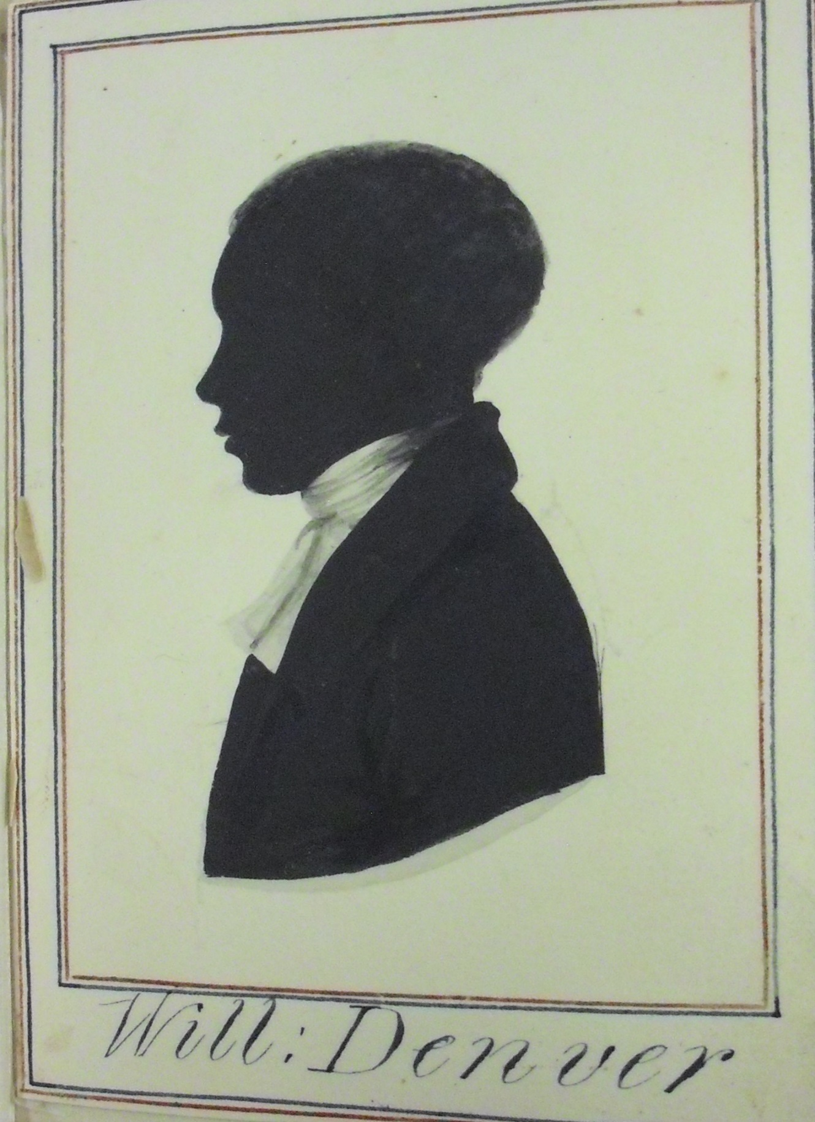

Slide 12
Extension activity
We know that the majority of the pupils who left Blue Coat School were placed into apprenticeships, with many of the boys being sent to sea.
Some of the boys were grateful for the opportunities afforded to them by the school since when they’d made their fortunes, they donated money to the school.
Liverpool was at this time a rapidly growing town and although some people were becoming very rich, there was also a high level of poverty.

Slide 13
From the school reports written by teachers at Blue Coat School, we can see what they thought of some of the pupils in their care. In most cases, we do not know what happened to these boys once they left the school.
Ask the children to read carefully the report of one boy and write an account of what happened to him once he left the school. This can either be written in first person or third, creating a report similar to those in the silhouette book.

Slide 14
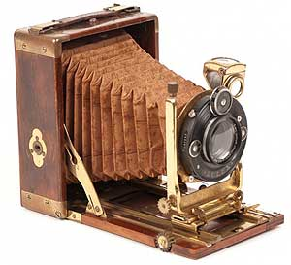
End question
How has photography changed since its early years in the 19th century, and how do you use it in your daily life today?

