Slide 1
Transatlantic Slavery

Slide 2
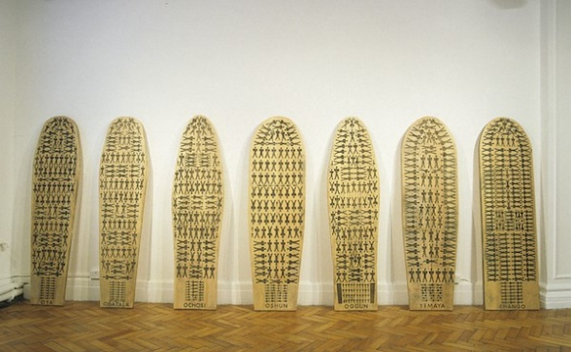
Starter question What is enslavement?

Slide 3
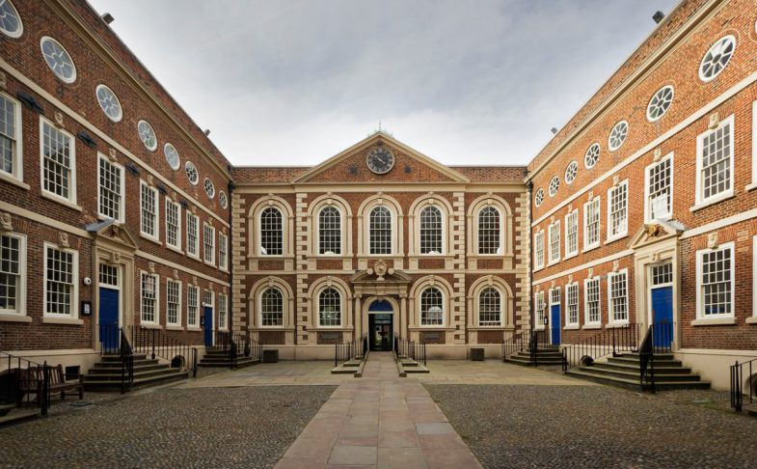
Starter question Do you know anything about Liverpool’s connections to slavery?

Slide 4
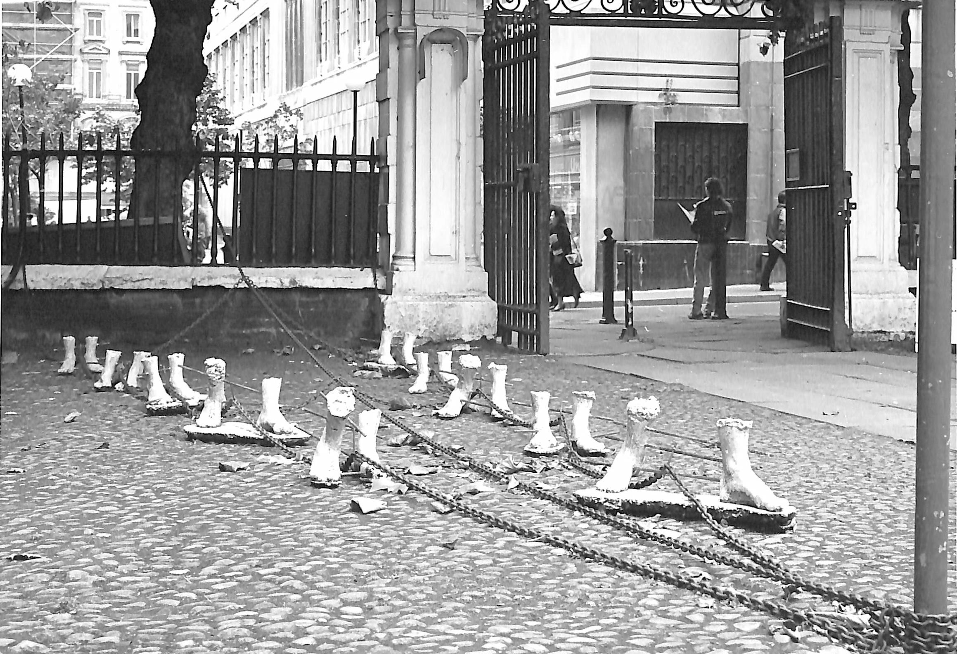
Andrew Robarts’
Installation from Second Wave exhibition at Bluecoat
1988

Slide 5
This work was installed in the front yard of Bluecoat in 1988. The artist, Andrew Robarts, created the work for an exhibition called Second Wave, having researched how the charity school, like many Liverpool institutions of that period, had grown as a result of funds derived from Transatlantic slavery. Although no enslaved people were officially sold in Liverpool, such was the importance of the trade to the port that it was said that every brick of the town was ‘cemented with the blood of an African.’
In Robarts’ installation, the concrete feet are chained together and to the Bluecoat railings. There is no body or face to give the feet a personal identity, they are just one of many.
Once Blue Coat School children finished their education at the age of 14, many were apprenticed to sea, some of them involved in the slave trade or in trades related to it, such as sugar, tobacco and cotton. Following a successful career at sea, several old boys of the school donated money to it.

Slide 6
Importance of Freedom
The artwork explores being enslaved, forced to do something against your will, not having your own thoughts and feelings listened to, being treated in a brutal and inhuman way.
The opposite of enslavement is freedom. Working as groups or on your own, create an artwork describing the idea of freedom, just as Robarts’ explores enslavement? You could think about:
- What does freedom mean to you?
- Why is freedom important?
- Are there colours, shapes or symbols you associate with the idea of freedom?
- What emotions would you like people to feel when they look at your artwork?
Robarts’ artwork suggests what it might have felt like to be a slave. Are you trying to tell a story through your artwork?
You could do a painting, take a photograph or create a sculpture like Robarts’ to best show what freedom is, and why it is so important.

Slide 7
Maria Magdalena Campos-Pons
The Seven Powers by the Sea
1992-99, at Bluecoat in 1999

Slide 8
This installation by artist Maria Magdalena Campos-Pons was exhibited at Bluecoat for the first Liverpool Biennial in 1999. It addresses the theme of human displacement and refers to the slave ships that sailed from West Africa to the Americas. The images on the wooden boards leaning against the wall refer to the cramped conditions on board the ships, how little space the slaves had and how brutally they were treated.
The artist’s Yoruba ancestors were shipped from Nigeria as slaves. Her grandfather was transported to Cuba to work on a sugar plantation and her family were still living and working on the plantation when she was a young child. The installation therefore also reflects a personal story.

Slide 9
No space, no respect
Look at the way people were cramped on the slave ships and how little personal space that they had. Can you come up with five thoughts or feelings you think people might have had when they were on the slave ships? For example, anger, fear, sadness.
Working in groups, come up with some movements that represent the thought and feelings that people may have had while imprisoned on the ships – ones that could be performed in a very restricted space (for example, only an arm’s length around you).
Once you have decided on your movements, work as a group to arrange yourself in a shape like those on the artwork and perform your movements in a restricted space to give an impression of what life might have been like, and how people felt, on the ships.

Slide 10
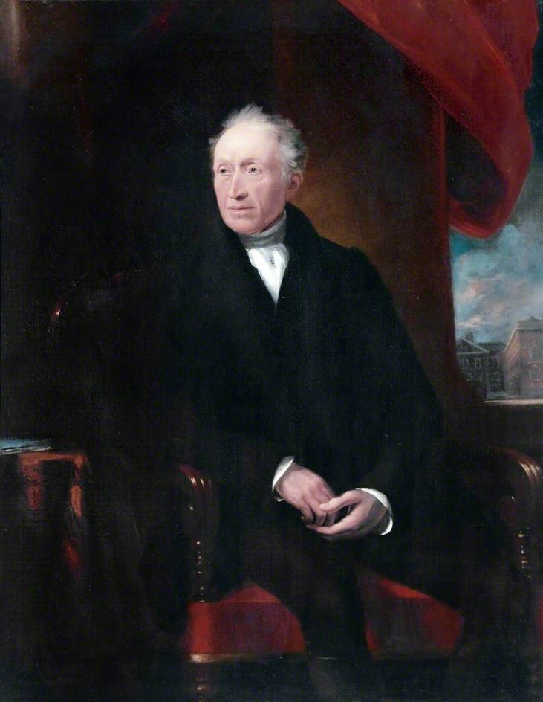
James Lonsdale George Brown with Liverpool Blue Coat School in the background oil on canvas not dated Collection of the Liverpool Bluecoat School

Slide 11
George Brown became a pupil of Blue Coat School in 1765. Aged eight, he was an orphan and his only possessions were his parents’ marriage certificate and his own birth certificate.
He was a successful pupil and when he left the school he was apprenticed to the sea. Before taking his first voyage, however, he got tangled in a rope and broke both legs.
He recovered from his accident and went to sea, eventually making his fortune and becoming one of the wealthiest merchants in Liverpool. He donated money to Blue Coat School, as he felt he owed his good luck and fortune to the opportunities it had given him.

Slide 12
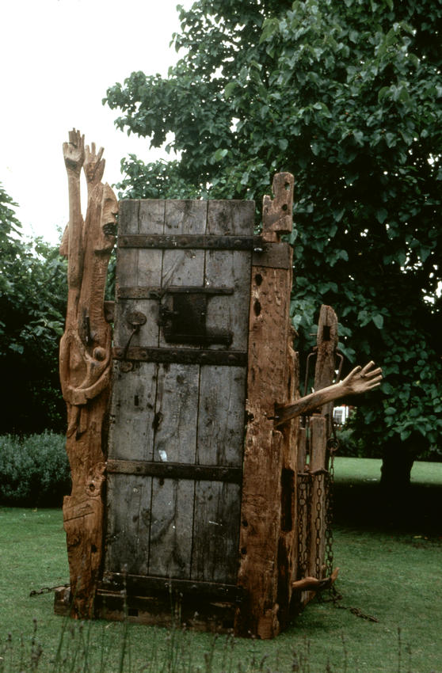
Juginder Lamba The Cry 1992 shown in Trophies of Empire in the Bluecoat garden and in the garden of Wilberforce House in Hull (pictured here)

Slide 13
This sculpture by Juginder Lamba was created for a series of exhibitions in 1992, Trophies of Empire, and shown in the gardens of both Bluecoat and Wilberforce House in Hull.
A rectangular prison cell made of wood and metal chains is the focus of the work and arms reach through the locked door in despair. Carvings in wood of faces and figures also appear.
The Cry is a reflection on the human tragedy of slavery. Lamba conceived the work to be a shrine to people all around the world who suffered, or continue to suffer, because of slavery.
The Cry reminds us of Liverpool’s connections to slavery, and – constructed from old ships’ timbers - the ships that sailed from the Old Dock, close to Bluecoat, to transport enslaved African people across the sea.

Slide 14
Poets often use works of art for inspiration. Ekphrasis means writing that has been inspired by art.
You will be using Juginder Lamba’s art work, The Cry, as a starting point for your own poem, which will reflect upon the horrors and ongoing legacy of slavery.
To do this, think about the five different senses and how you might react if you were trapped inside The Cry listening to the people who had come to visit the shrine:
- Hearing
- Smelling
- Seeing
- Touching
- Tasting

Slide 15
South Atlantic Souvenirs and Trouble Trophies of Empire 1992

Slide 16
Trophies of Empire In the early 1990s, artist Keith Piper approached Bluecoat with the idea for a series of commissions looking at Liverpool’s historic association with Transatlantic slavery. As a result, sixteen artists’ projects were selected and presented in 1992 as Trophies of Empire in Bristol, Hull and Liverpool. For one of the commissions, the artists known as South Atlantic Souvenirs & Trouble presented a ‘trophy cabinet’ of products – tea, sugar and tobacco - associated with and enabled by slavery. Every packet came with a picture card that could be collected and stuck into an album, which told the story of ‘five hundred years of Imperial violence, pillage and mayhem around the globe.’ Imperial – connected to the British Empire Pillage – to rob using violence Mayhem – chaos and violent disorder

Slide 17
You are going to select three products that are the product of modern slavery and then, using the work by South Atlantic Souvenirs and Trouble as inspiration, design your own packaging for them, and design a set of cards to insert into these products. The cards will include images and some background information about the product. Use these designs to discuss why it is important of put a stop to modern slavery.

Slide 18
End question Do you know anything about contemporary slavery and how does this make you feel?

Slide 19
End question Why is it important to talk about and remember difficult and upsetting issues and historic events?

