Slide 1
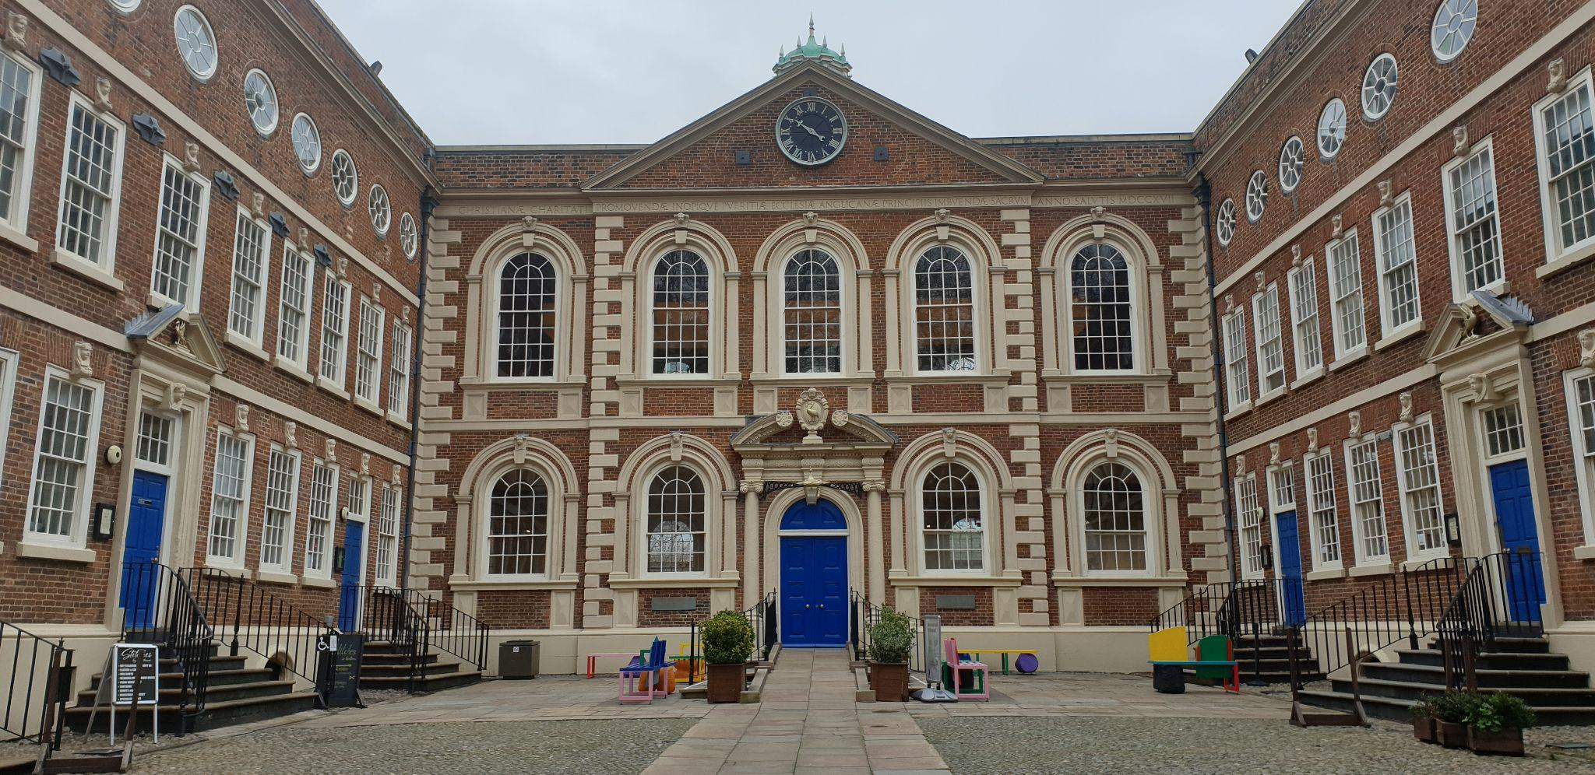


The Bluecoat’s Colonial Legacies
Discover the echoes and origins of the Bluecoat building

Slide 2
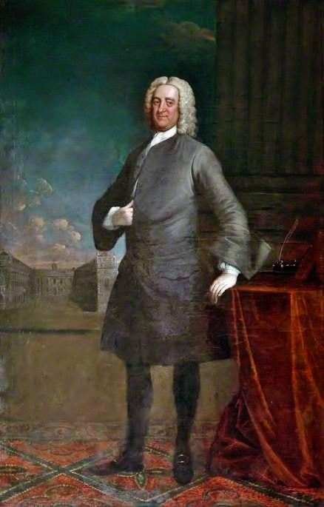
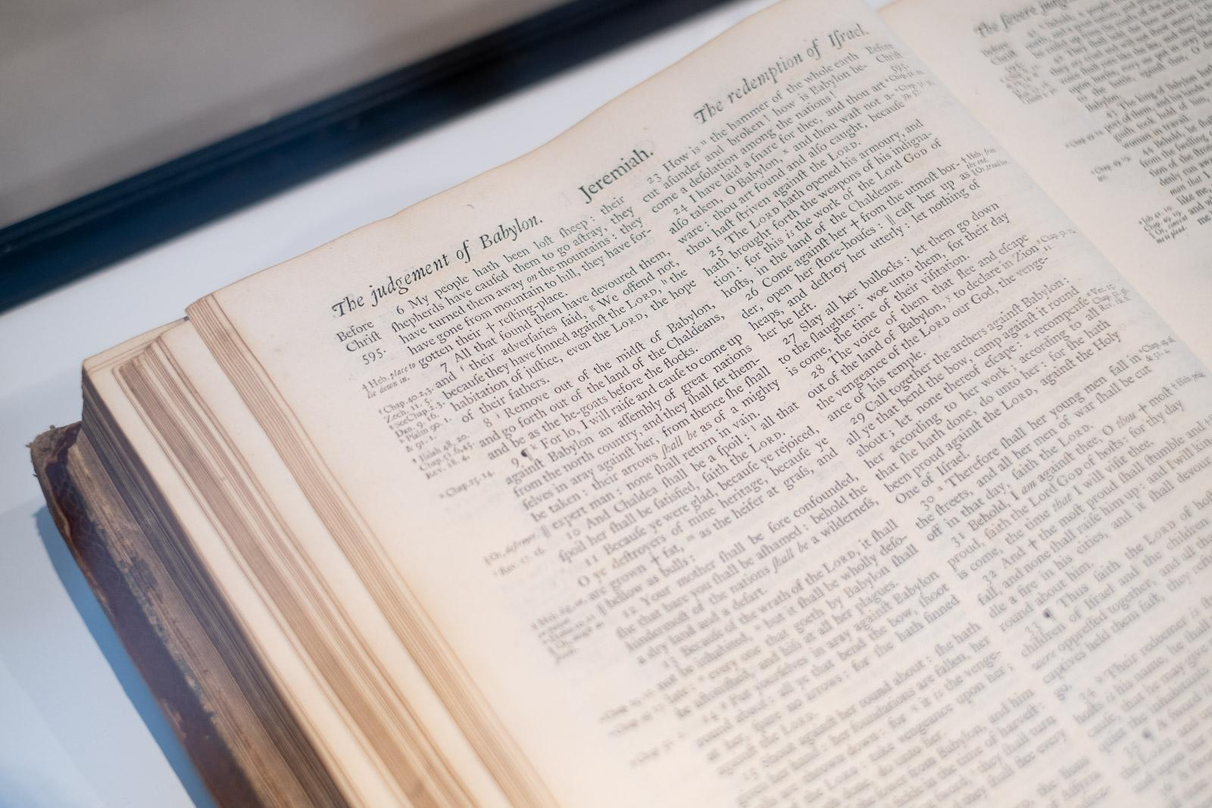
The Blue Coat School was founded in 1708 by Bryan Blundell and the Church

Slide 3
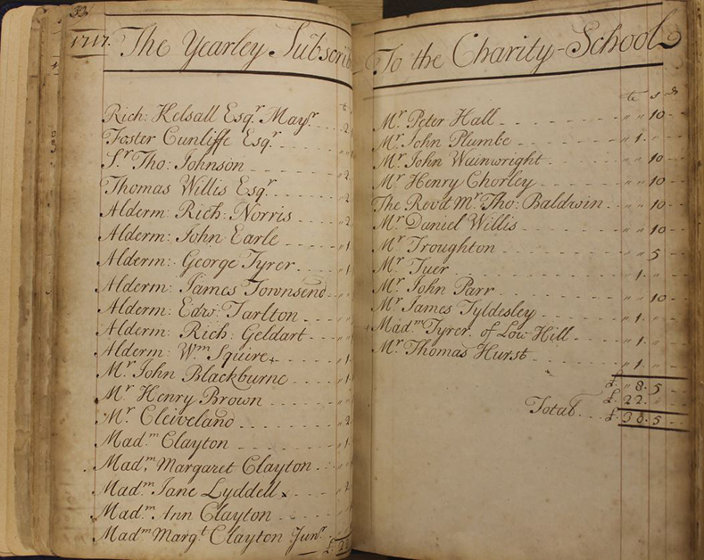
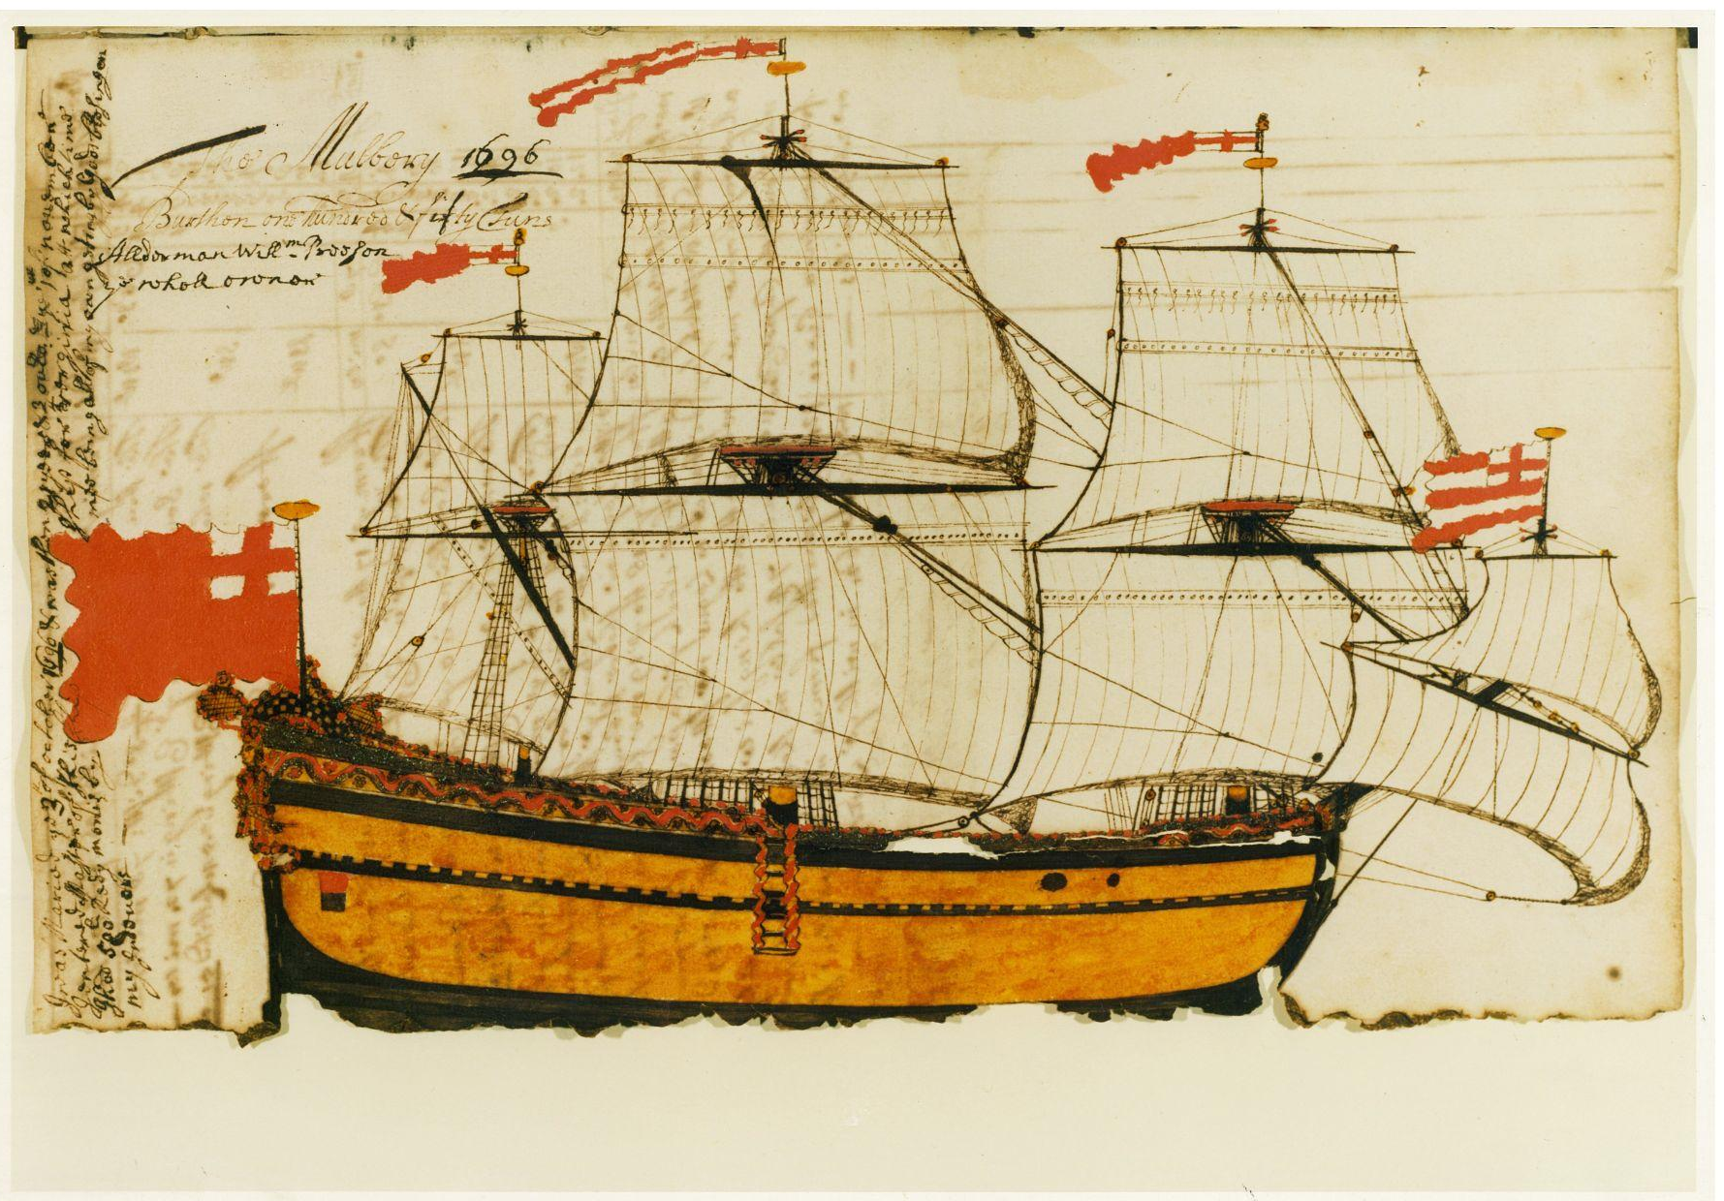
Accounts records 1717: subscribers donated money to the school, many of them were merchants

Slide 4
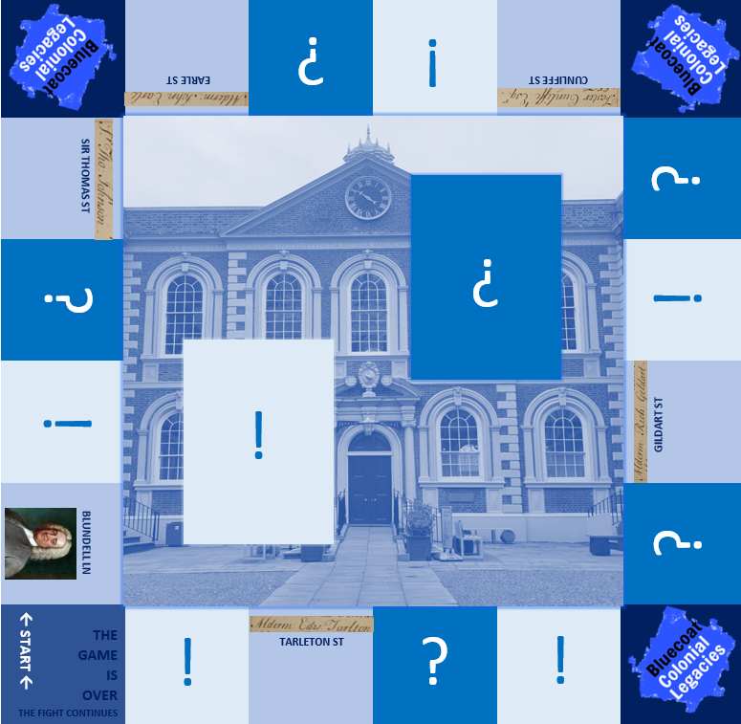
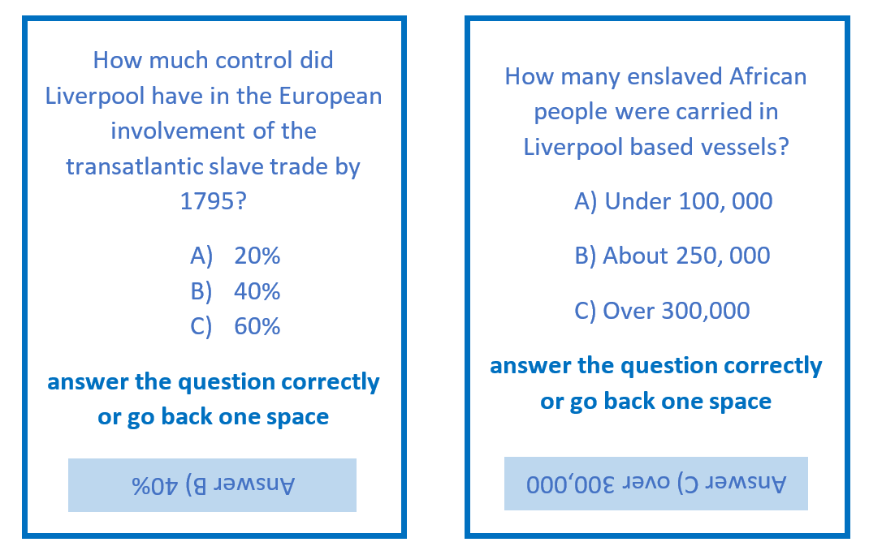
What do you know about Liverpool’s involvement in transatlantic slavery?
play Bluetropolis to find out more!

Slide 5
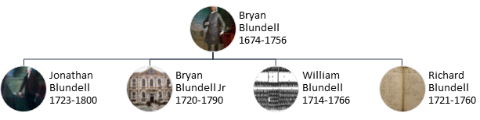
Who were the merchant class?
Merchant
Philanthropist
Clergy
Politician
Human Traffickers?

Slide 6
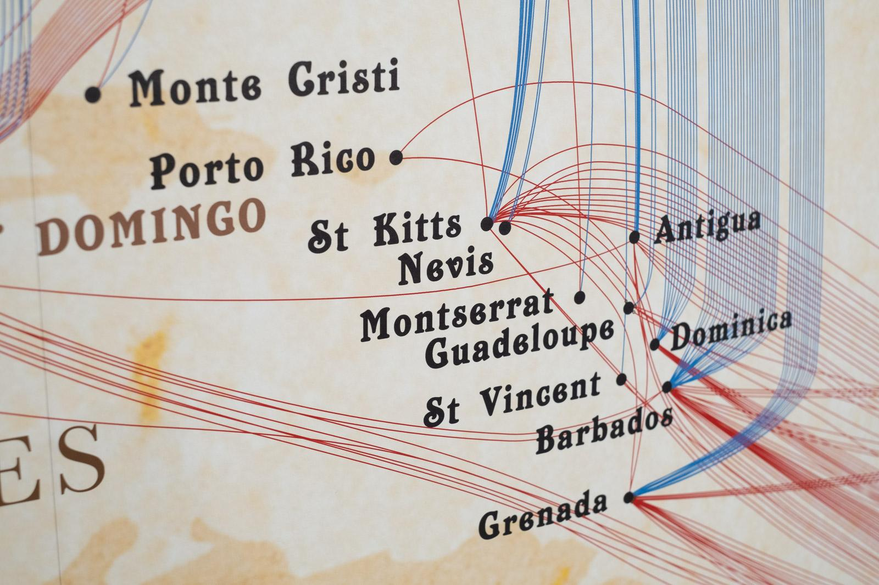
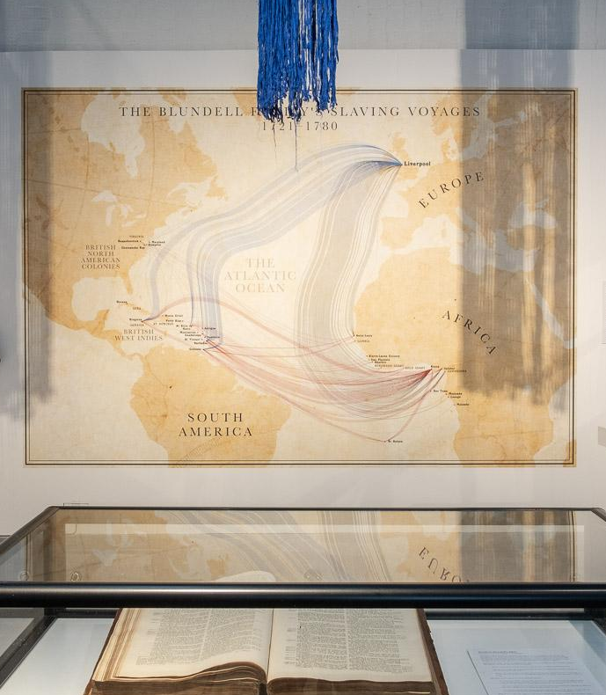
The Blundell Family’s Slaving Voyages, 1721-1780

Slide 7
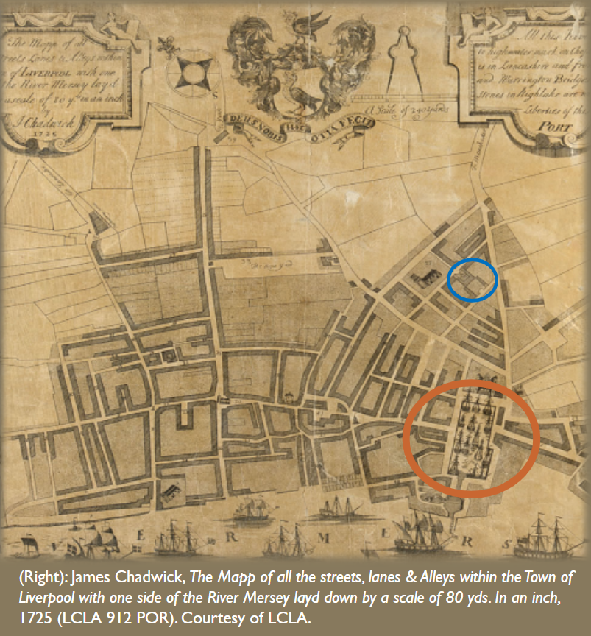
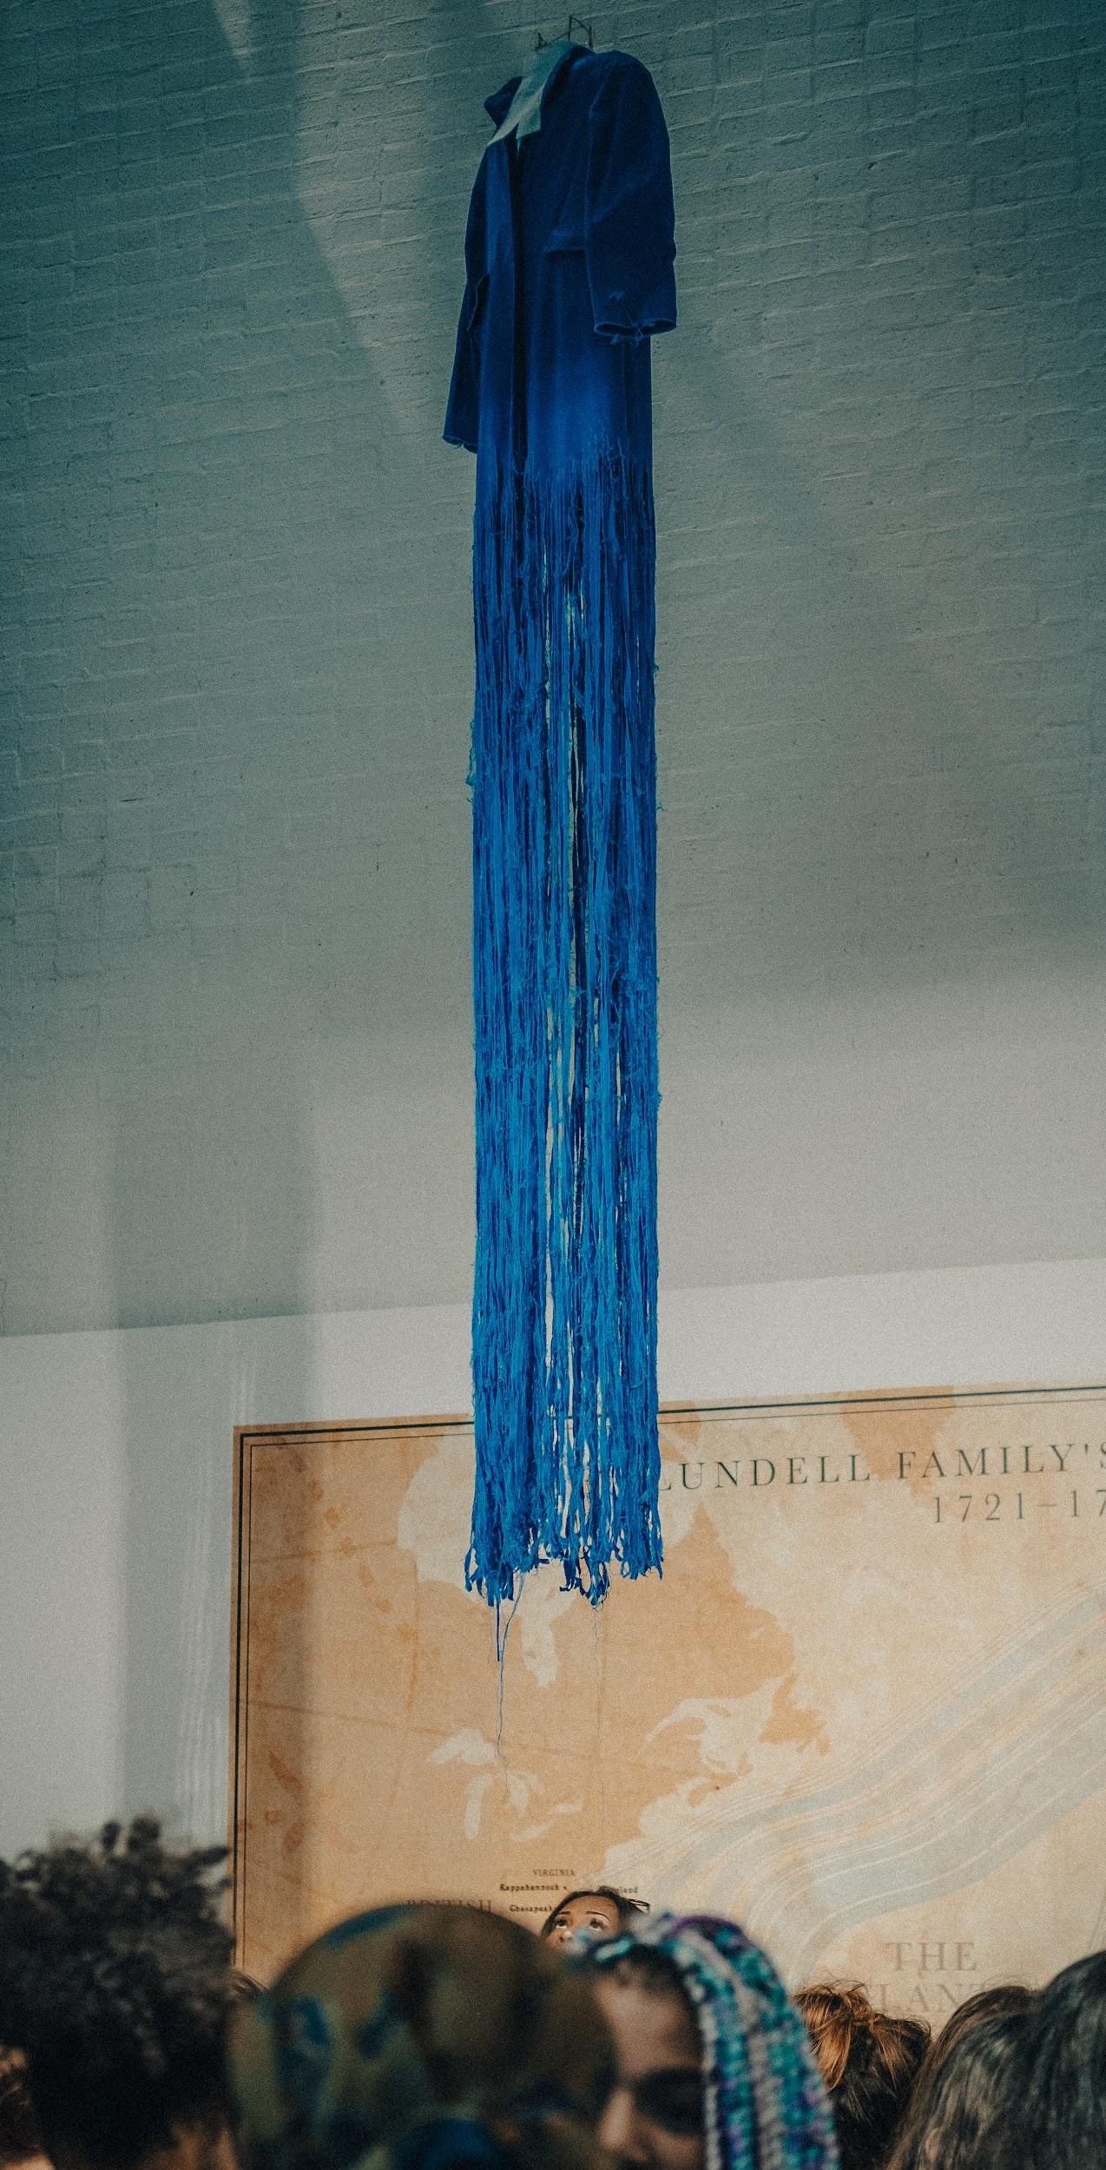
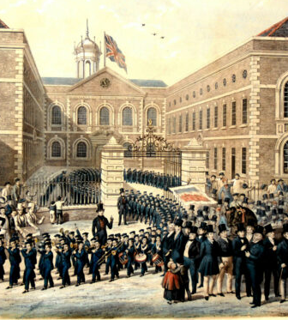
Liverpool Old Dock 1715, Blue Coat School building 1717

Slide 8
school work
apprenticeship
indentureship
slavery
colonial - legacies - merchant - maritime - philanthropist - clergy - transatlantic - slavery - slave trade - enslaved - human trafficking - politician - clergy - servant
- banker - immigrant -
expatriate - rioter - protestor
- multicultural - migration
- global city
can you define these words?

Slide 9
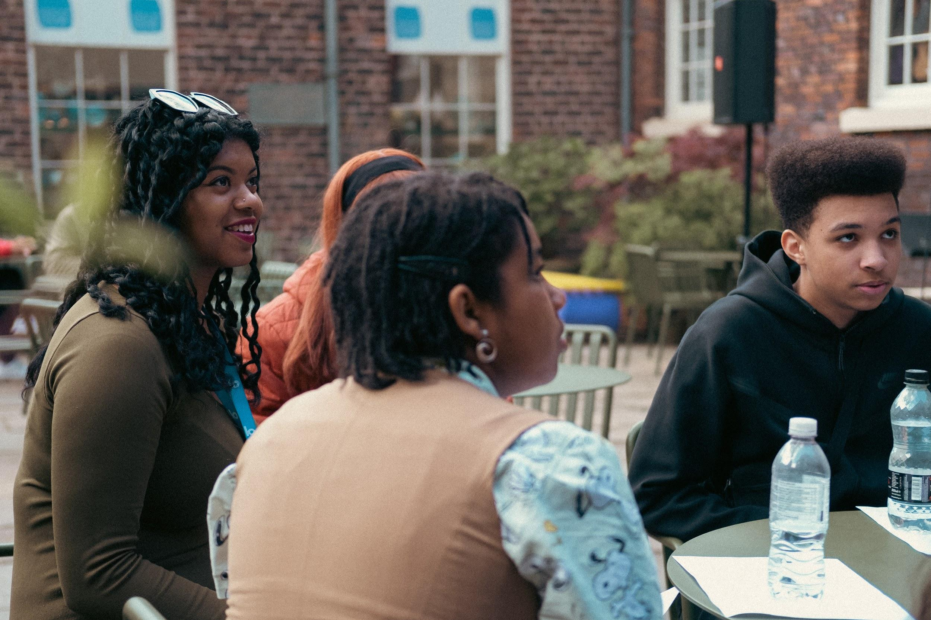
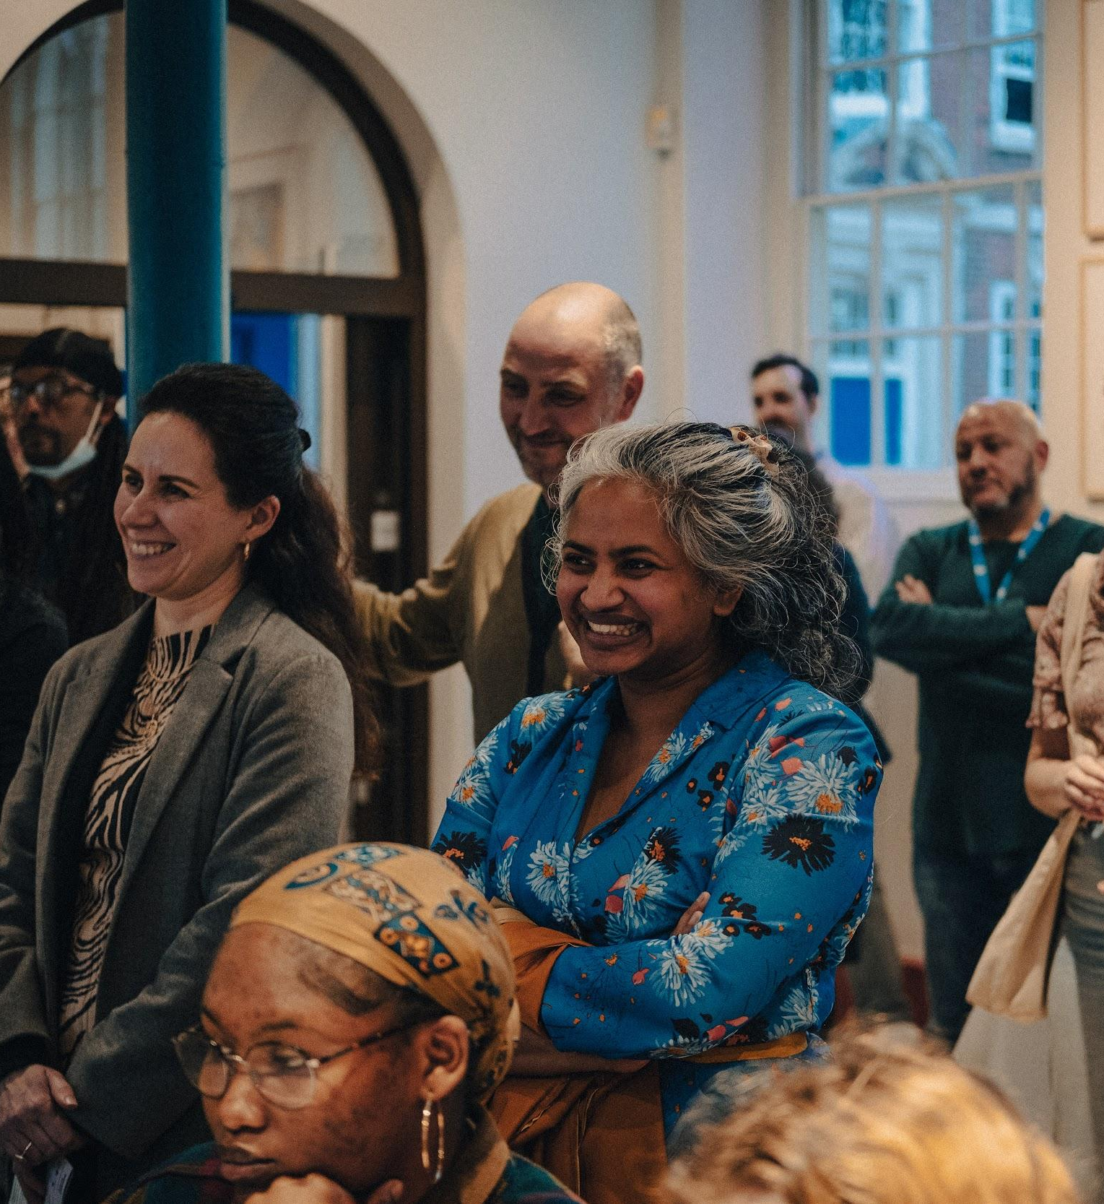
The Bluecoat - UK’s first contemporary arts centre, 1927

Slide 10
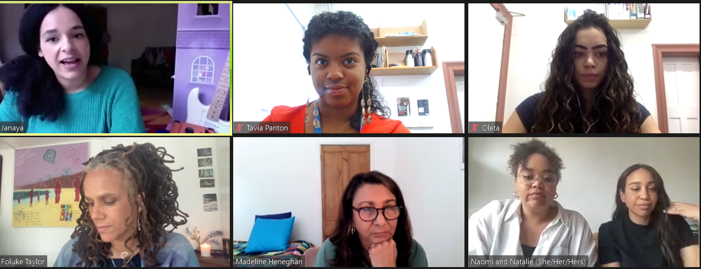
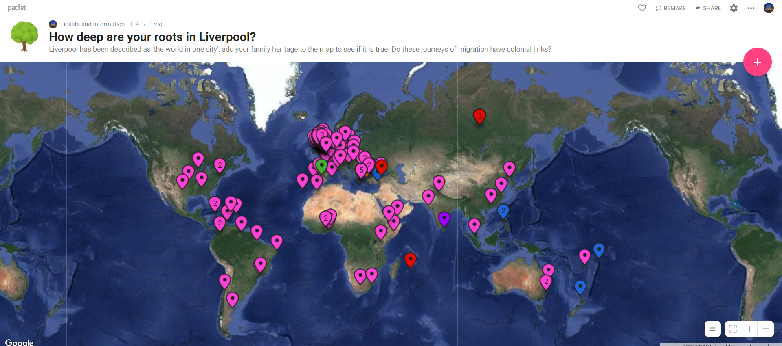
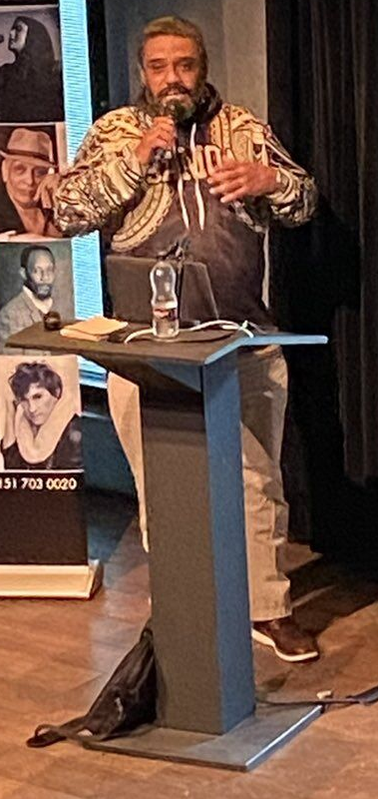
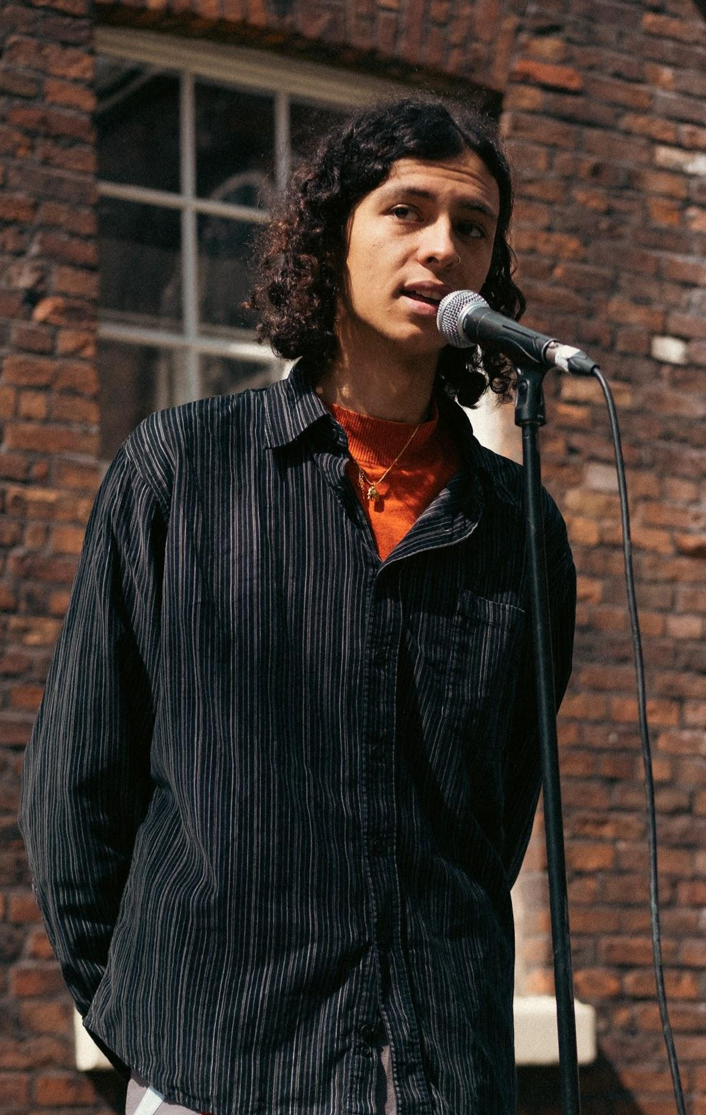
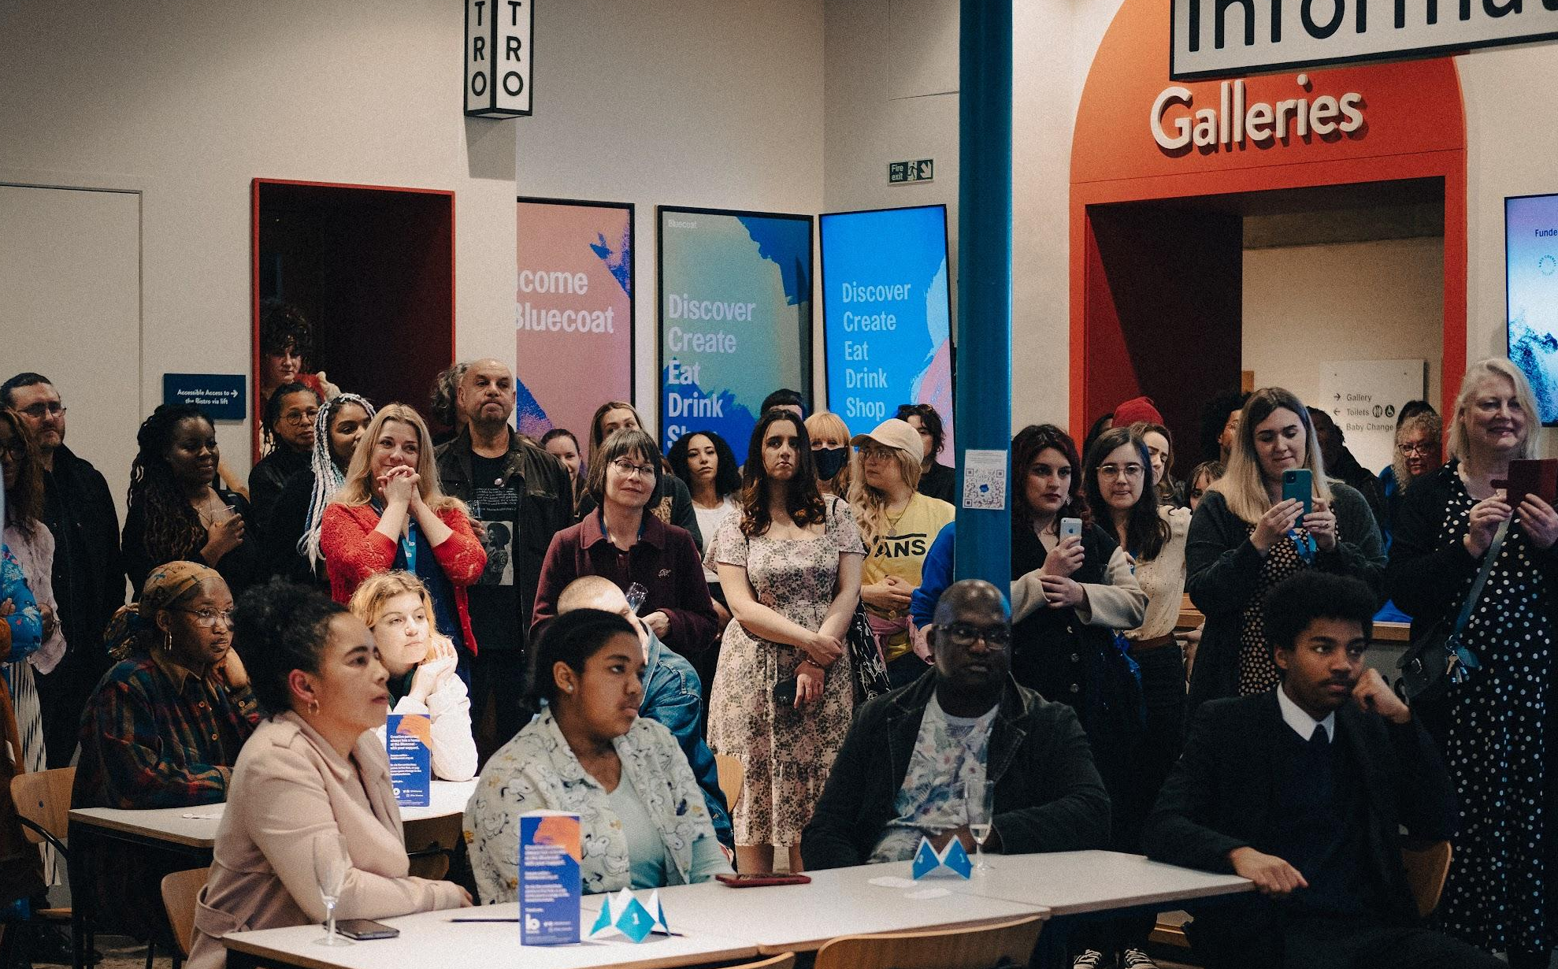
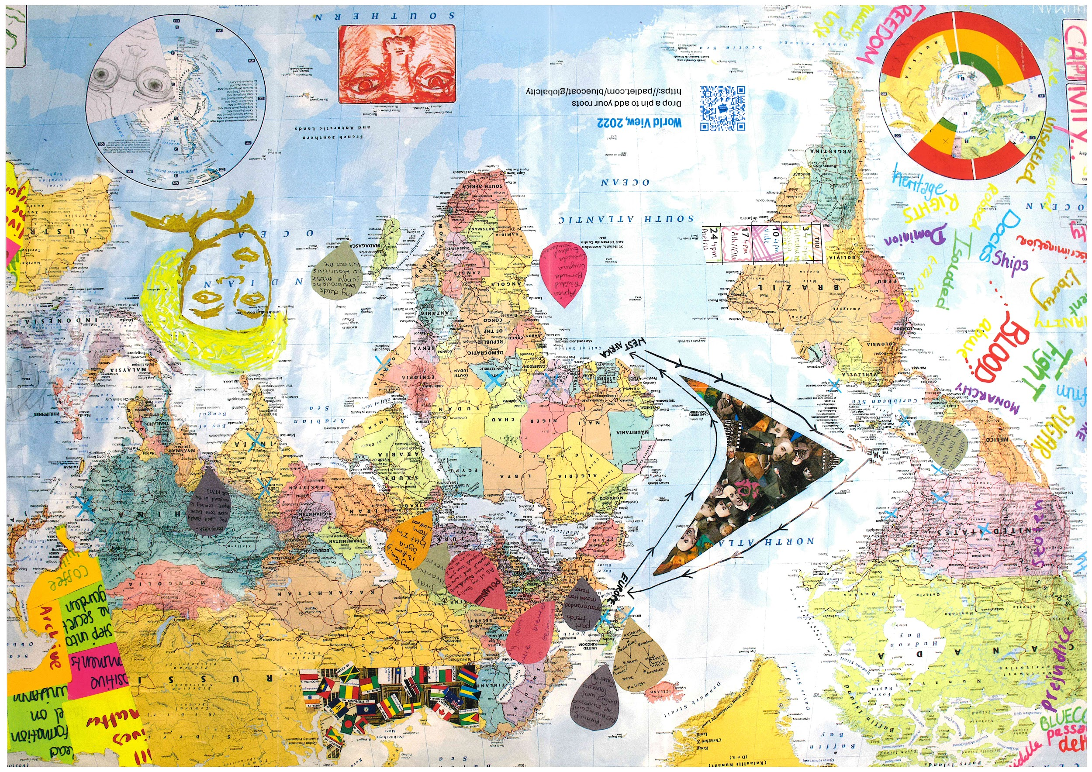
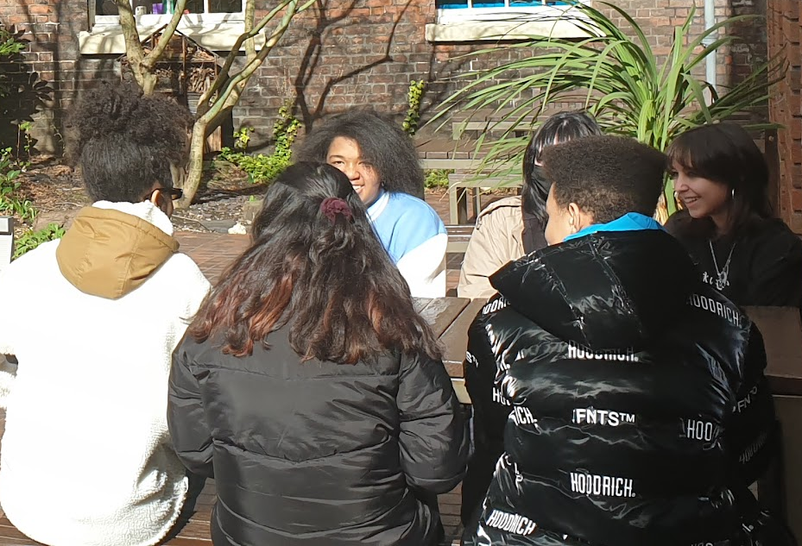
Liverpool’s multicultural roots…

Slide 11
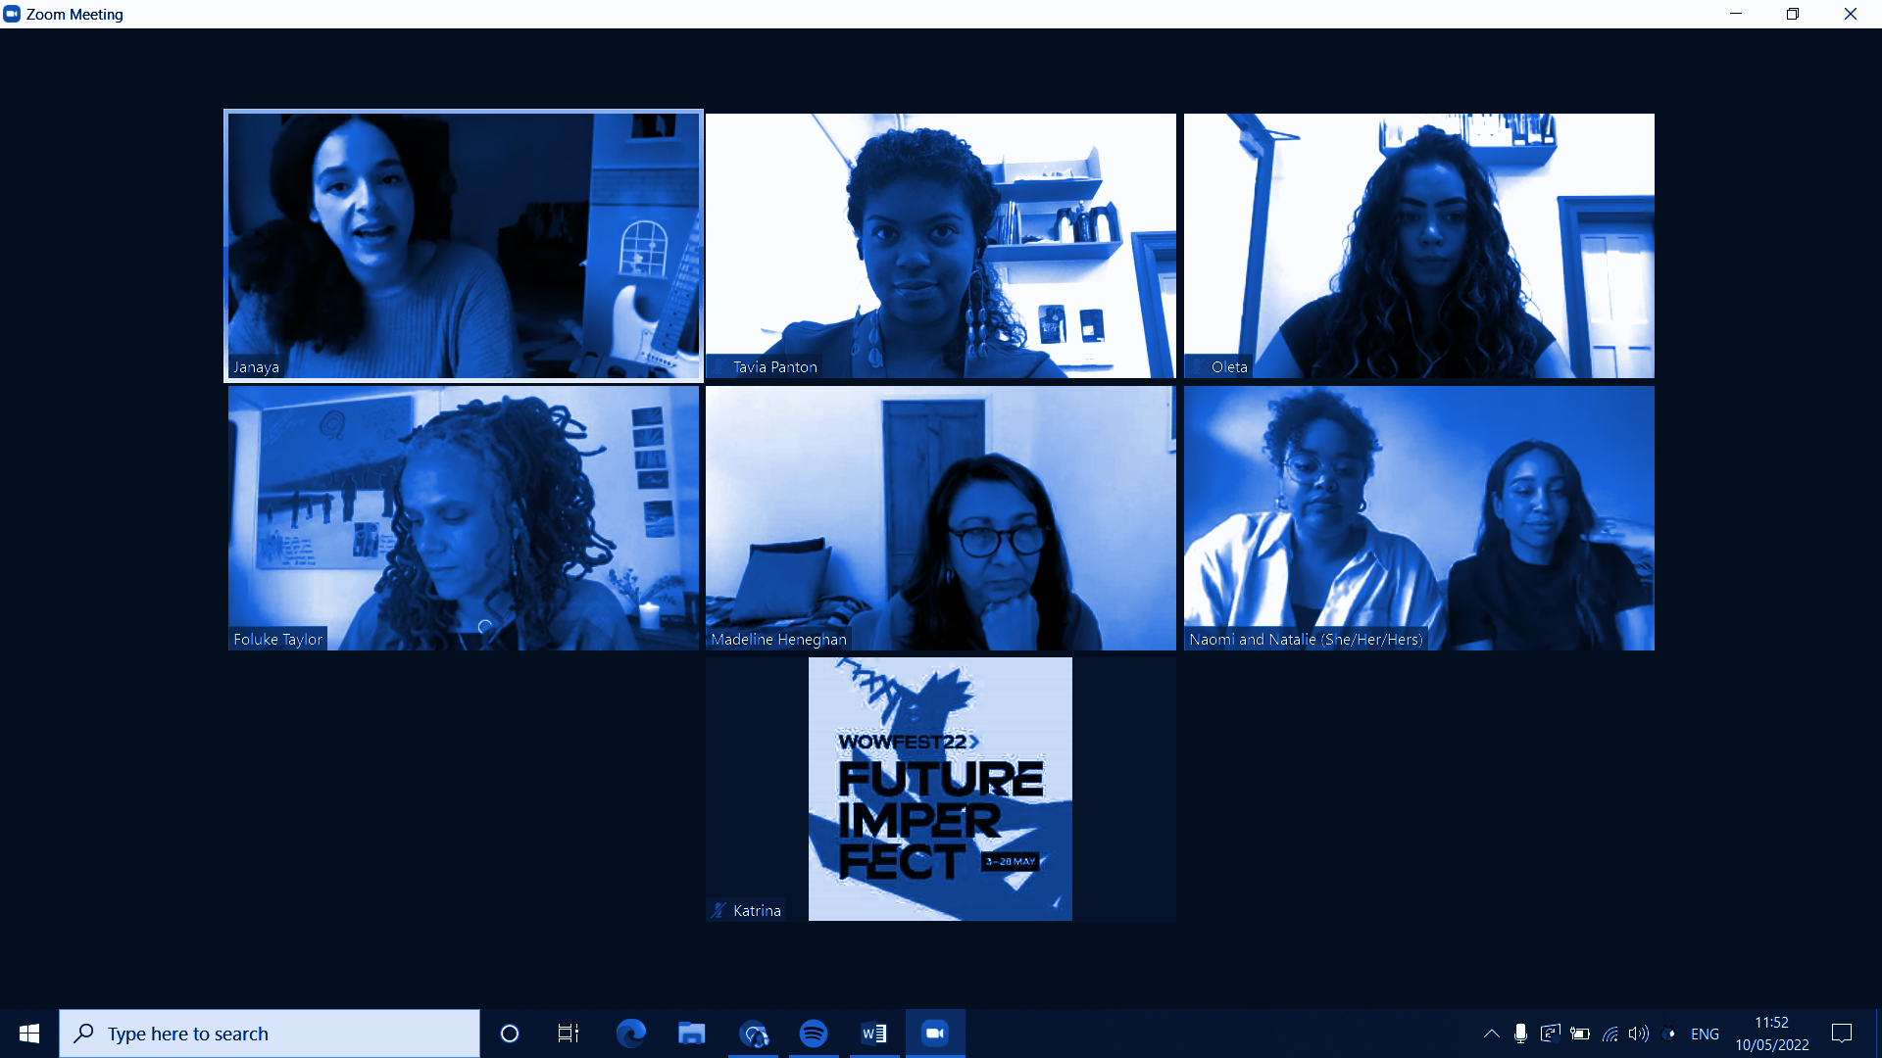
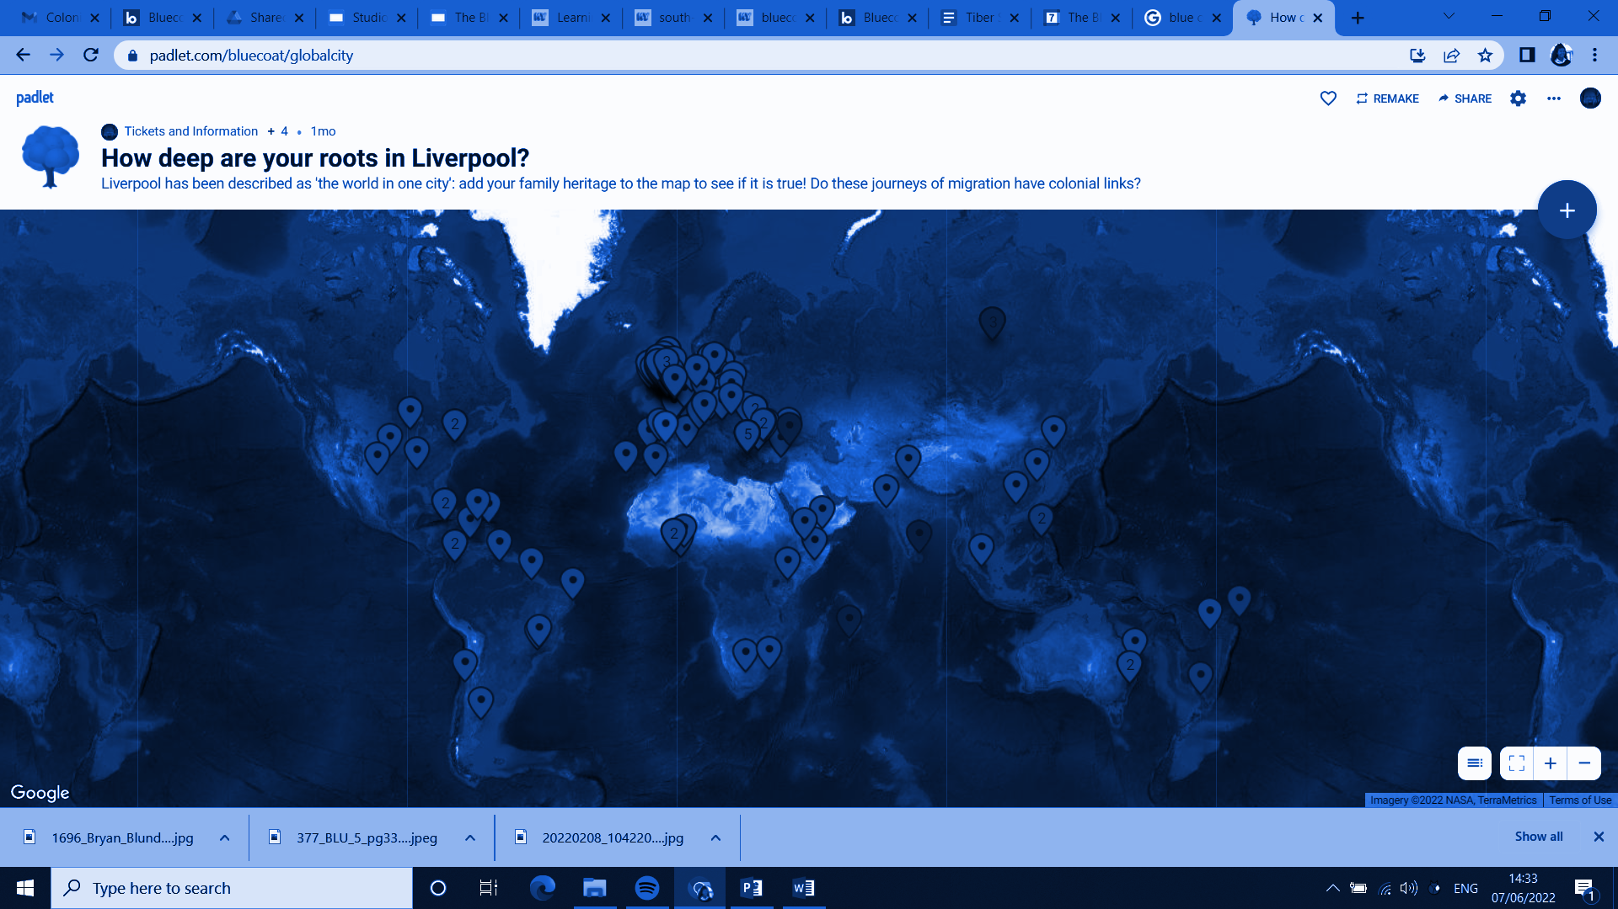
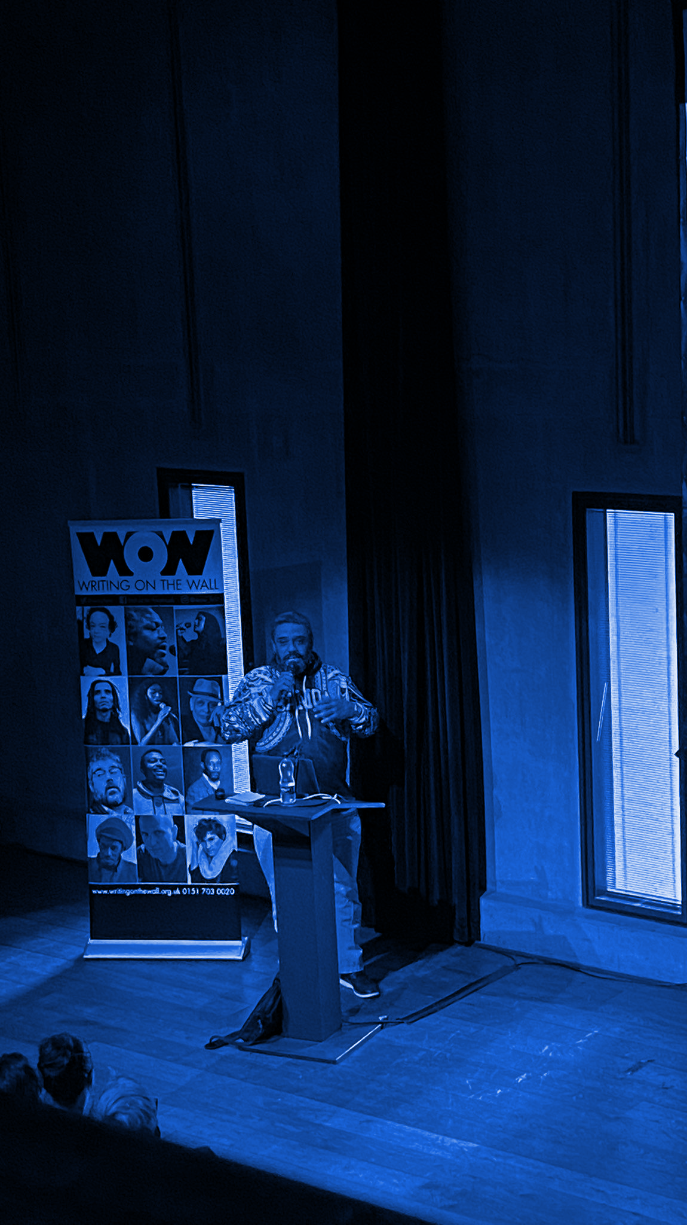
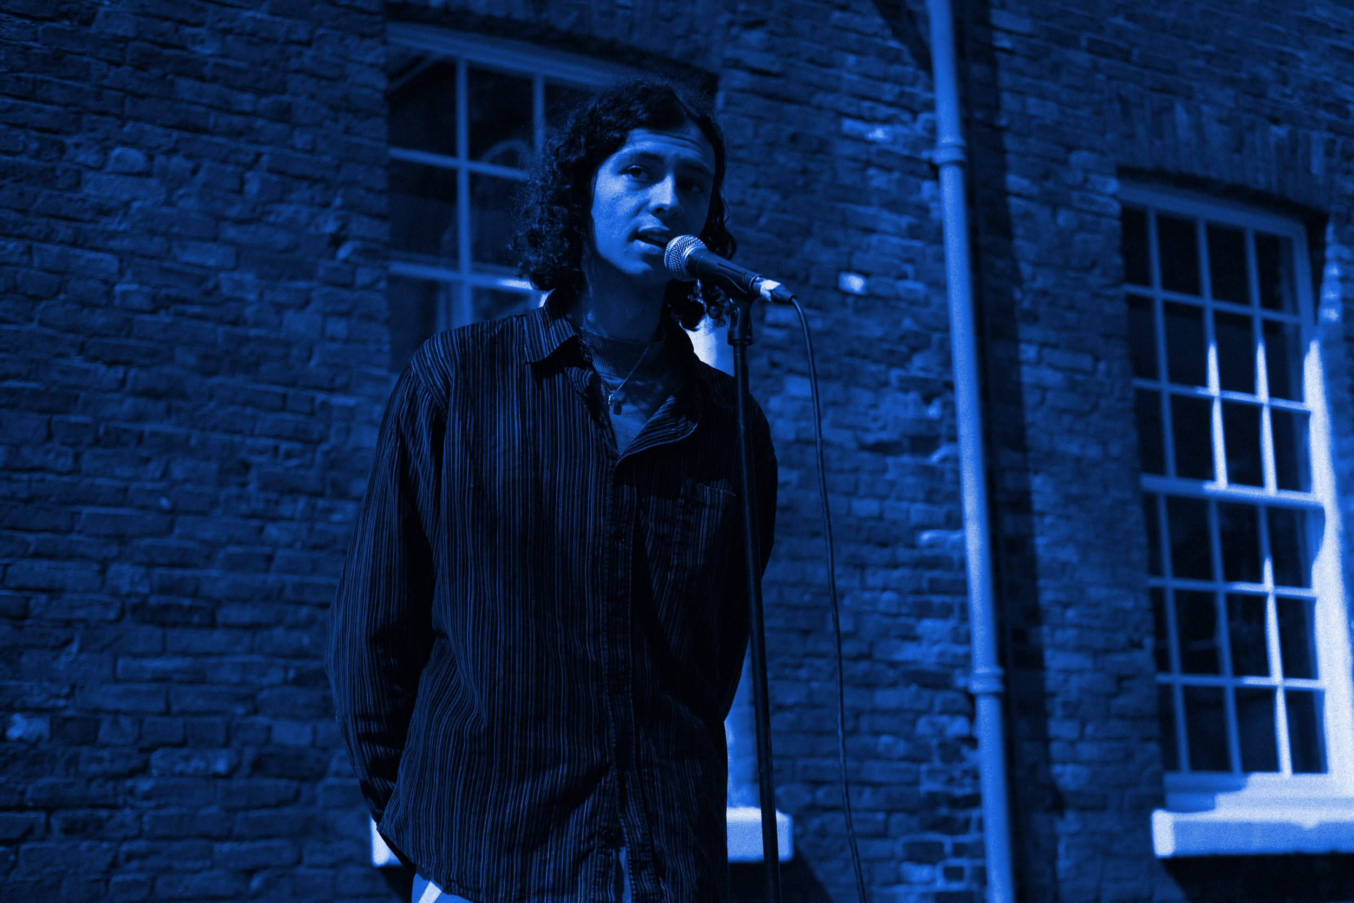
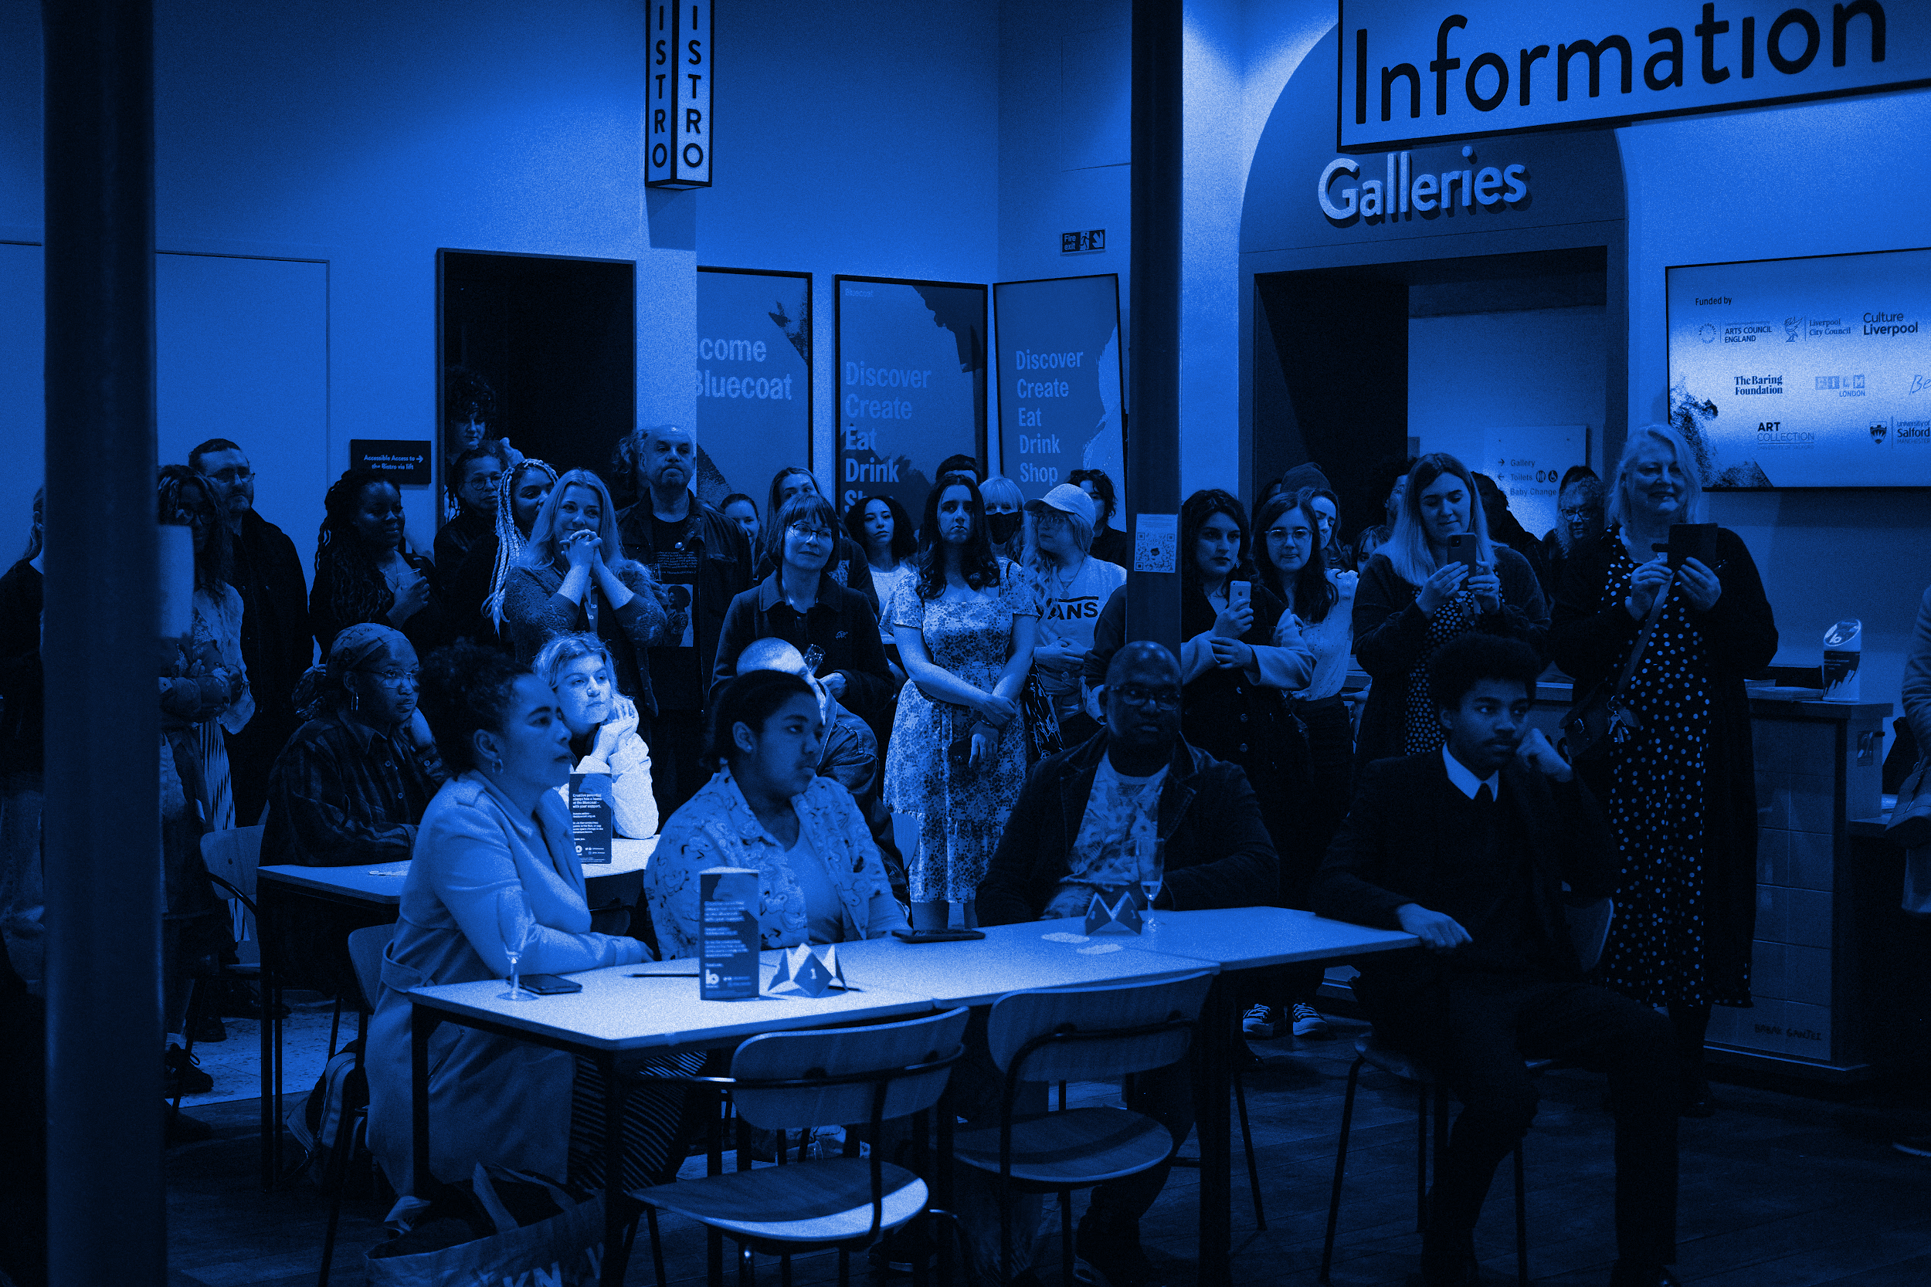
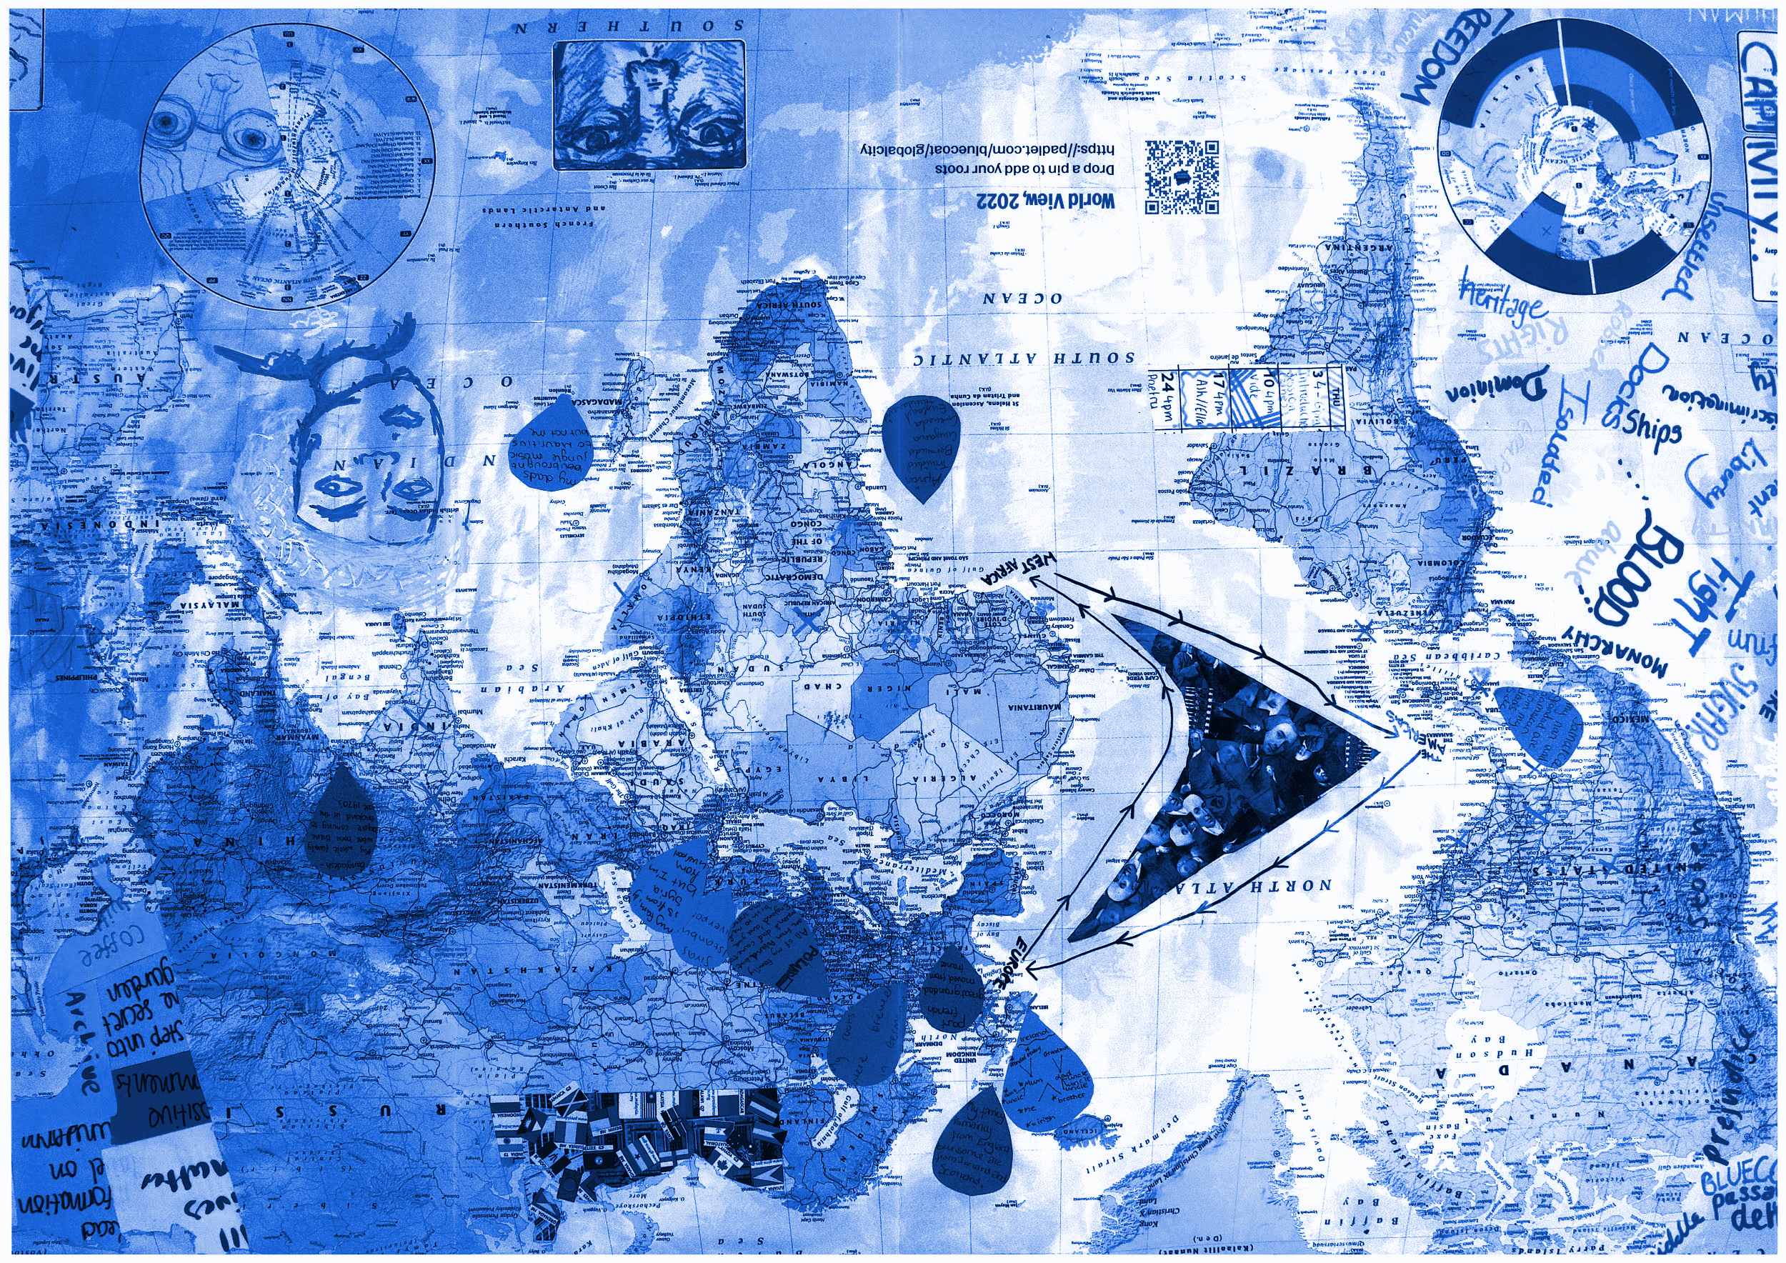
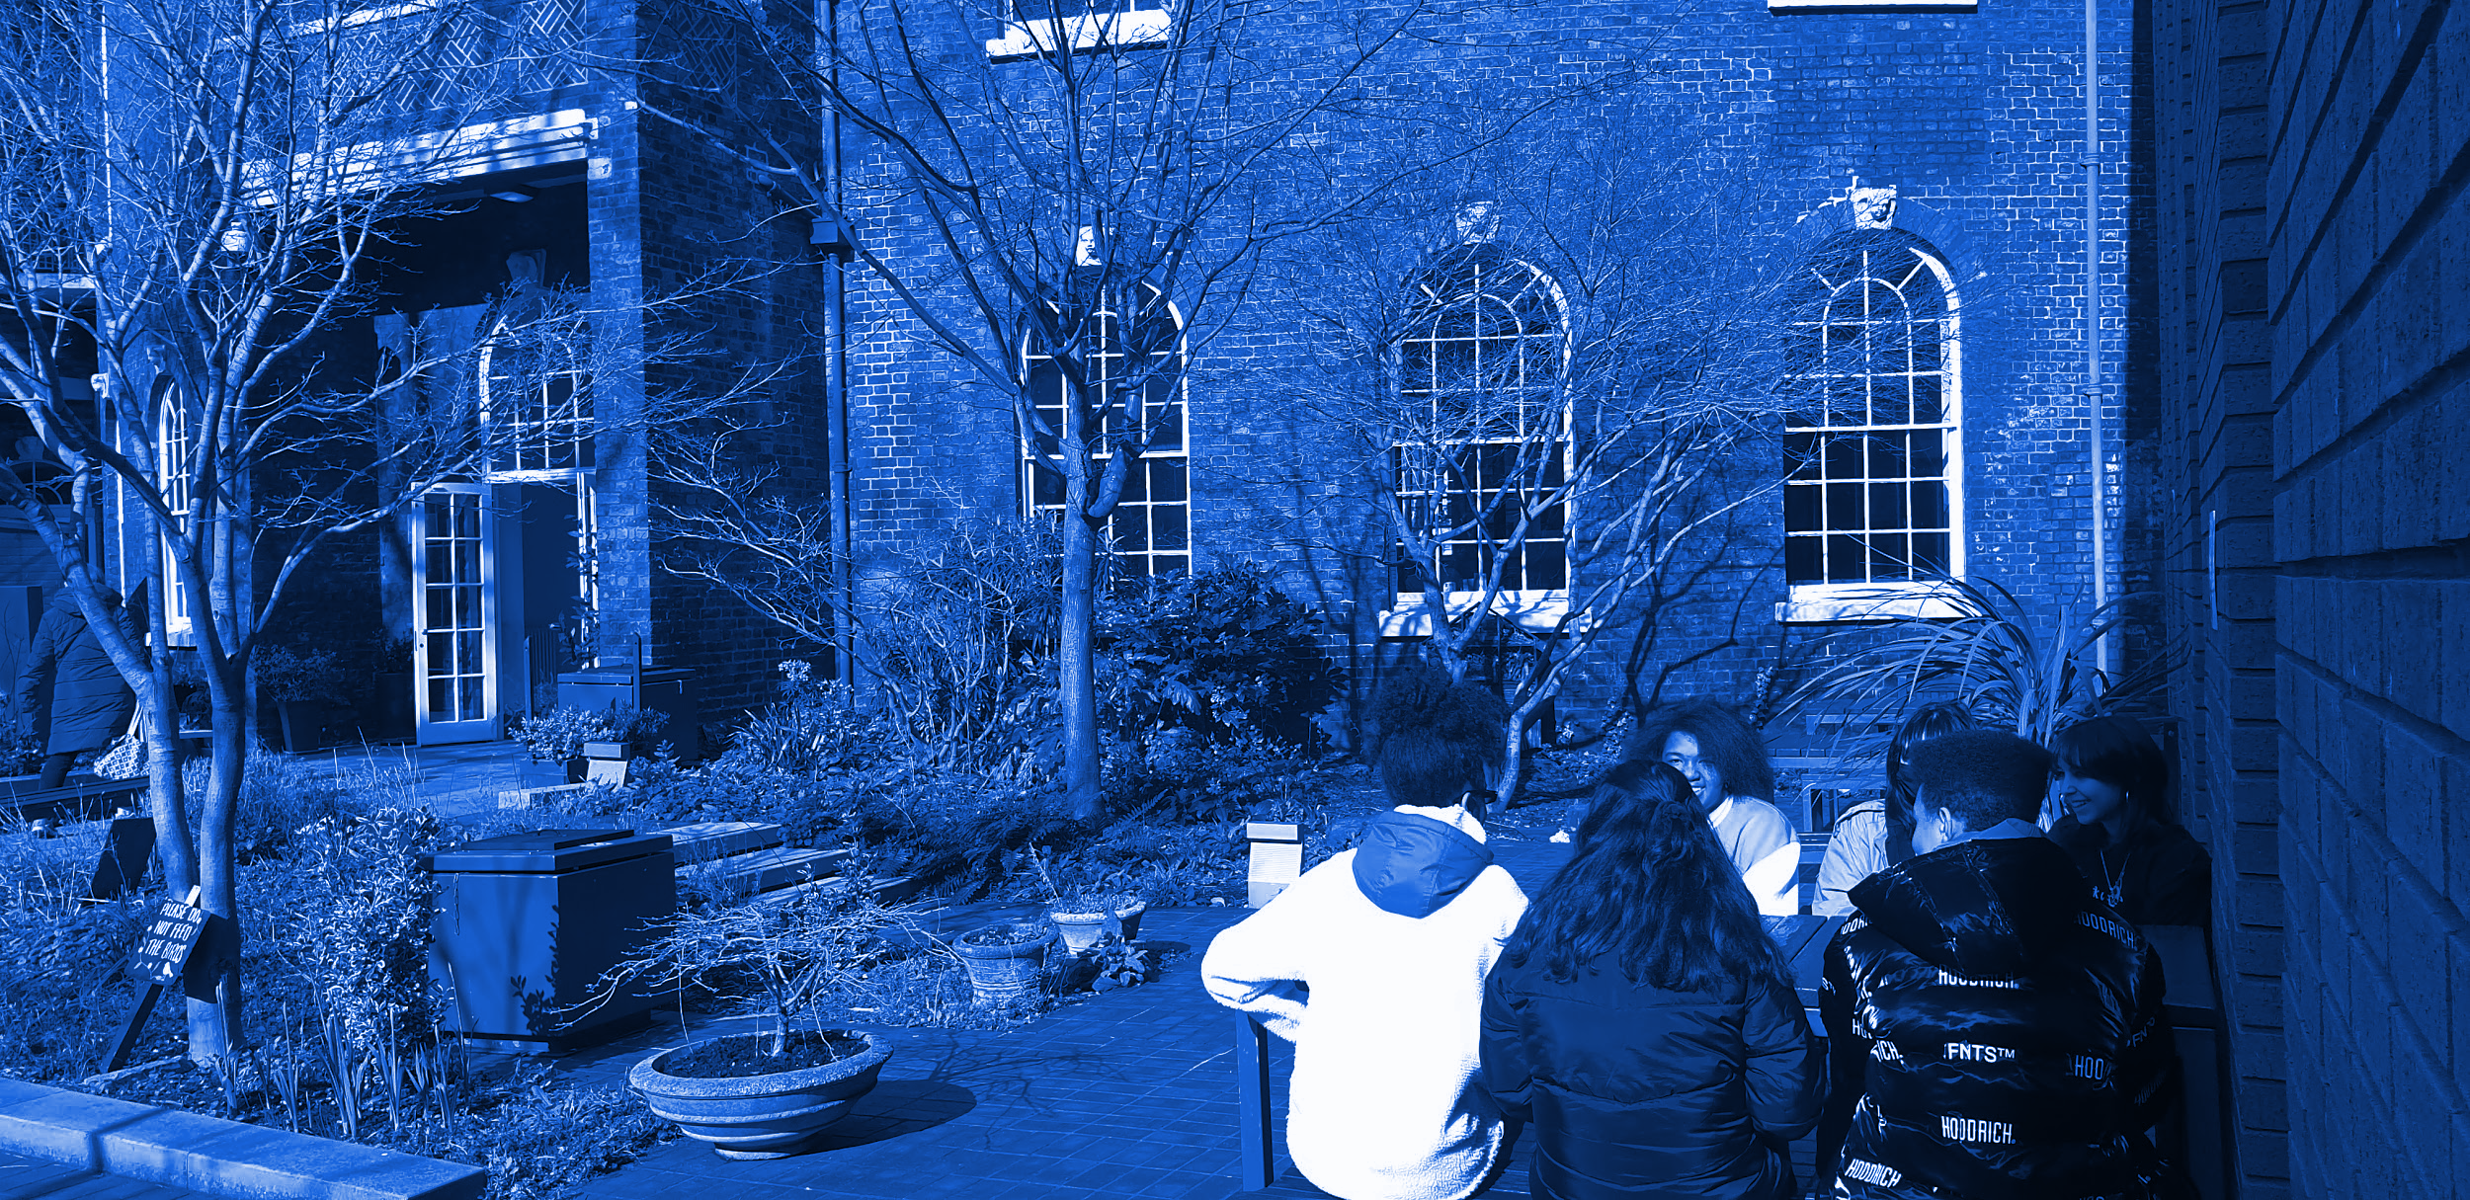
Which colonial legacies are most present in your life?
ancestral/familial legacies
vibrant multicultural society
colonial systems
racism
education
something else?
public spaces
get creative!

